Slide 1
How to access Show My Homework☺

Slide 2
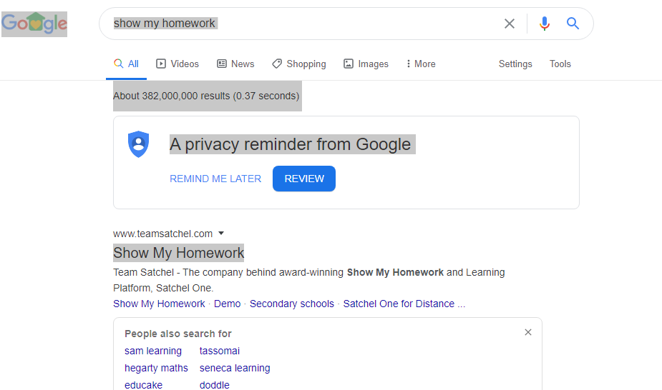
Step 1: Google Show My Homework

Slide 3
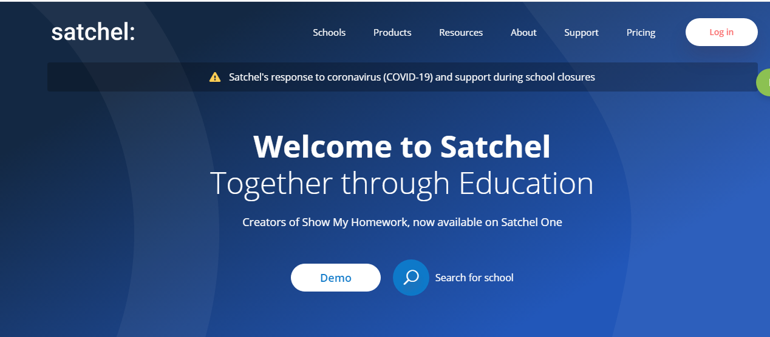
Step 2: Once on this page hit LOG IN button

Slide 4
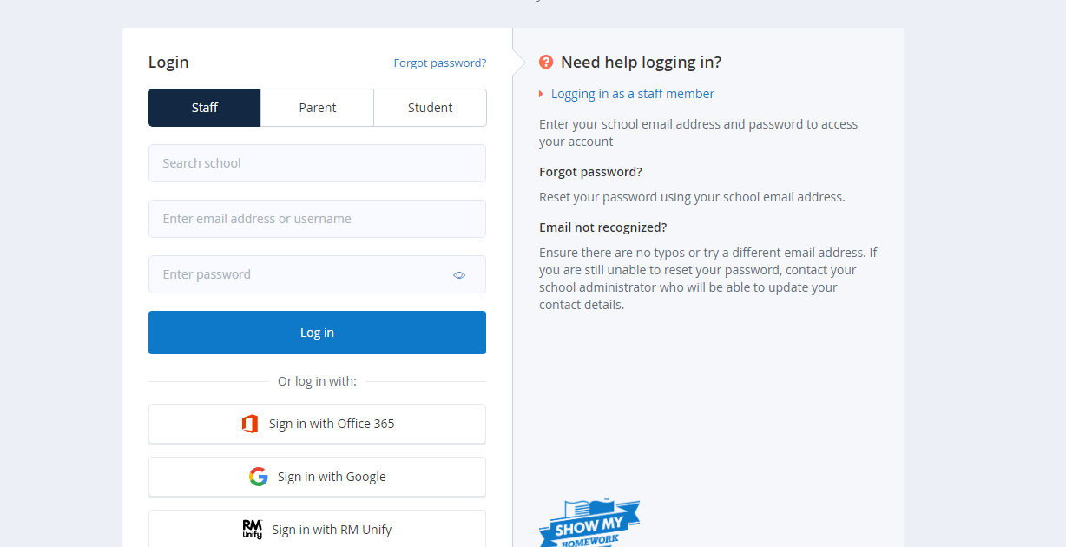
Step 3: Use the Office 365 sign in option

Slide 5
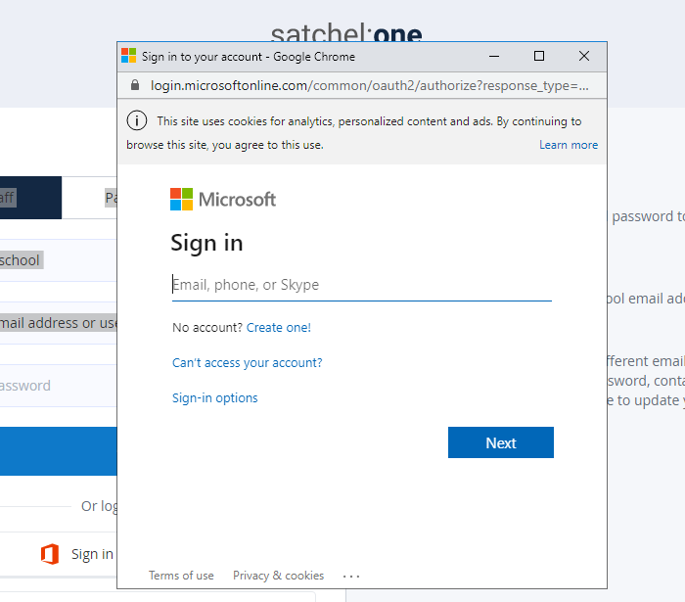
Step 4:Enter your school email address e.g. 12345@tbowa.org
Followed by your normal school login password.
If you have forgotten this and need it reset just email and I will sort this for you.

