Slide 1

E-Safety Parents Evening
The Bishop of Winchester Academy
2016 – 2017

Slide 2







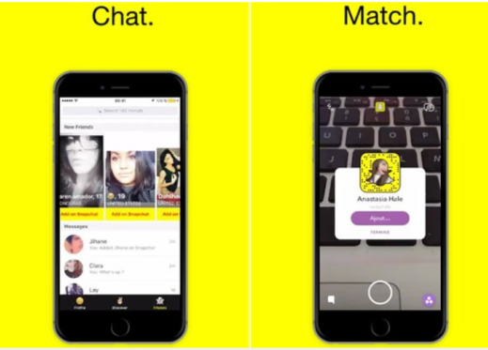

Name the apps / websites

Slide 3
Technology at Home
We all want to keep our children safe, but online safety is not the only issue affecting young people with access to technology.
According to a study published in the Journal of Paediatric Psychology, one of the biggest culprits for inadequate and disturbed sleep is technology:
Losing as little as an hour's sleep can significantly affect a young person's performance at school
The study states: “Even modest differences in sleep duration, accumulated over a few days, can affect critical cognitive and emotional functions in children.”

Slide 4
Advice for parents:
Take charge of your child’s use of technology - the earlier you start the easier it will be, and the more it will become part of normal routine.
Implement a technology curfew – phones, tablets etc. must be turned off during meals, and at least one hour before they go to bed.
Make bedrooms off-limits for technology - laptops, phones, tablets etc. should be left downstairs when she goes to bed.
If they use their phone as an alarm clock – buy them a traditional one.
Implement parental controls for your child’s device

Slide 5
Cyberbullying
"Cyberbullying" is when a child, preteen or teen is tormented, threatened, harassed, humiliated, embarrassed or otherwise targeted by another child, preteen or teen using the Internet.
Advice for the young person:
– Don't respond
– Don't retaliate
– Talk to a trusted adult
– Save the evidence
– Block the bully
– Be polite

Slide 6
Advice for parents:
Listen to them and take them seriously
Make sure they are safe, and feel safe
Don't overreact
Encourage them not to retaliate
Gather the facts and save the evidence
Get them to help solve the problem
Talk to us if there are school links to the bullying
Encourage them to reach out to friends

Slide 7
Sexting
Sexting means sending sexually explicit photos, images, text messages, or e-mails by using a mobile phone or other mobile device.
Most young people are reluctant to talk to adults about it because they are afraid of being judged or having their phones taken away.

Slide 8
Advice for parents:
If your child has shared an explicit photo or video of themselves they may be very upset, especially if it's been widely circulated.
If you become aware of this, try to stay calm and reassure them that they have your support and you'll help them by taking the following steps:
Explore the facts
Find out who the content was shared with initially, who it was passed on to, whether it was done maliciously or not.
Call the school
We will be able to help you deal with the repercussions and support your child at school. Ask for a member of the Safeguarding Team.
Report it to CEOP
If you suspect the image has been shared with an adult, contact the Child Exploitation and Online Protection Centre (CEOP), who are the national policing lead for online child sexual exploitation
Contact the website or provider
Social networking sites should remove an image if asked.
Young people can contact ChildLine
Childline will work with an organisation called the Internet Watch Foundation to get all known copies of the image removed from the internet (Childline: 0800 1111)
Parents can contact the NSPCC
The NSPCC have trained counsellors available for advice and support 24/7 (NSPCC: 0808 800 5000)

Slide 9
Trends in websites, games and apps
Content
Is it age appropriate?
Is there violence or bad language or sexualised content?
Is the content trying to persuade those that may be vulnerable?

Slide 10
Trends in websites, games and apps
Contact
Who can the young person contact?
Does it work by Geolocation / GPS?
Is there any way to change the settings about who they are in contact with?
Does the young person know the people they are speaking to?
Is the contact happening via audio/video or messaging?

Slide 11
Trends in websites, games and apps
Conduct
What is the behaviour of the users like?
Is there bullying or highly sexualised conversations taking place?
Are other users asking for private messages to take place?

Slide 12
Strategies for families
Talking
Find out what young people are using, what they enjoy and who they are interacting with. Ensure that your child knows not to give away any personal information including:
Location.
Risks in talking to strangers.
How to block and report.

Slide 13
Strategies for families
Family agreements
It may be useful to have a family agreement on how the internet will be used, including:
Where and when devices can be used.
What your child is allowed to access or download.
Who your child is able to talk to or play games with.
How is internet use going to be monitored
Are parents going to have passwords for devices / accounts?

Slide 14
Strategies for families
Technical tools
Parental controls on broadband.
Adult content block on mobile phones.
Passwords on devices.
Settings on devices
Settings on accounts – use of parent email address.

Slide 15
Thankyou for your time.
Any further questions?
Contact:
Kevin.Jones@tbowa.org

