Slide 1
In the event of closure
Follow your homework timetable as normal.
Each day you should complete one full page (minimum) of self-quizzing in your purple quiz book. If the set homework is going to take longer than a page you should focus on what you don’t know.
write the title (subject) and date at the top of each page
tick any correct answers and correct any incorrect answers in red pen

Slide 2
In the event of closure
Close your skills gaps
In M2 and L1 you sat Knowledge Organiser assessments in your subjects. You now have the opportunity to look at the assessment questions in each subject, see the correct answers, and learn from your mistakes. How will this work?

Slide 3
In the event of closure
All the tests will be uploaded to the school website. You need to:
Open the document on the website
Type your student ID number into the search bar (with a 0 in front, e.g. if your student number is 12345 you would need to type 012345)

Slide 4
In the event of closure

Slide 5
In the event of closure
This will show your results for the KO assessments in all you subjects for L1 and M2 (two separate documents)
Each row will give you your data from a different subject telling you:
What band you were in for the assessment (quiz) for that subject
What answer you put for each question
Whether you got the question right or wrong (it will be highlighted red if you got it wrong, highlighted in green if you got it right)

Slide 6
So in the above example, this student sat the L1 English Language quiz. They got questions 1, 2, 3 right but not question 4. The answer for Q4 was answer ‘A’.
So, if you were that student you would need to
find the L1 English Language test
find question 4
copy the correct answer, which is A, in your KO purple book
explain, if you can, why that is the correct answer (you can look back at previous Knowledge Organisers if you need support). Knowledge Organisers are now on the website as well as in your folders
Move on to the next ‘red’ question – and repeat for the rest of the test
Repeat this for all your subjects in M2 and L1

Slide 7
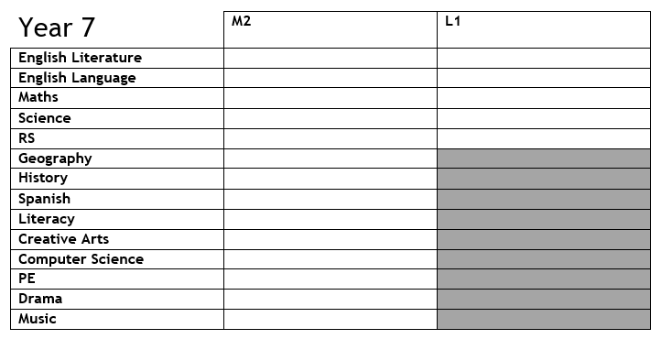
The table below (different tables for each year group) will help you keep track of what assessments you have corrected and what assessments you still need to work on. You can tick the column for the term and subject once you have closed the skills gaps for that specific assessment. Each table lists all the assessments for M2 and L1 for each year group. You may wish to cross out the rows for the subjects which you do not take.

Slide 8
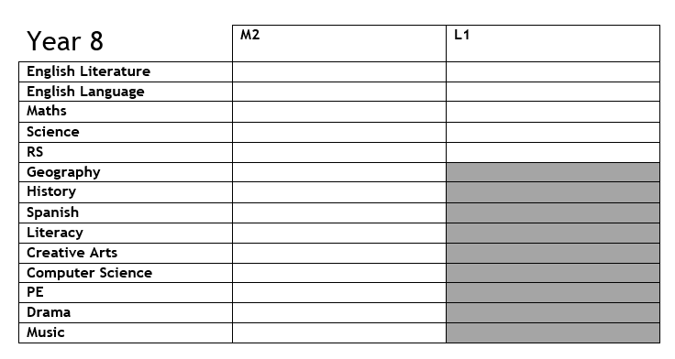

Slide 9
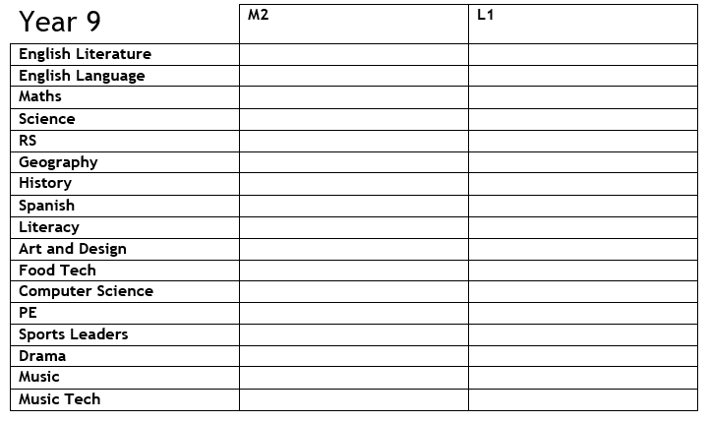

Slide 10
