Slide 1
Year 11 Information evening
February 2020

Slide 2
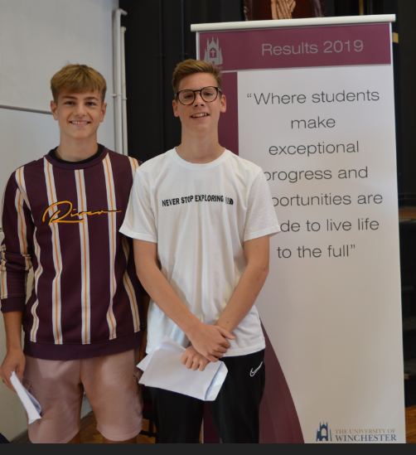
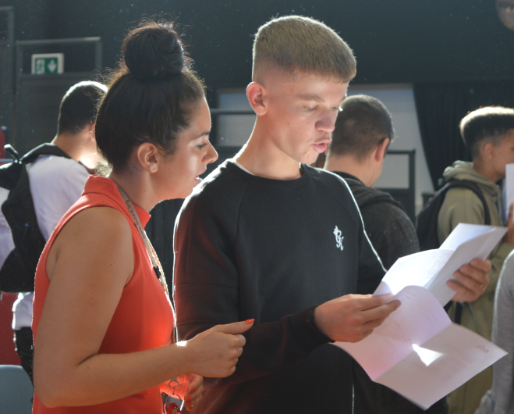
The 7 Habits of Highly effective people – Habit 2: Begin with the end in mind

Slide 3
KS4 Information evening
The purpose of this evening…
Key dates
Attendance
Advice for students
Core subject key information
Revision resources for parents
Advice for parents

Slide 4
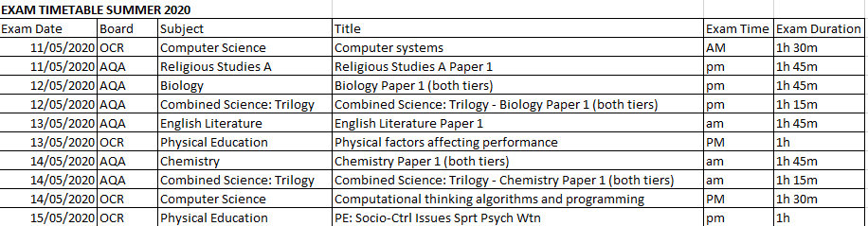

Slide 5
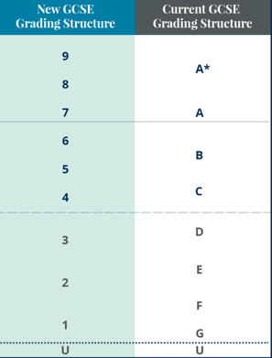

Slide 6

How can you support your children so they feel they have the preparation to perform??
Being a role model
Help them set goals
Keep them active
Healthy eating
Time out
Sleep patterns
Unplugging
Stay Calm, keep Believing and be Supportive
Belief
Be supportive
https://www.youtube.com/watch?v=kqYPeQZfpb8

Slide 7

1. Being a role model
Planning for the week
Eating healthily and well
Keeping hydrated
Leading an active life
Staying calm
Being organised
Good sleep habits

Slide 8

2. Goal Setting
Encourage them to keep their goals and targets visible – e.g. printed and displayed on their bedroom wall
Help focus them and talk to them about their goals regularly
Give positive reinforcement
Connect with them about ‘why’ and ‘what’ they want to achieve
Notes:
You child has been given target grades based on their KS2 results but this is a BIG Goal and it can sometimes feel very overwhelming and not tangible, aiming for a 9 in Maths doesn’t feel as real as having a goal of scoring a hat trick at football at the weekend, or saving enough money for a new bike, so it is your role to help them keep their focus over time. Encourage them in their goals and try to link their goals to their aims in life such as a job they aspire to, a college they want to get into.

Slide 9

60 minutes per day
3. Keeping Active
Encourage them to keep active on a daily basis
Carry out exercise in manageable chunks e.g. 3 x 20 min sessions throughout the day
Plan to do active things together on a weekend
Go out for a walk together and get some fresh air
Help them plan out their weekly exercise schedule in advance
After exercise your brain functions well, so encourage a revision session afterwards
Notes:
Researchers have analyzed almost 5,000 schoolchildren and found that grades increased in direct correlation with the amount of physical exercise undertaken in the average day.
They discovered that an extra 17 minutes of exercise for boys and 12 minutes for girls could boost children’s results by the age of 16.
Overall, researchers found an average of 60 minutes of “moderate to vigorous” physical activity could be the difference between achieving a 4 or 5 grade by the time pupils sat their GCSEs. The effect was particularly marked for girls in science.
Your children may be reluctant, which is where us being role models is very important, maybe work out together at the gym, take a walk or there are lots of exercise videos for free on Youtube.

Slide 10
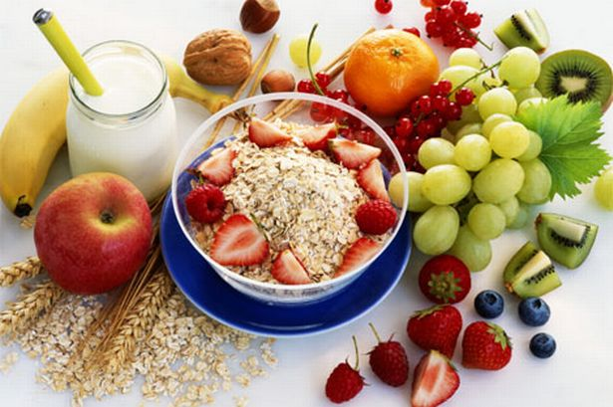
4. Healthy Eating
Plan your family meals for the week – breakfast, snacks, lunches and evening meals
Ask your child to help you carry out a weekly food shop and write a shopping list with some ‘treats’ they can have as a reward
Avoid high sugary and fatty foods or drinks
Aim to eat clean, fresh and healthy foods
Have a couple or ‘treat’ snacks, meals / or meals out per week
Encourage them to eat breakfast everyday
Hydration is key to brain functioning so make sure your child carries a bottle of water with them
Notes:
In order to prepare to perform our students need to be sustained with a balanced diet, we find that too many high-fat, high-sugar and high-caffeine foods and drinks (such as cola, sweets, chocolate, burgers and chips) make your children hyperactive, irritable and moody.
Please encourage them to eat three meals a day, bring snacks like fruit and vegetables and if they are in intervention after school maybe pack an extra sandwich or an extra money on their lunch card per day. At the end of the day our canteen sell sandwiches, pasta and other meals for 50p which they can buy before going to intervention.

Slide 11


5. Time Out
Going out for food
Seeing friends
Having a bath
Listening to music
Reading a book
Doing a hobby
Going shopping
Going to the cinema
Notes:
Tests and exams can be a challenging part of school life and exam stress can have a huge impact on attainment, and students with high anxiety can score over 10% below their low anxiety peers.
Symptoms can range from:
feel tense
get lots of headaches and stomach pains
not sleep well
be irritable
lose interest in food or eat more than normal not enjoy activities they previously enjoyed
To seeming negative and low in their mood and seem hopeless about the future
Encourage them to build in opportunities to take some time out every week, away from study.

Slide 12

6.Sleep Patterns
Young people need between 8 – 9 hours sleep per night
Help your child create a relaxing evening routine
Don’t eat too late at night
Avoid caffeine or sugary drinks late at night
Make sure they don’t work or revise too late before going to bed
Limit screen time

Slide 13

7. Unplugging – Digital Detox and Digital Drop Off
Year 11 have mocks starting the week beginning 16 March
In order to improve focus and memory retention we are setting up a voluntary ‘digital detox and drop off’ system
This will begin on Monday 2 March
Temptation is hard to resist. When given the choice between homework and revision or Gaming, Netflix or Social Media, a high proportion of students are choosing the latter
The ‘digital drop off’ system will help with this

Slide 14
7. Digital Drop Off (in March)
Students can drop off game console leads, smart mobile phones etc. at school where they will be stored in a safe
Students sign up saying how long they want to commit for e.g.
  2nd–30th March – before and during the mock period
  From Mon to Fri between 2nd-30th March
However if they change their mind saying that they want their device back then we will give it back
We will probably give a pep talk and encourage them to drop off devices again as soon as possible!

Slide 15
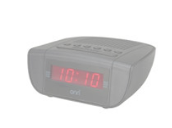


7. Unplugging – Digital Detox and Digital Drop Off
We would encourage you to buy a substitute mobile phones during this period
They cost £10 or less – you will also need a top-up SIM card
This will allow your child to text or call
Crucially, this phone has no internet access capability so temptation is removed
Alarm clocks can be purchased for as little as £2 (1 AA battery needed) to help your child wake up in the morning
These can be bought locally at ASDA or Tesco or via sQUID

Slide 16
7. Unplugging – Digital Detox and Digital Drop Off
Also consider removing TVs, Playstations, Xboxes, Gaming Devices etc from bedrooms leading up to and during Mocks
Mobile phones should, preferably, be kept out of the bedroom overnight too
You may not be popular but your child will thank you later
We will be sharing this information with Year 11 students on Friday
This will be a great investment in your child’s academic success
Commit to being part of this and others will too

Slide 17

8. Stay Calm, keep Believing and be Supportive
Set a good example by staying calm yourself during mock exam and revision periods and celebrate any successes and reward them e.g. if they have achieved their mini-goals
Help them plan out coping strategies to deal with their stress and give them positive distractions away from studying
Promote a balance of their academic studies & other activities during the week
Show them how proud of them you are
Be a good listener
Be approachable
Just be there for them!
Notes:
Having someone to talk to about their work can help. Support from a you can be instrumental in reducing anxiety and stress, but it doesn’t all needs to fall on you, encourage your child to talk to a study buddy, a member of school staff, someone who they can share their worries with and keep things in perspective.
If you feel your child isn't coping, it may also be helpful for you to talk to their teachers at school.

Slide 18


9. Belief
Give them positive reinforcement
Boost their confidence daily
Celebrate any successes and reward them e.g. if they have achieved their mini-goals
Try not to set your expectations too high
Show them how proud of them you are
Highlight things to make them feel good
Give them the belief in themselves to help them achieve

Slide 19

10. Be Supportive
Be a good listener
Be approachable
Encourage them to take breaks in between revision
Show some understanding of what they are going through
Help them deal with their emotions & feelings
Offer caring advice
Just be there for them!

Slide 20
Role model
Goal setting
Active / Exercise
Healthy eating
Time out
Sleep patterns
Unplugging
Calming
Believe
Supportive

Slide 21
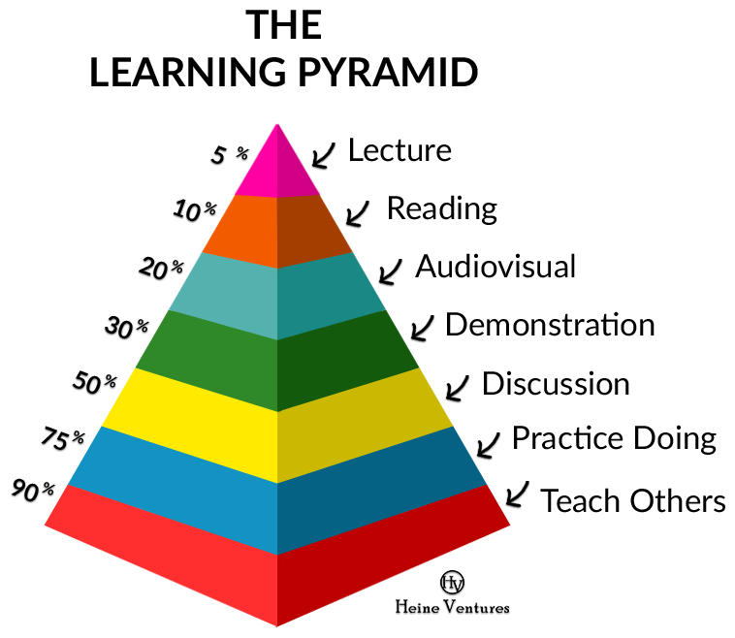
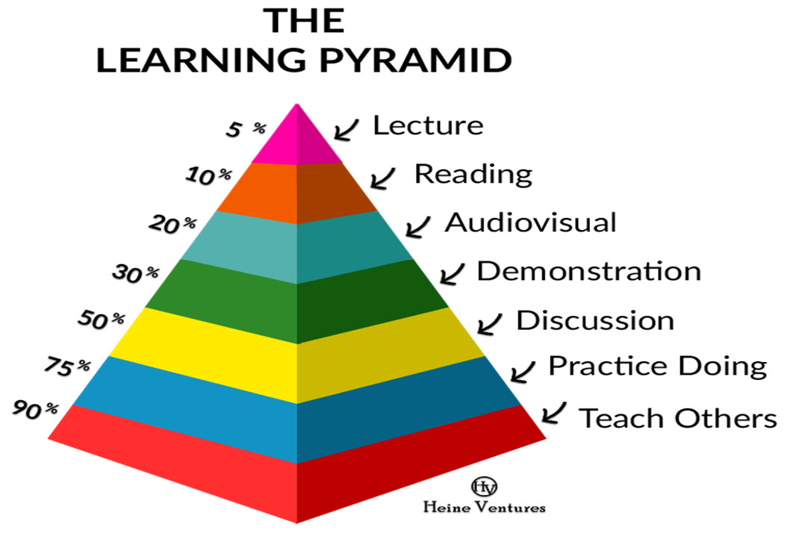
According to the student room, “students revise 15 to 20 hours per week for their exams, which might sound a lot until you break it down. The recommended time equates to 2 to 3 hours a day (broken down into 30-45 minute segments.

Slide 22
Bishop of Winchester Academy
Maths Department

Slide 23
Our Y11 students are working towards
three potential GCSE qualification
GCSE Maths
All students studying, some will take the higher tier exams and some the foundation tier
GCSE Statistics
Some students have chosen as an option, others are choosing to study as an extra qualification
Level 2 Certificate in Further Maths
Entry usually only made for 11Ma1 students

Slide 24
Maths and Statistics Homework
Students should be completing a GCSE Maths
(and GCSE Statistics) past papers every week.
These papers should be done with appropriate equipment (including calculator) and should help focus students on necessary revision topics. These papers should NOT be done under exam conditions.
You need to purchase the Casio FX991 model.

Slide 25
Revision advice
Do your past paper(s) every week
Go back over the previous week’s homework to ensure that any skills gaps are being closed
Continue to work on memorising the necessary Mathematical formulae and other important facts
Use the Maths and Statistics knowledge organisers to identify key vocabulary as well as the Maths skills and topics that may need additional revision
Use websites such as HegartyMaths or Senaca

Slide 26
Revision Materials
Available on SQUID for GCSE Maths
Revision guide
Workbook
Exam practice workbook
Flash cards
Revision guides and workbooks are
also available for GCSE Statistics

Slide 27
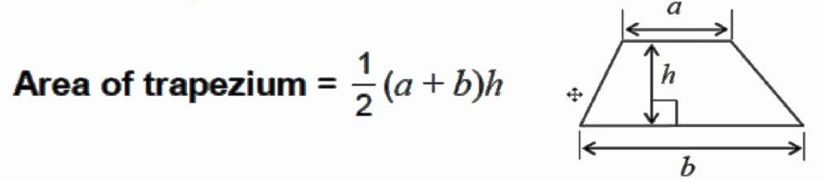
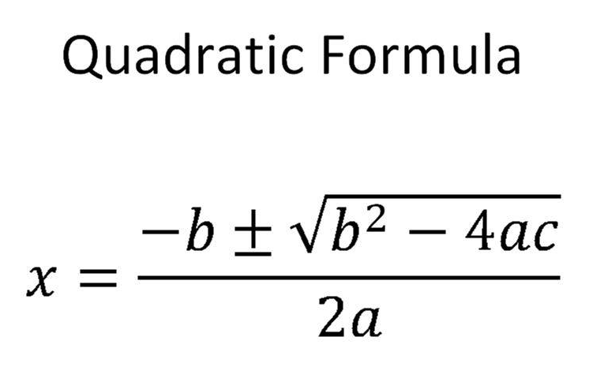
Key formulae

Slide 28
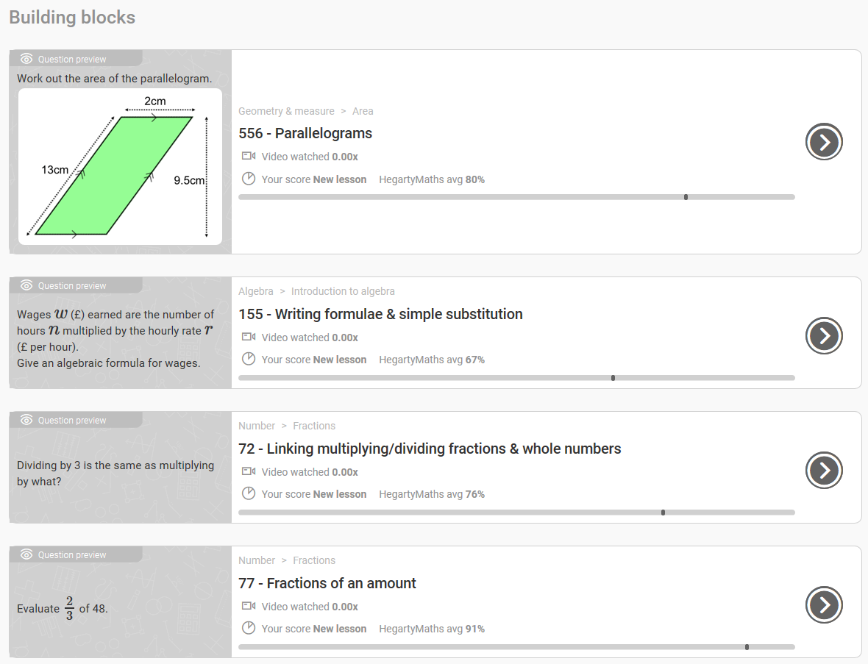
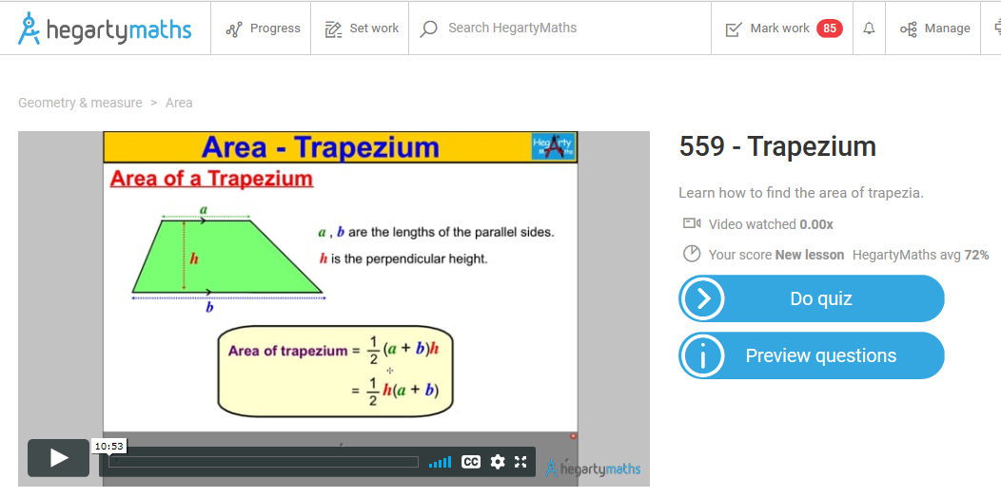

What if I’m not very confident with Maths/Statistics?

Slide 29
Additional Support
Week 1 Tuesday lunch:
Help with homework, support with revision plans
Week 1 Thursday Period 6 (3pm - 4pm):
Additional Maths lesson in usual classroom with usual teacher
Every Tuesday from 7:45am:
Homework support with Mrs Peddle in D107
Every Friday from 8am:
Additional GCSE Statistics lessons for those opting for additional GCSE (starting after half-term)
Every Friday from 2pm:
Additional L2 Further Maths support for those opting for the additional qualification (starting after half-term)

Slide 30
Strategies for success
Ensure that your child attends every lesson
Ensure that your child does their homework every week
Support your child when catch-ups are necessary
Encourage your child to attend after school as required
Buy the revision materials on SQUID
Contact individual teachers with any questions/concerns

Slide 31
Bishop of Winchester Academy
English Department
Notes:
RWE

Slide 32
How can I support my child in English?
English Literature:
Learn purposeful quotations. Get your child to identify techniques and explain the quotations to you.
Watch adaptations of the texts- this will support plot structure. Use youtube- Mr Bruff/ Stacey- free tuition at home!
Ask your child to reiterate what they have learnt in English that day.
Ensure students complete the homework booklets given to them in class. Exam practice is provided every week.
Use dual coding and the Leitner flashcard method to support metacognition (examples to follow).
English support reminder:
Week 1 Weds 3-4
Week 2 Thurs 3-4
Thursday lunchtime
1:1 English tutors
English Literature 8702 Exams
8702/1 Shakespeare and the 19th century novel 1h 45m 13 May 2020 am
8702/2 Modern texts and poetry 2h 15m 21 May 2020 am

Slide 33
How can I support my child in English?
English Language:
Language exams are about repetition. We know the language of the exam and the questions- we just do not know the extracts.
Writing stamina is key! Students need to practice writing stories- revise against the clock.
Practice papers available for all students. Understand your child’s experience- do it with them.
Revise techniques with students- paper 1 question 2- language techniques/ question 3 structure.
Vocabulary- explicitly teach your child impressive words that they could use in the exam.
English support reminder:
Week 1 Weds 3-4
Week 2 Thurs 3-4
Thursday lunchtime
1:1 English tutors
English Language revision station- located in the English corridor.
Exam dates for English Language
8700/1 Explorations in creative reading and writing 1h 45m 02 June 2020 am
8700/2 Writers' viewpoints and perspectives 1h 45m 05 June 2020 am

Slide 34

What is Dual Coding?
How does it work? You apply words and images to support metacognition.
Take a subject. Pick a topic that you want to revise. Create a mind map of all the powerful knowledge you have remembered from that topic-including key information, words and sketches. Once you have done this. Say everything out loud to yourself or a friend/ family member.
Research the topic or use your class notes to add to the mind map.
Finally, look at the mind map and say everything aloud.

Slide 35
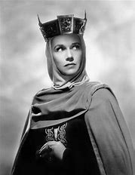

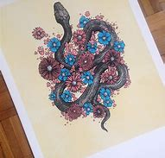
Example…
‘Take my milk for gall’
Manipulative
Emasculates Macbeth
‘Are you a man?’
Rhetorical question
‘Unsex me here’
Verb
Atypical
Controlling
Ambitious
‘Look like the innocent flower but be the serpent under’t.’ Simile/ animalistic imagery

Slide 36
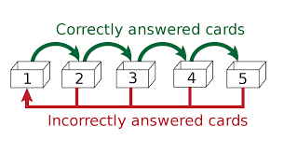
What is the Leitner method?
How does it work?
Studies show that this is one of the most effective ways to boost memory retention.
You need 3-5 numbered boxes/envelopes to catergorise and order your flashcards. Take a topic. Write everything you need to know on a selection of flashcards. Put all of them in box one. Each day take the flashcards and test if you have remembered everything on each flashcard. The correct flashcards move to box 2. The answers you do not know keep in box one.
Example…

Slide 37
Bishop of Winchester Academy
Science Department

Slide 38
How can I support my child in Science?
Science:
Learn the physics equations. Get your child to chant the equations with you.
Watch Free Science Lessons or Primrose Kitten videos on YouTube – try the attached exam questions from each video.
Ask your child to reiterate what they have learnt in Science that day.
Ensure students complete the past papers given in class. Exam practice is provided every week.
Use dual coding and the Leitner flashcard method to support metacognition (similar to English examples).
Use Seneca Learning, an online portal to boost exam grades.
Use CGP Revision Flashcards for quick-fire questioning.
Science support reminder:
Week 2 Weds 3-4
Wednesday Lunchtime
1:1 Science tutor

Slide 39

Seneca Learning
Students should log in and complete science revision on this platform.
Seneca Premium – guaranteed results or your money back!
Don’t pay for a gym membership and not use it – revision materials work the same!

Slide 40


How can I support my child in Science?
Science Exams:
Tuesday 12th May PM – Biology Paper 1
Thursday 14th May AM – Chemistry Paper 1
Wednesday 20th May PM – Physics Paper 1
Monday 1st June PM – Biology Paper 2
Wednesday 10th June AM – Chemistry Paper 2
Friday 12th June AM – Physics Paper 2
Physics Equation Sheet to take away tonight – please collect on departure!

Slide 41
WE ARE ON THE SAME SIDE EVERY DAY
WE ARE STRONGER AS A TEAM THAN AS INDIVIDUALS

Slide 42
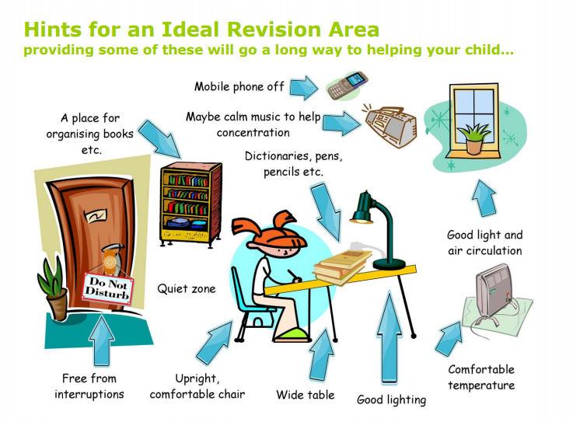

Slide 44
Key Dates:
Thursdays – Parent surgeries between 4pm and 7.30pm. Discuss progress and attainment; suggest study skills and programmes to support your child’s revision for their GCSE examinations.
Week Beginning 16th March - Mock examinations
Monitoring report - March
First examination – 11th May
Final examination – 16th June (however 24th June is contingency)
Class of 2020 Prom - Tuesday 30th June – AFC Bournemouth.
Results day – Thursday 20th August

Slide 45
‘The best way to finish
an unpleasant task is to get started’
‘So get started’

