Slide 1
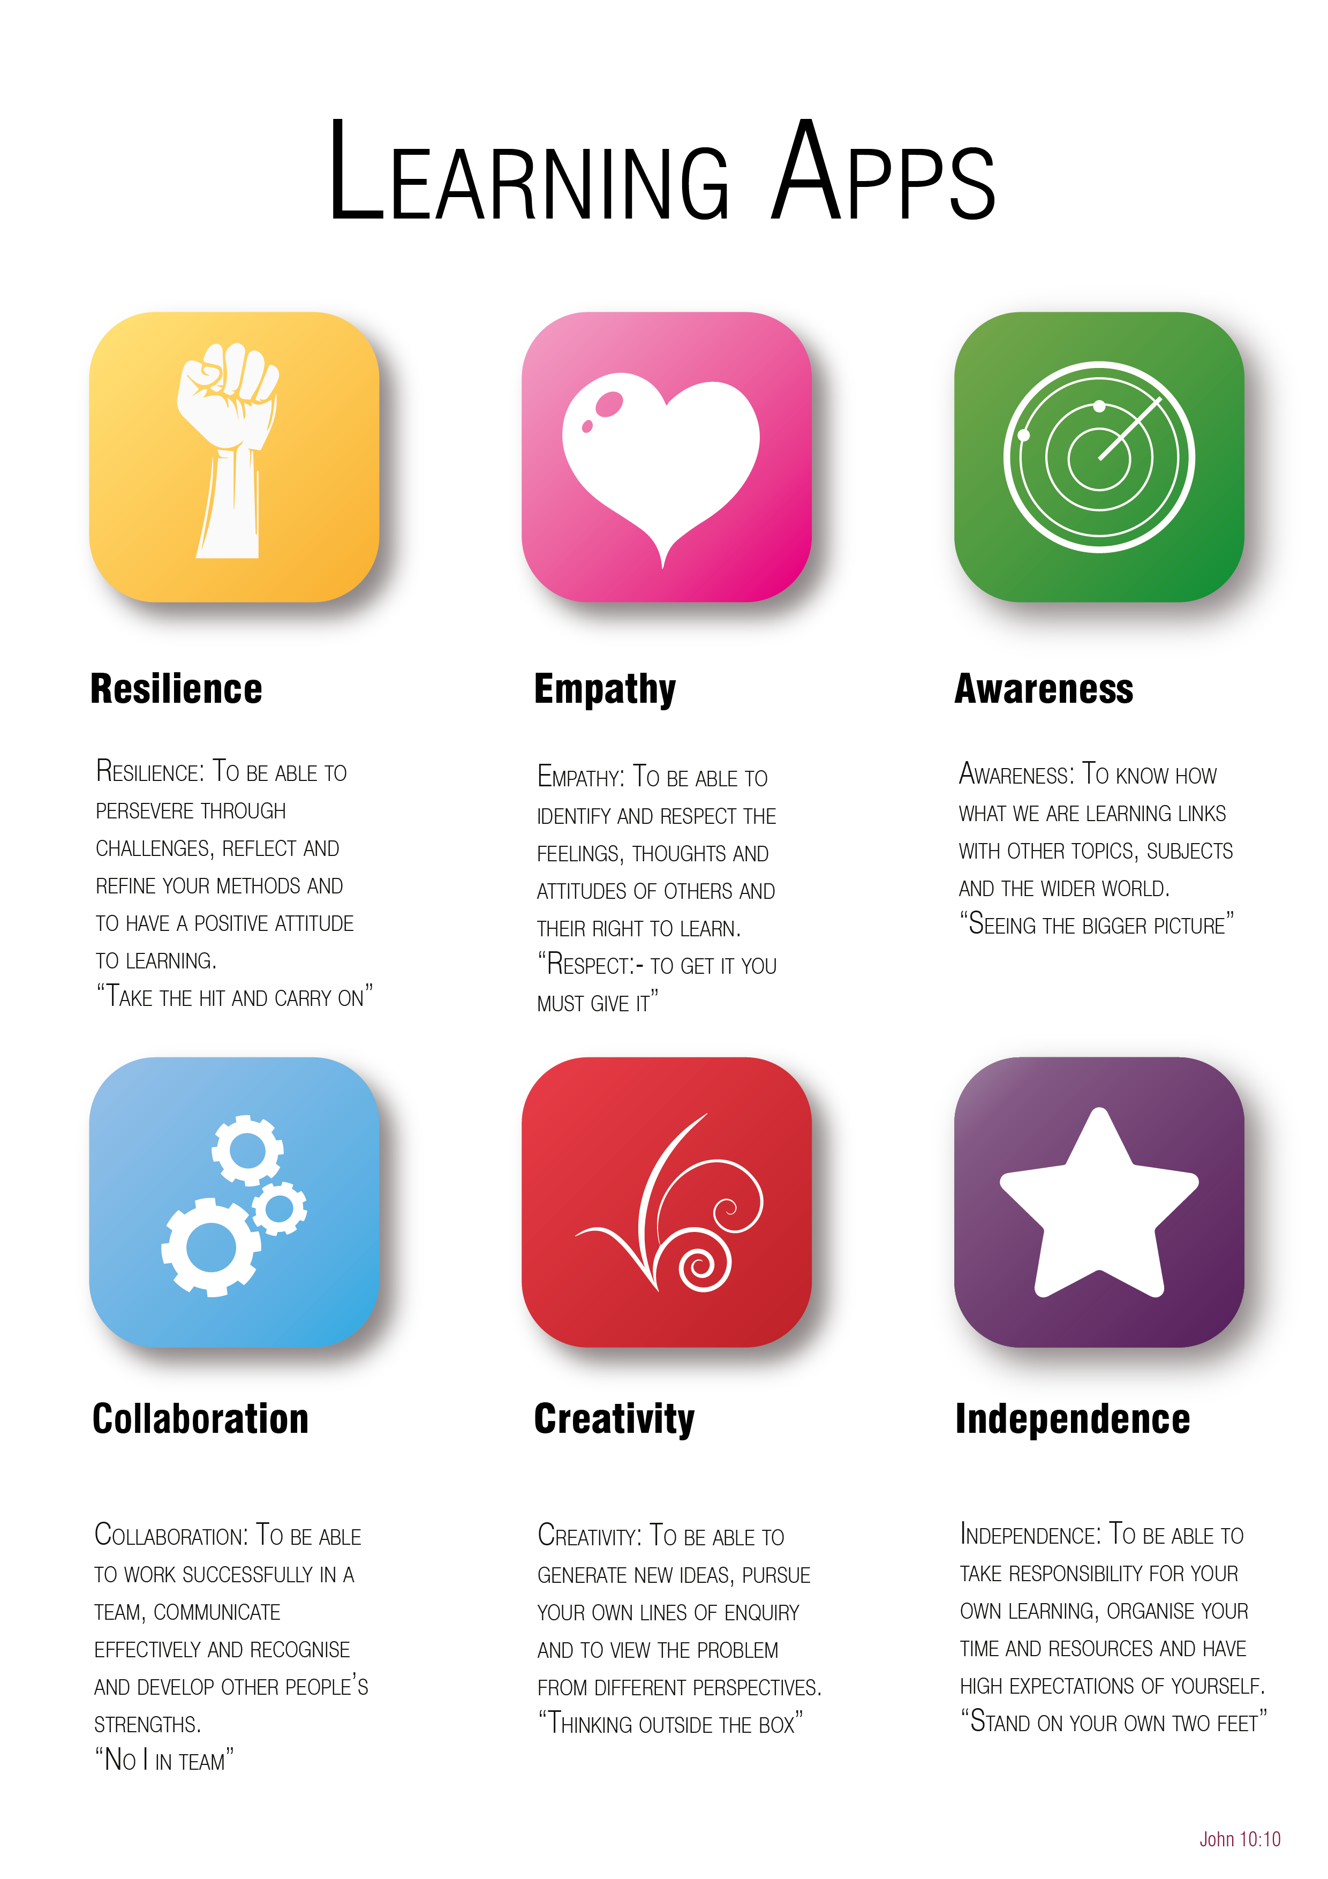
Year 6 to 7 Transition Project
Maths
The Bishop of Winchester Academy

Slide 3

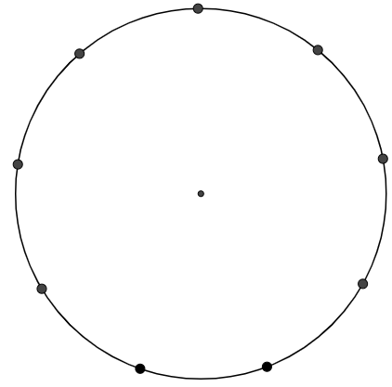
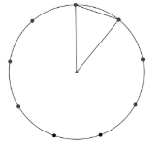
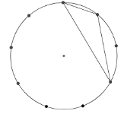
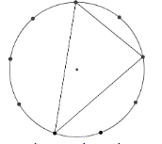
Resilience
Draw as many different triangles as you can, by joining the centre dot and any two of the dots on the edge.
Have you many different triangles can you make?
Are you sure you have found them all? Check they are not the same. You should find 4.
Extension: Can you work out the angles in your triangles?
Now try joining 3 points on the circumference.
How many different triangles can you find?
Be resilient, have a go and keep trying.
You can use Appendix 1 for this task.

Slide 4

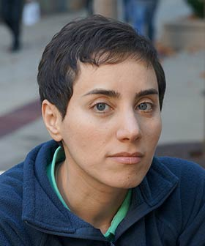
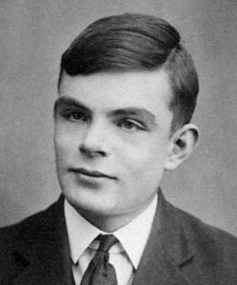
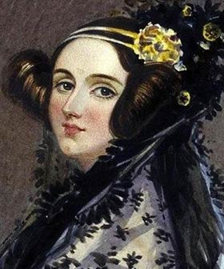
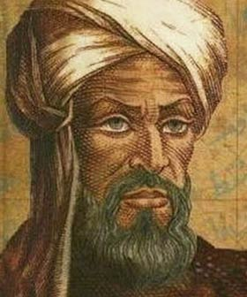
Empathy
Create a fact file on your favourite Mathematician. Include the following key points:
Their name
The years through which they lived
What they are famous for discovering
How they might have felt when they made their discoveries
What their discoveries meant to them and to others
How their discoveries have affected the world.
Here are some mathematicians you could choose as a starting point:
Maryam Mirzakhani
Alan Turing
Ada Lovelace
Muhammad Al-Khwarizmi
Use this website to help you, if you need it:
https://mathigon.org/timeline/

Slide 5

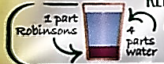
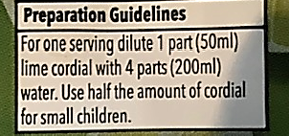

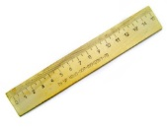
Awareness
Investigation:
How does the ratio of squash to water affect
how strong my drink is?
Ratios are often used on packaging. See the examples of cordial/squash mixing instructions below:
For this investigation, you will pour the stated amounts of water and squash into a cup and accurately measure using a ruler.
Example:
A drink is 10 cm in height and shared in a water to juice ratio of 4:1.
So, for every 4cm of water I put in, I will put in 1cm of squash.
4cm: 1cm = 5cm – Oops, not enough drink! Let’s try
putting another 4cm:1cm in the same cup.
Now we have:
8cm: 2cm = 10cm It’s the same strength because it’s the same ratio but we have double the amount of drink!

Slide 6
Awareness
Investigate this idea by making drinks of squash in the following ratios. Remember, if it tastes too strong, don’t drink the whole thing! You don’t want a tummy ache!
The first drink will be 4cm up the cup, with a water to juice ratio of 1:1.
Now make a drink that is 5cm high in the cup, with a water to juice ratio of 4:1.
Next, make a drink that goes 6cm up your cup, with a water to juice ratio of 11:1.
Finally, make a drink with a water to juice ratio of 7:3 that is 5cm high in your cup.
For each squash ‘recipe’ answer these questions:
How many centimetres of water do you need to pour out?
How many centimetres of squash are needed?
Do you think your squash is too strong, too weak or just right?

Slide 7

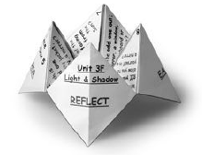
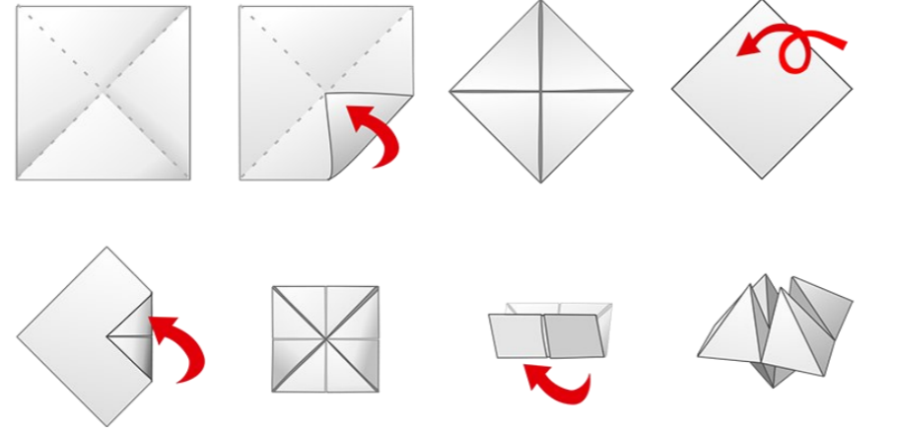
Collaboration
You might think of mathematics as a solitary pursuit, but in fact, many mathematical breakthroughs have been made by people working together to solve problems that they couldn't tackle alone. Good thinkers collaborate and communicate. To help you collaborate and talk about maths we have two ‘chatter boxes’ for you to cut out and make and play with.
To make your Chatter Box
Cut out the chatterbox in Appendix 2 or 3.
Make sure you start with the design facing down.
Fold and unfold corner to corner first, to give a middle point. There are lots of YouTube clips available if you need some extra folding guidance!

Slide 8

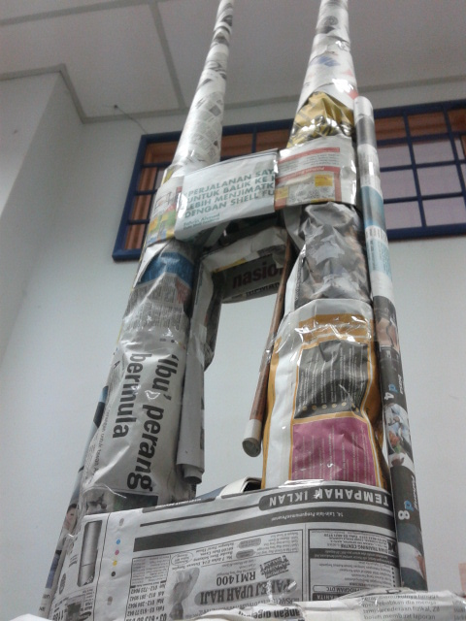
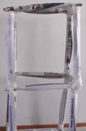
Creativity
Can you create a tower using only newspaper and sellotape?
Your tower needs to stand up without support.
Measure to the highest point without holding it up.
Hint: Try using different techniques to strengthen your tower eg folding, rolling, making different shapes.
Be as creative as you like with the shape and design of your tower.
Extension: Can your structure hold a weight? Try building a tower which could support the weight of a book. Good luck!

Slide 9


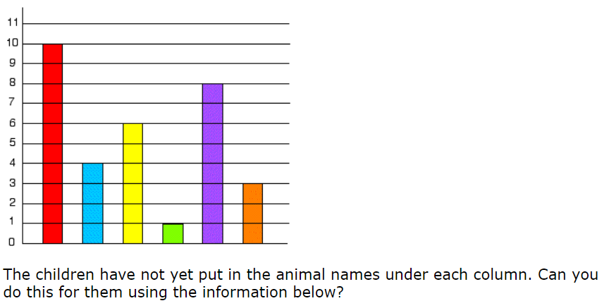
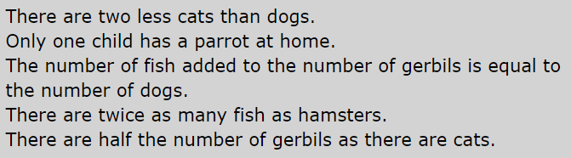
Independence

Slide 10


Appendix 1
Resilience
Print out this page if you would like circles to draw on.

Slide 11

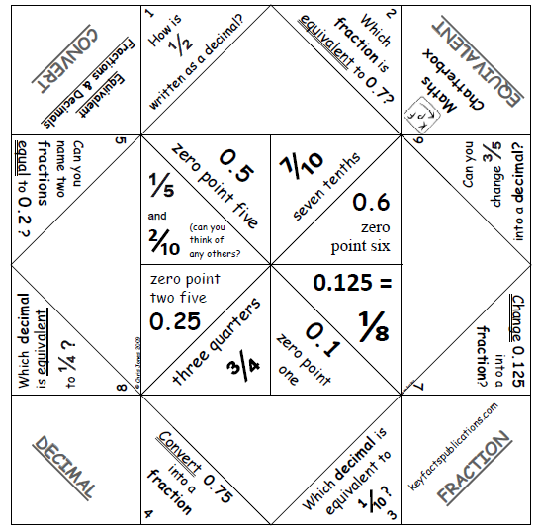
Appendix 2 Collaboration
How to play?
Ask a partner (sibling or grown up) to choose one of the words displayed on the outside of the chatterbox, then spell out that word opening and closing the chatterbox as you say each letter.
At the end of spelling this word, four of the inside numbers will be displayed.
Ask your partner to choose one of the numbers, and count up to that number opening and closing the chatterbox again as you say each number.
At the end of counting out the numbers, four of the inside numbers will be displayed again.
Ask your partner to choose one of the numbers and answer the question and then open up the chosen number flap.
Read out the answer and see if they have got it right - then swap over and keep taking it in turns to play.
What Next? If you’ve had a go at our Maths Games Chatterbox, how about creating your own? You could use different activities, or skills specific to a sport that you enjoy. Or how about creating one that contains fun facts or jokes? You could theme it around food, countries or animals. You can use just a blank piece of paper, it’s easier to make all the folds first and then create your design). We’d love to see some of your ideas !

Slide 12
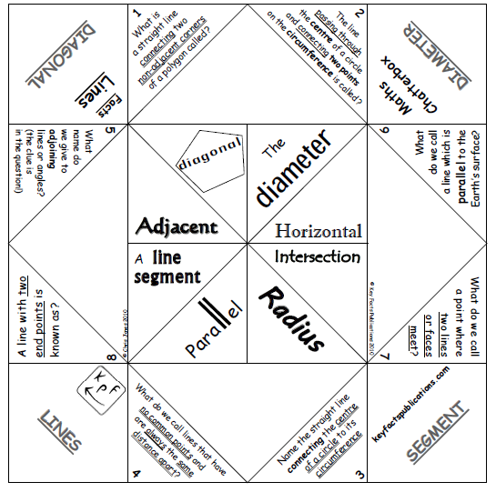
Appendix 3
Collaboration

