Slide 1
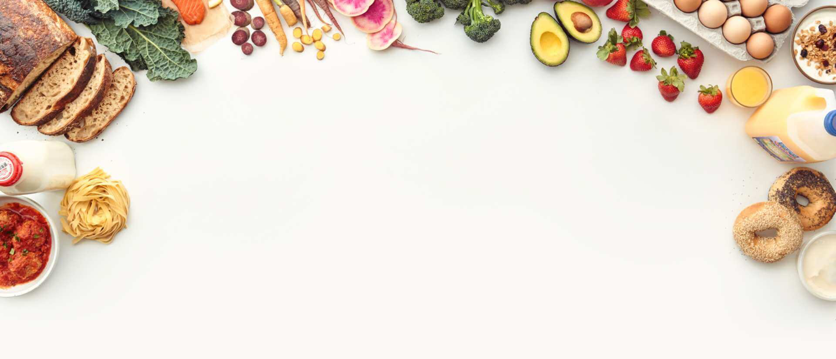
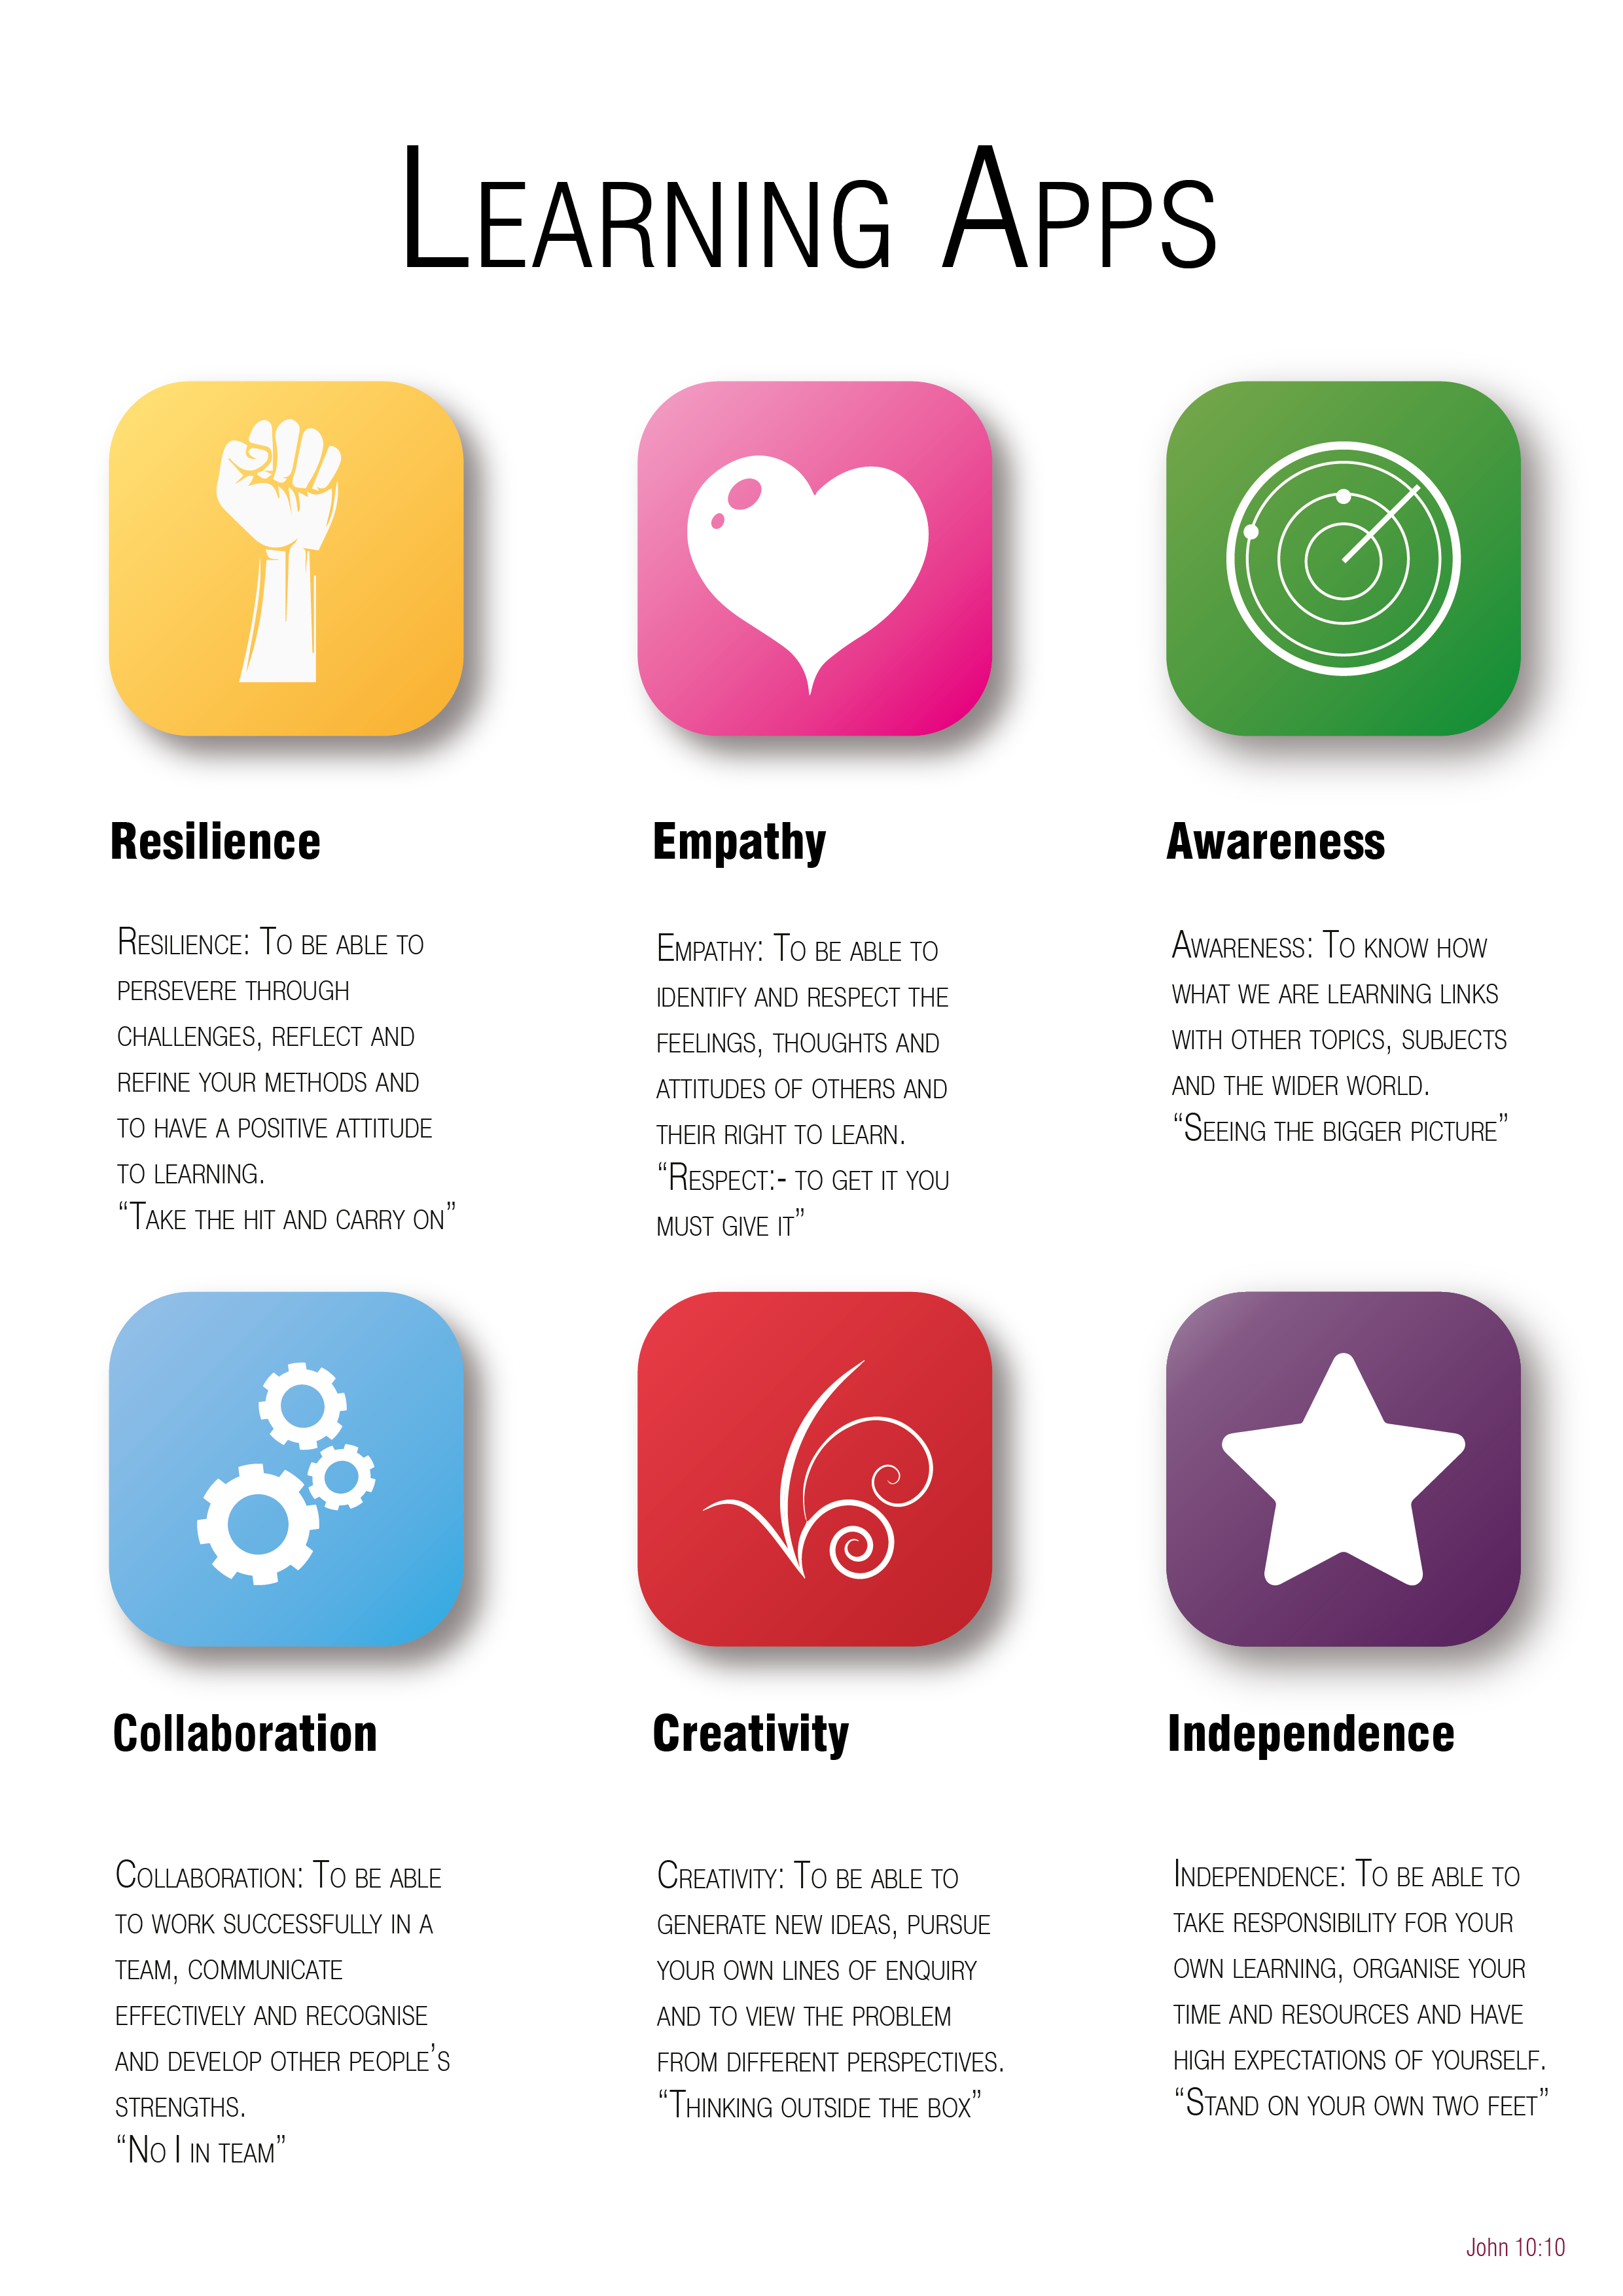
Year 6 to 7 Transition Project
Food & Cookery
The Bishop of Winchester Academy

Slide 3

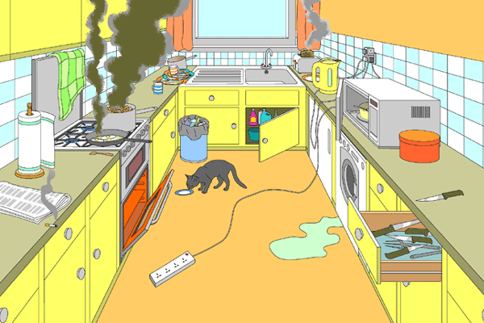
Awareness
List the hazards (dangers) you can see in the picture below:
What could happen to people if they are not following safety guidelines in the kitchen?
How can we make sure we are as safe as possible when working in a kitchen?

Slide 4

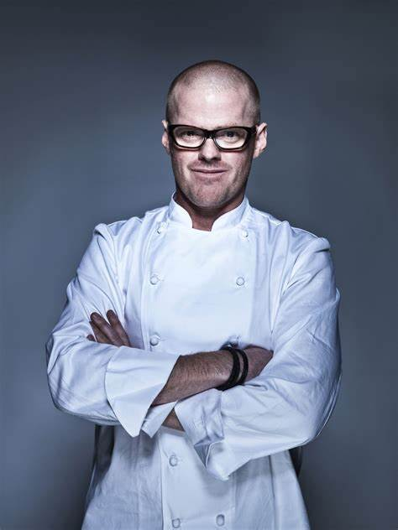
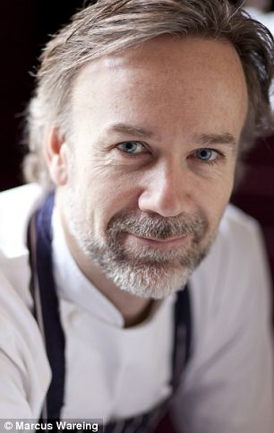
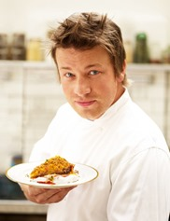
Independence
Create a fact file on a chef of your choice.
Include the following key points:
Their name
Where are they from?
When did they become a chef?
Have they worked in restaurants?
Have they worked with famous chefs?
Do they have a restaurant?
Do they have a Michelin star?
Have they changed the food industry at all?
Be creative with your presentation!

Slide 5

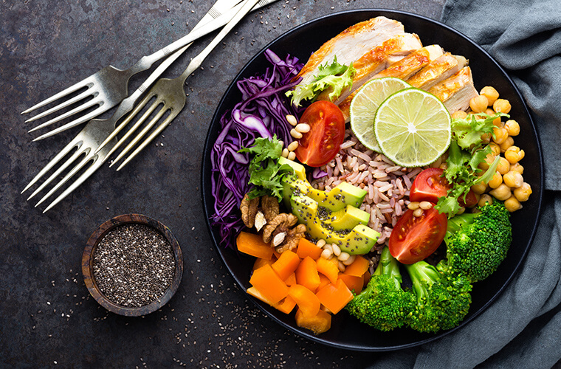
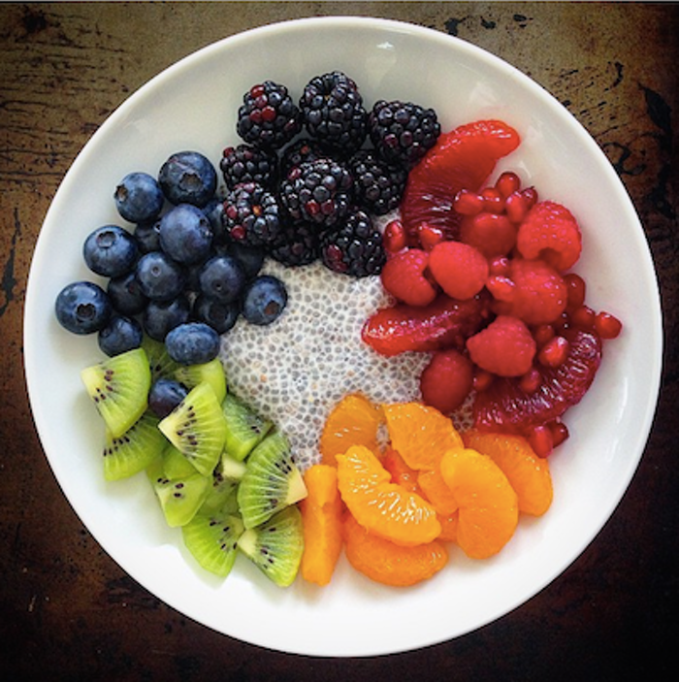
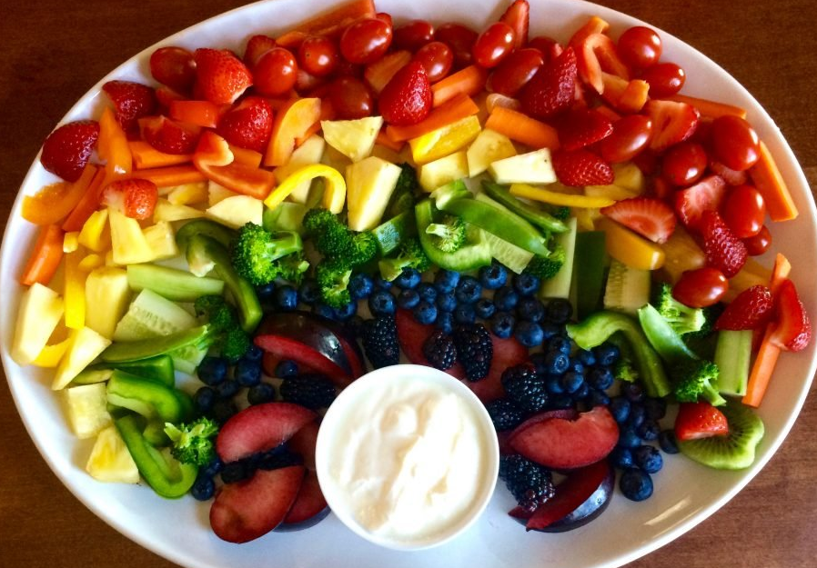
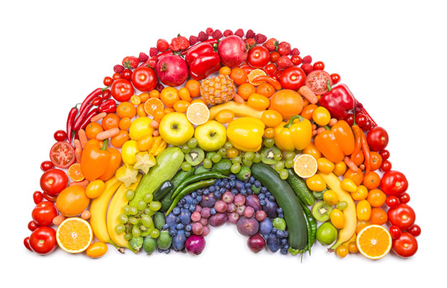
Creativity
Design a healthy plate of food using as many different coloured ingredients as possible.
You can do this by drawing the plate and drawing each different ingredient, and adding colour.
You could create it in person using food and take a photograph of your final dish!
Could you create an image/scene/animal out of food?

Slide 6




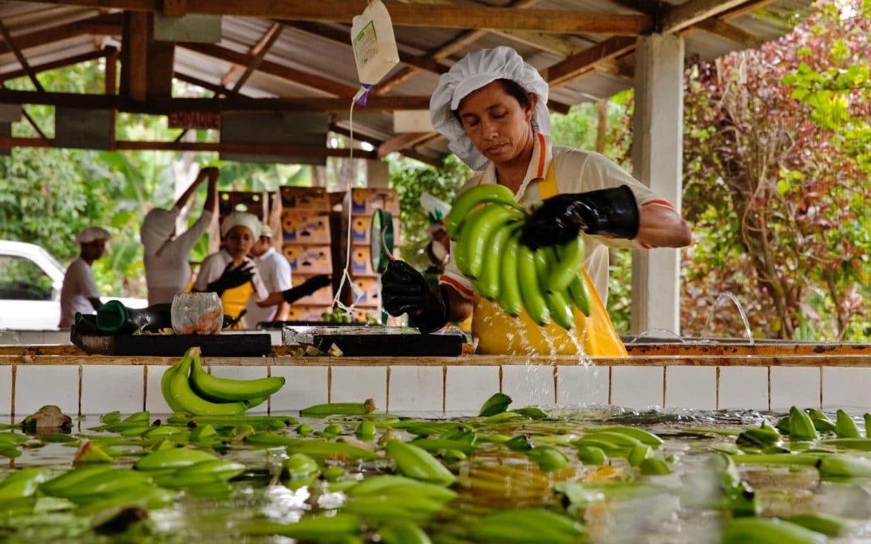
Empathy
Research “Fairtrade” in the food industry.
Create a poster that can be displayed in the local town to encourage people to buy Fairtrade.
Be creative to design an eye-catching poster.
Include as many facts and figures as you can about the Fairtrade program and why it is so important.

Slide 7

Collaboration
Work with an adult at home to help with a meal.
Which of the following jobs have you helped with?
Tick all of the jobs/roles you have done.
Meal: ________________________________________________
Getting ingredients out of the fridge/cupboard
Peeling vegetables
Turning oven/hob on
Preparing meat
Using a knife
Using a kettle
Measuring/weighing ingredients
Stirring ingredients
Blending ingredients
Laying the table
Clearing the table
Washing up
Wiping up
Wiping down surfaces
Adult signature: ___________________________

Slide 8

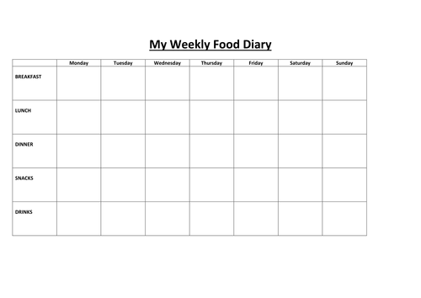
Resilience
Keep a food diary for a whole week using this table.
Record all the food and drink you consumed in one week. Keep this as ‘normal’ to your regular routine as possible.
At the end of the week, look at the types of foods you have eaten. What is good about your diet? What do you think you need to improve? Would you say that you have a ‘healthy diet?’

Slide 10
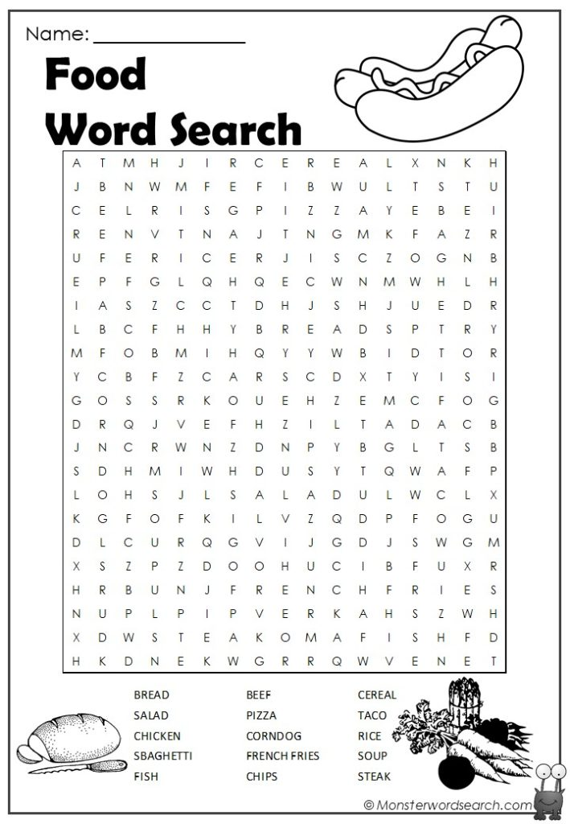

Slide 11
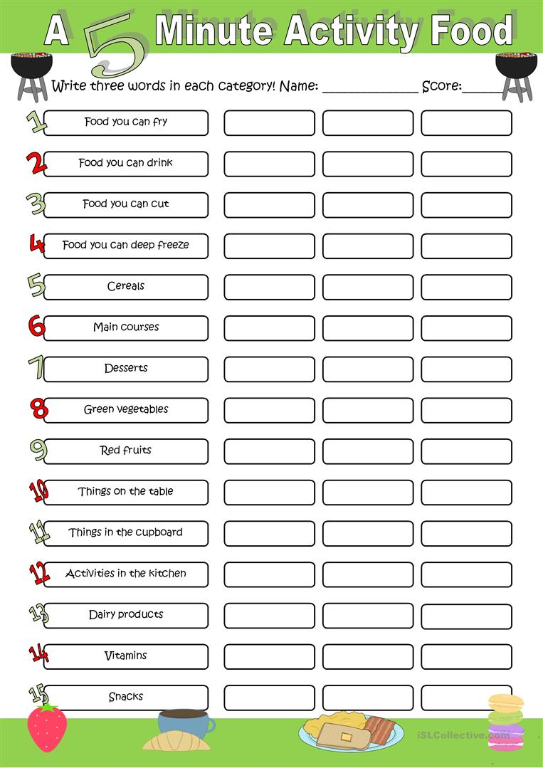

Slide 12


