Slide 1
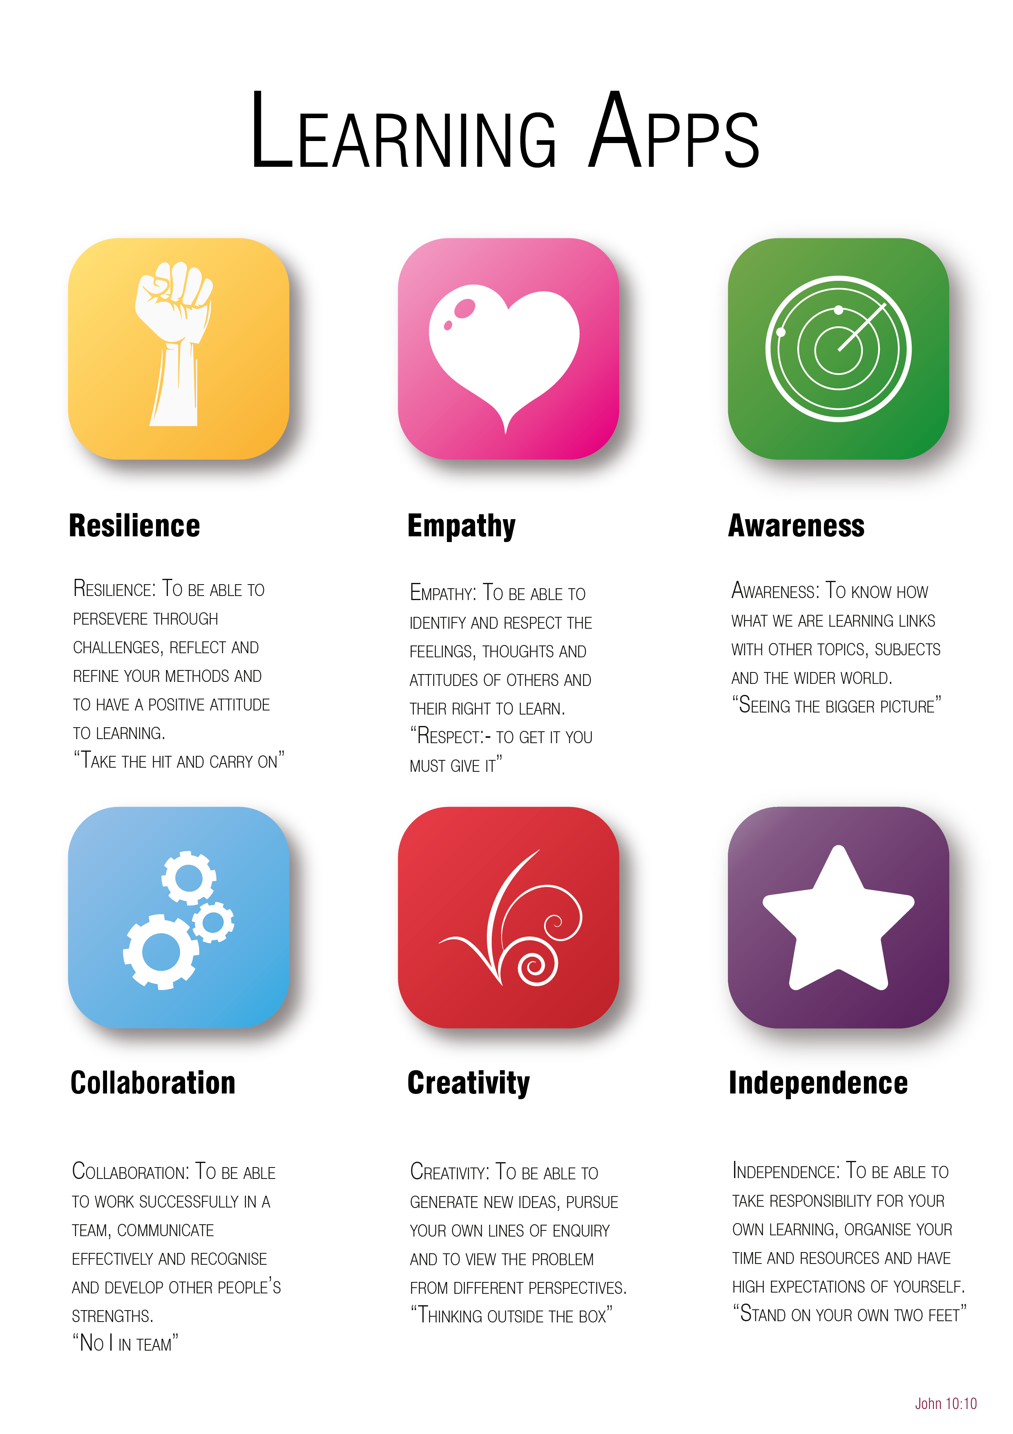
Year 6 to 7 Transition Project
Geography
The Bishop of Winchester Academy

Slide 3

Resilience
Reading is the cornerstone towards becoming a better writer and a better student in all subjects, not just Geography.
TASK: Over the course of a week, find one event in the news about geography. Things like earthquakes, volcanoes, flooding, climate change. It can be from anywhere in the world
You might read a newspaper, or news website, a magazine or blog.
Day | The event | Where was it, what was the impact?
Monday
Tuesday
Wednesday
Thursday
Friday
Saturday
Sunday

Slide 4

Awareness
During your time studying Geography at TBOWA you will explore many different parts of the world. One of these is Africa, and more specifically Nigeria. We study the environment and must be aware that sometimes big companies harm the environment.
An oil company called Shell caused two massive oil spills in the Niger Delta in 2008. This caused enormous damage to the environment and for the people who live there.
TASK:
Research what happened in the Oil spill. Write a short summary of what happened and how it affected people and the environment. Try to include some images.

Slide 5

Collaboration
Working with others, or understanding that your work/contribution often builds on the contribution of other people, is an important skill in Geography.
Working with a friend or member of your family try to create a record of as many different cloud types / types of weather as you can in a week. This works best if they are far away from you (a few miles at least).
You can do this by taking pictures of the sky at different three times of the day, for example morning, afternoon and evening, over the course of a week.
Share your images with each other to build up a picture of how different the sky and the weather can be in two different places.

Slide 6

Independence
One of the key things all of your teachers will aim to encourage at TBOWA is independent research and reading.
When you are studying and learning Geography there will be so many exciting topics that we will not always have time to study them in detail.
When this happens, students are pointed in the direction of various journals, websites or podcasts to learn more.
For this independent task you must read about Fairtrade and how it helps people in developing countries.
Visit the website below to read about Fairtrade.
https://www.fairtrade.org.uk/What-is-Fairtrade

Slide 7


Creativity
TASK:
Design a Fair trade product that you could sell.
You can do it in a poster format or a booklet, whichever you prefer.
Design the brand and packaging.
Explain why this product is fair trade
Describe how the product will benefit the producers and their community
Give examples on how selling this product can benefit the producers and the consumer
Price, ingredients or materials used
Explain how the money is distributed

