Slide 1
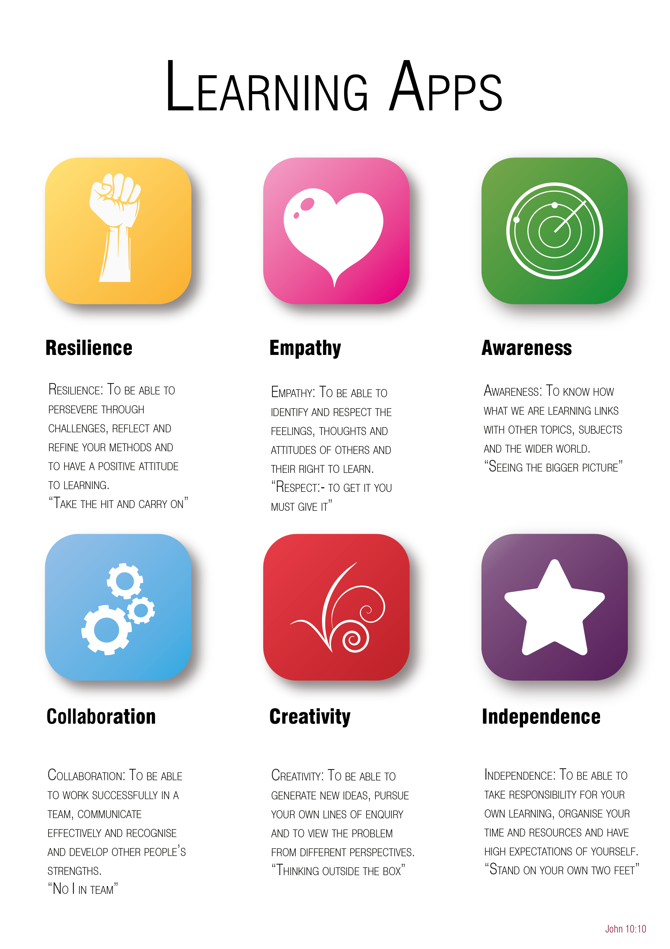
Year 6 to 7 Transition Project
Healthy Living
The Bishop of Winchester Academy

Slide 2






Transition Pack Contents
Slide Number | LApp | Task Name | Tick when complete
3 | An Introduction to our LApps
4 |  | Diet and nutrition
5 |  | Health, fitness and wellbeing
6 |  | Training program
7 |  | Role model fact file
8 |  | Careers in sport
9 |  | Physical challenge
10-12
13
14-20
Click the LApp Logo to go directly to the task!

Slide 4

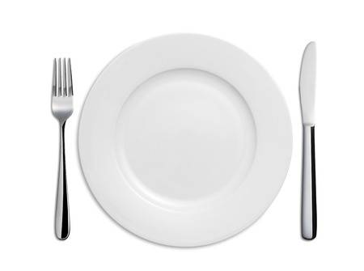
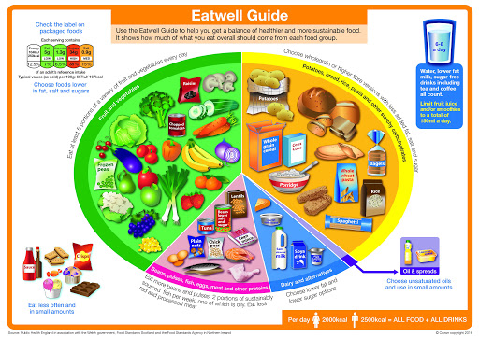
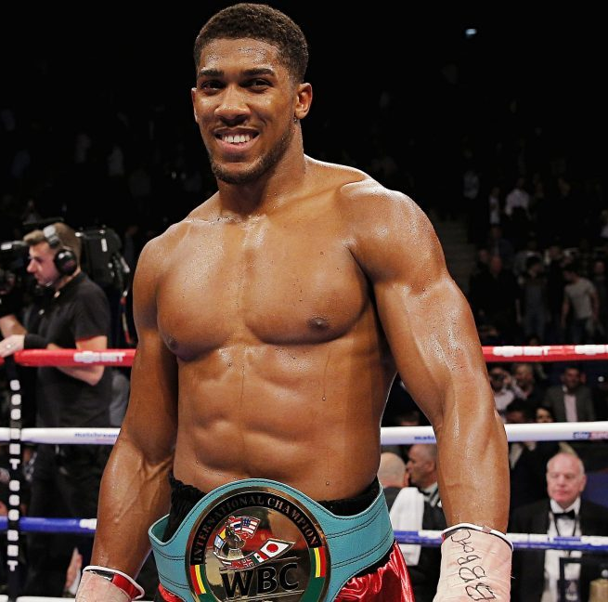
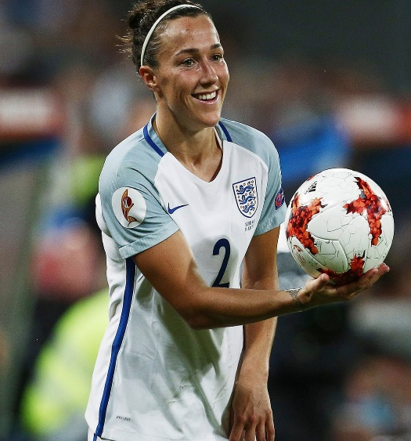
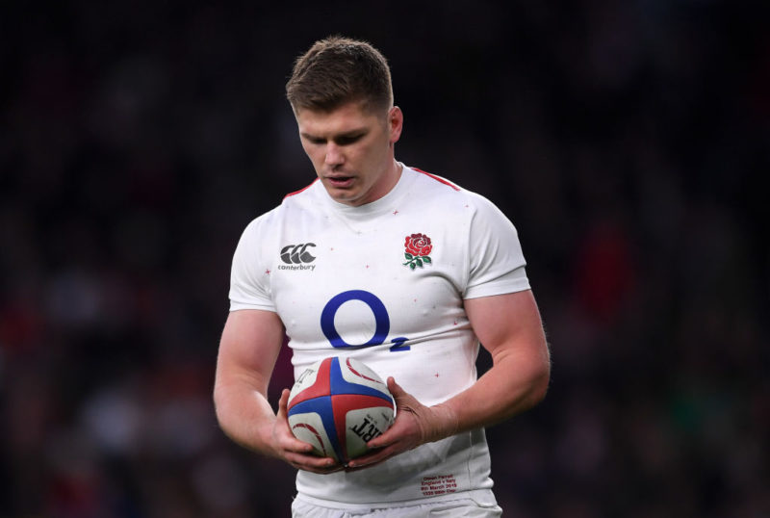
Awareness
Contents
Below is an empty dinner plate. Using the Eatwell guide (below) design a healthy meal for a professional athlete of your choice. At the bottom of the page are some examples of athletes you could use.

Slide 5


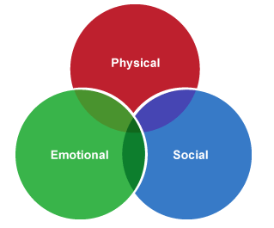


Independence
Contents
Physical activity is an essential part of a healthy lifestyle. Linked to other positive lifestyle choices, it promotes good physical health and contributes to people’s emotional and social wellbeing.
Activity: Using your own knowledge or the web link below draw a mind map stating at least three physical, mental and social benefits of physical activity.
Resource: https://www.bbc.co.uk/bitesize/guides/z3shycw/revision/1

Slide 6

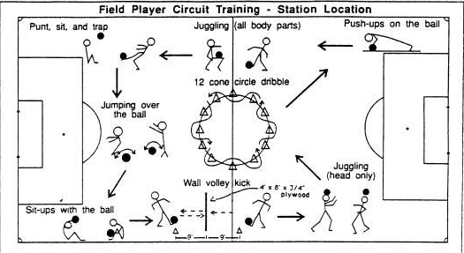
Creativity
Contents
Design a circuit to improve your performance in a sport of your choice.
Below in an example of a circuit a Footballer may do.
You should include:
At least five stations
Include the time / repetitions of each exercise at each station
Think about the muscle groups used in that particular sport (i.e. a circuit for a Footballer may be designed to target leg muscles).
Need some help creating a circuit? Click here!

Slide 7

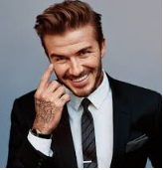
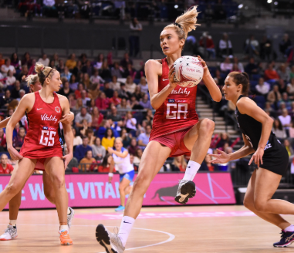
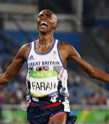
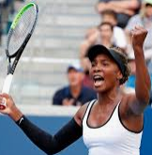
Empathy
Contents
Create a fact file on your favourite sports performer. Include the following key points:
Their name, height, interesting facts
The years through which they lived
What sport they are famous for playing
Their on and off field achievements
Brief information on their upbringing
Why they are your favourite sport performer
Below are some sports men and women you could choose as a starting point.
David Beckham
Helen Housby
Mo Farah
Serena Williams

Slide 8

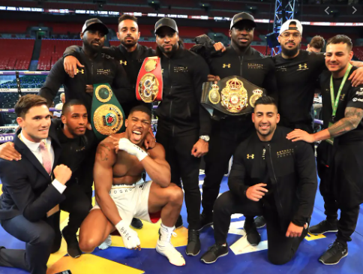
Collaboration
Contents
Anthony Joshua
Boxing is an individual sport and currently Anthony Joshua (English boxer) is the two-time unified heavyweight champion.
However despite Anthony Joshua participating in an individual sport, he has to work with the team around him collaboratively to ensure progression and high level performances are produced.
Below is a list of roles within Anthony Joshua’s team. Your task is to research what is involved for each role.
Boxer –
Boxing coach -
Sports nutritionist –
Sport psychologist –
Physiotherapist –
Promoter –
Personal trainer –
Publicist -
Cuts man -

Slide 9

Resilience
Contents
60 second challenge
Perform as many repetitions as you can in 60 seconds of the exercises below. Remember technique is more important that quantity of repetitions. Record your results on the table below. Can you beat your parents, siblings or guardians?
What you will need:
A stopwatch
Someone to count your repetitions
Useful resources:
Burpee - https://www.youtube.com/watch?v=dZgVxmf6jkA
Tuck jump - https://www.youtube.com/watch?v=r7oBejx1PHM
Note:
The difficulty of exercise increases from red to green.
 | Monday | Tuesday | Wednesday | Thursday | Friday | Saturday | Sunday
Jumping jacks
Hops
Sit ups
Press ups
Burpees
Tuck jumps

