Slide 1
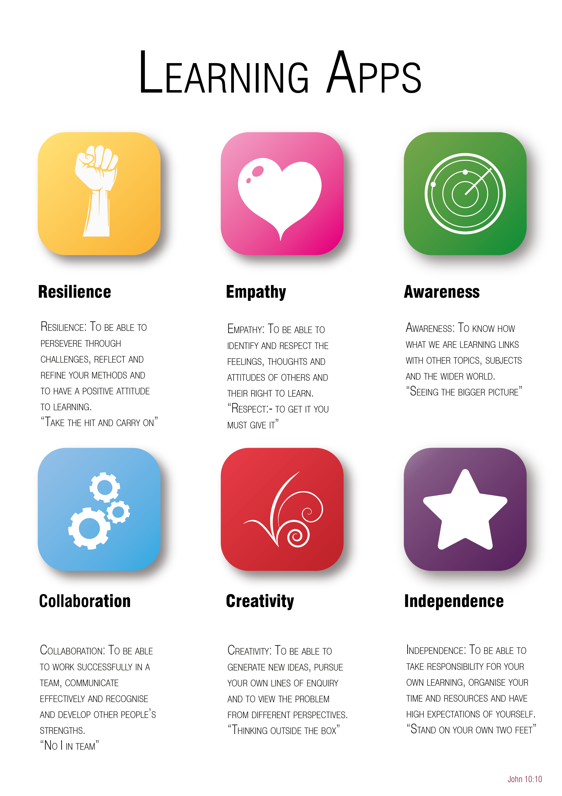
Year 6 to 7 Transition Project
History
The Bishop of Winchester Academy

Slide 3

Resilience
Investigation is an important part of a Historians work: It not only improves you understanding of History but also gives you a contextual overview which enables you to understand more in other subjects. Experiencing and understanding a breadth of historical periods is vital to help you become a great historian.
TASK: Over the course of a week, read 7 different historical articles, each on a different period of history on the Historical association’s website (https://www.history.org.uk/). You will need to log in using the following details: username: tbowastudent password:d8T2cWau
Day | The Text | Summary of the extract/article
Monday
Tuesday
Wednesday
Thursday
Friday
Saturday
Sunday

Slide 4

Empathy
Different historical events effect different people in different ways and this can have a profound affect on the consequences. In order to really understand how all the effects of an event historians must, in some degree at least, empathise with those they are studying.
TASK:
Using one of the articles that particularly interested you last week, write a historical piece of fiction that is based on what you have read showing how those in the situation may have been feeling.

Slide 5

Awareness
During your time studying History at TBOWA you will explore a range of issues that still impact the World today.
TASK:
Pick three events that have occurred in the news this year and explain how history may have influenced the events that occurred.
E.g:
1.
News Event:
Summary:
RELATED IMAGE

Slide 6

Collaboration
Working with others, or understanding that your work/contribution often builds on the contribution of other people, is an important skill in History.
TASK:
Complete one of the following tasks:
1. Using Zoom, Skype, Facetime, or another virtual meeting app, work with a friend or relative to create a project on a period that you both find interesting. You will need to think about what you want questions you would like to answer within your project and how you would like to present it. The project could be presented as a booklet, video, podcast or speech.
OR
2. Build on the work of an existing historian and try to add to their work. Use one of the articles you read on the Historical Association and write a piece that would add to that article but isn’t already included in it. E.g. if the article was about World War II but did not go into much detail about D-Day you could write a piece on D-Day.

Slide 7

Independence
One of the key things all of your teachers will aim to encourage at TBOWA is independent reading.
When you have read a book or article or listened to a podcast or watched a documentary, it is always worth reflecting on that experience. One way to do this is through writing a review.
Think about the interpretations of history that you have read, listened to, or watched, independently, this year. Choose one of your favourites.
TASK:
Write a review of this interpretation of history.
-Did you enjoy finding out about it? Why?
-What would you like to learn more about?
-How have you tried to find out more about the subject?
-Do you think the presenter of the interpretation had an agenda in what he was saying?

Slide 8

Creativity
TASK:
Design a film trailer for a film based on a historical event.
You could present this as a storyboard to show what would be in each section of the trailer, or using a phone/camera/animation you could try to create the trailer for the film.
You should include:
The title of the film.
What the film is going to be about
Why people should go and see it.
This can be completed using hand-written/hand-drawn materials, or using ICT.

