Slide 1
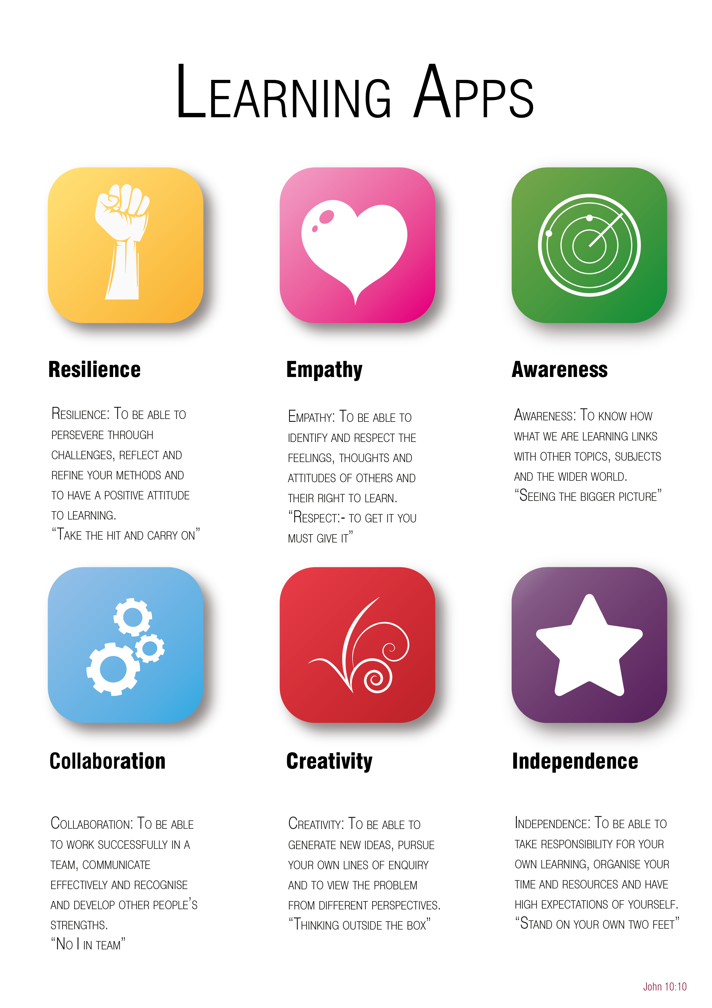
Year 6 to 7 Transition Project
Religious Studies
The Bishop of Winchester Academy

Slide 2






Transition Pack Contents
Slide Number | LApp | Task Name | Tick when complete
3 | An Introduction to our LApps
4 |  | Different Perceptions
5 |  | Meditation
6 |  | Places of Worship
7 |  | Influential Religious Figure Fact File
8 |  | Science and Religion
9 |  | Making links
Click the LApp Logo to go directly to the task!

Slide 4


Awareness
Contents
Look at this image:
What do you see in the picture?
An old lady or a young woman?
Awareness is important so that we can see more than one point of view, we shouldn’t just believe the first thing we hear or see.
Read the information in the link below:
How can we apply awareness to religion? Use the link to help you.
https://www.bbc.co.uk/bitesize/guides/zyygjxs/revision/3

Slide 5

Independence
Contents
For some meditation is religious practice, for others it is a way of maintaining good mental health and managing stress.
How can meditation or mindfulness have an impact on daily routines?
Professor Mark Williams, former director of the Oxford Mindfulness Centre, says that mindfulness means knowing directly what is going on inside and outside ourselves, moment by moment. "It's easy to stop noticing the world around us……an important part of mindfulness is reconnecting with our bodies and the sensations they experience. This means waking up to the sights, sounds, smells and tastes of the present moment”
Copy the table below and complete the first two boxes
Now watch the video:
Complete the remaining boxes
How do you think you could use meditation in your daily life?
How I think I will feel when meditating | How I think I will feel afterwards | How I felt when meditating | How I felt after meditating
https://www.youtube.com/watch?v=Bk_qU7l-fcU

Slide 6

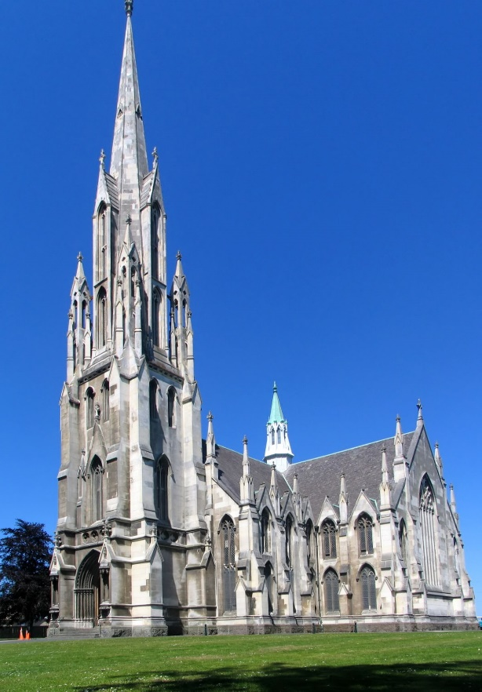
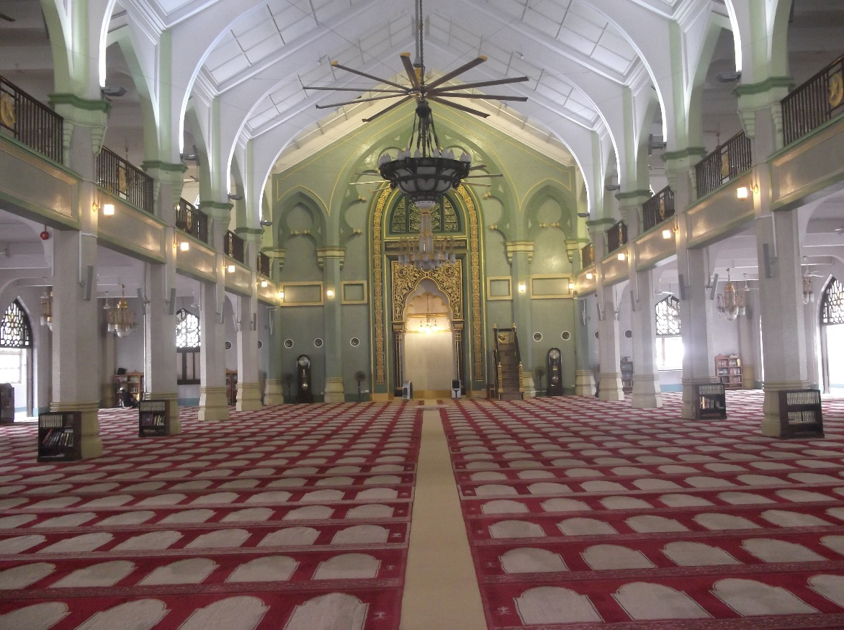
Creativity
Contents
Design a poster or leaflet informing people about a chosen place of worship (e.g. a Church):
You should include:
A picture or photo of your chosen place of worship
Its name, what religion its from and who worships there
A paragraph explaining its importance and why people worship there (aim for about 50 words)
Need some help picking a place of worship? Click here!

Slide 7

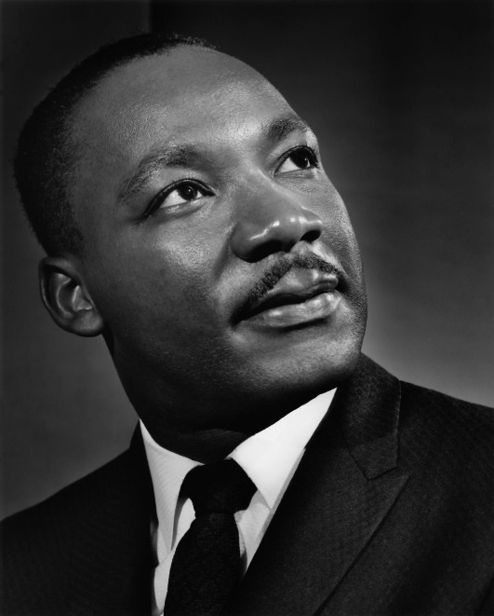
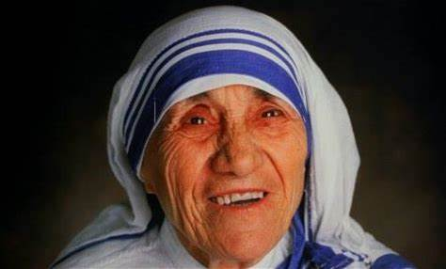
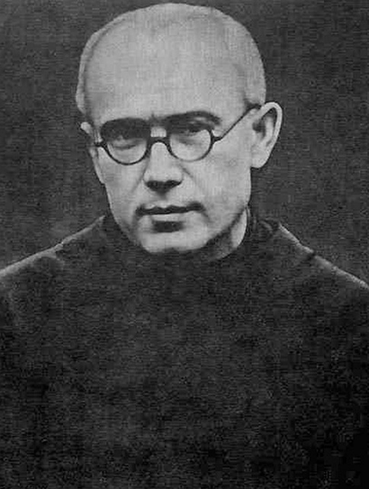
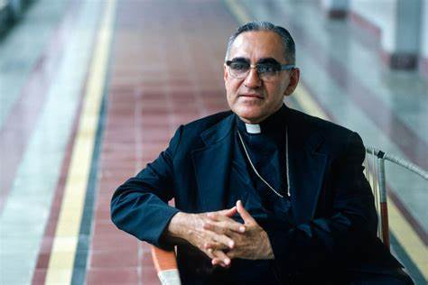
Empathy
Contents
Create a fact file on an inspirational religious figure. Include the following key points:
Their name
The years through which they lived
What they are famous for doing
How they might have felt
What they mean to others
How they have affected the world.
Below are some inspirational religious figures you could choose as a starting point.
Mother Teresa
Martin Luther King JR.
Maximilian Kolbe
Oscar Romero

Slide 8

Collaboration
Contents
Research one of the examples below of how religion and science can both be similar and different. Produce a newspaper article informing the general public of this!
Creation story vs Big Bang theory https://www.bbc.co.uk/bitesize/guides/zx7634j/revision/3
OR
Life after death https://www.bbc.co.uk/bitesize/guides/zphhw6f/revision/1

Slide 9

Resilience
Contents
Find different newspaper articles and suggest how they link to the following quotes.
How do you think religion links to everyday life? Write an explanation using your evidence to support your answer.
Article | Quote | How the article links to the quote
 | “Love thy neighbour.”
 | “God saw all that he had made, and it was very good.”
 | “You shall not steal.”
 | “I have come that they may have life, and have it to the full.”
 | “And the LORD God said, “The man has now become like one of us, knowing good and evil.”

