Slide 1
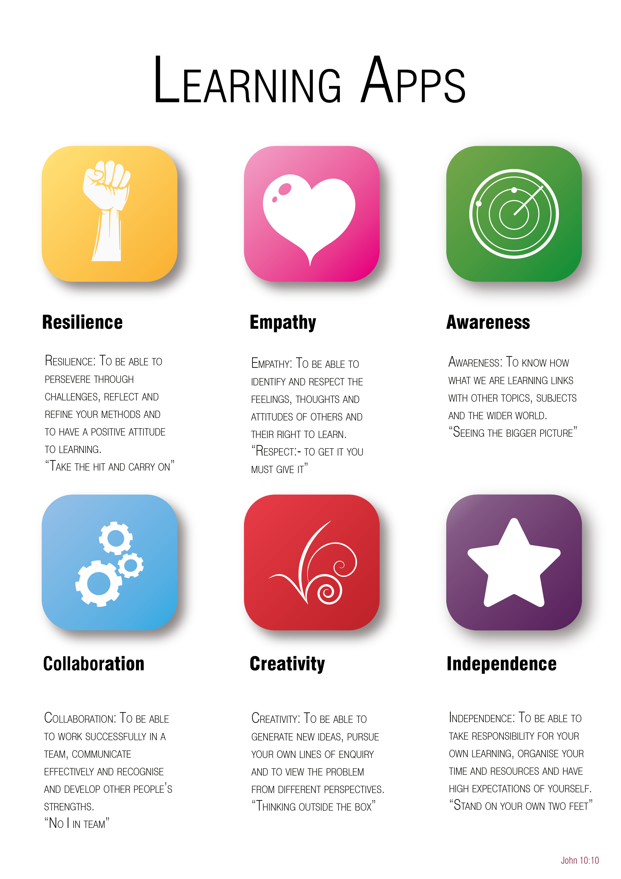
Year 6 to 7 Transition Project
Computer Science
The Bishop of Winchester Academy

Slide 3


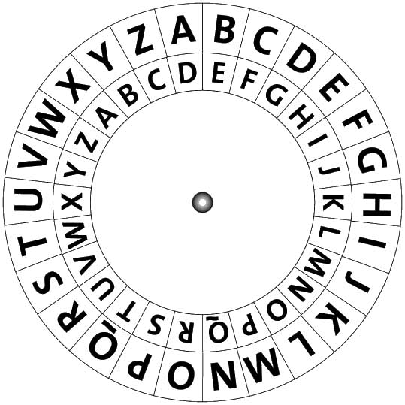
Resilience
THE ALAN TURING CRYPTOGRAPHY CHALLENGE!
Have you got what it takes?
Use the Cipher wheel in Appendix 1 to decrypt the message below and complete the task.
XVH WKV FLSKVU ZKHHO WR FUVDWH BRXU RZQ FRGHG PHVVDJH.
FKDOOHQJH VRPHRQH WR GHFUBSW BRXU PHVVDJH.
You can use Appendix 1 for this task.

Slide 4

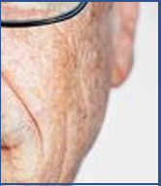

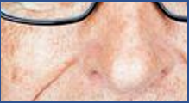




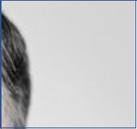
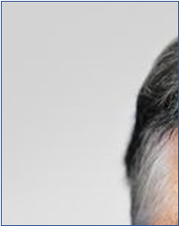

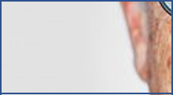






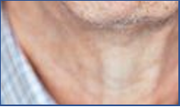
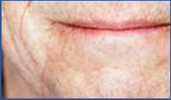
Empathy
Finish the puzzle to reveal the Tech Tycoon!
Create a fact file for this person.
What is there name?
What have they created?
How have they transformed the world we live in today?

Slide 5

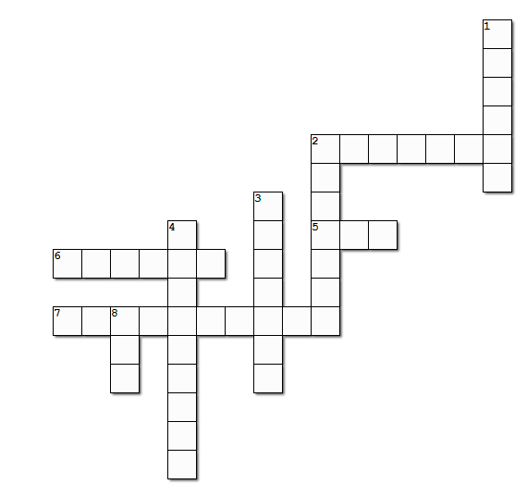

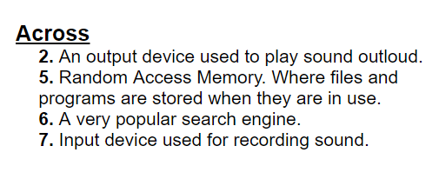

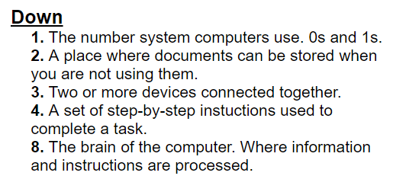
Awareness
How much do you know about computing?

Slide 6

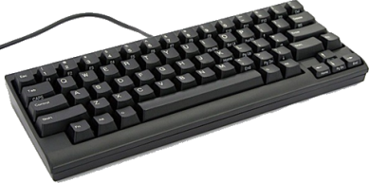
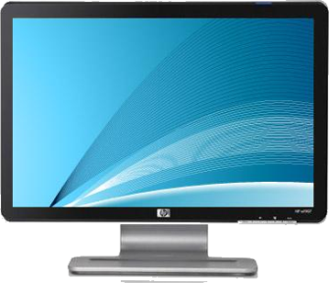

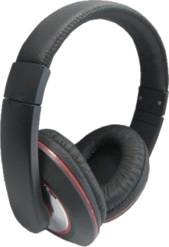
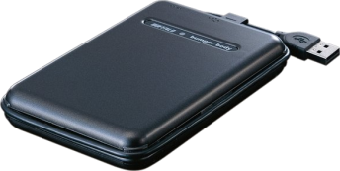
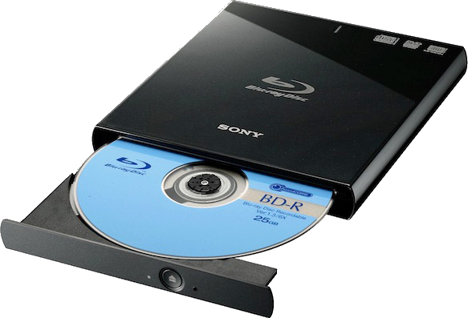
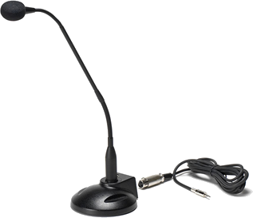
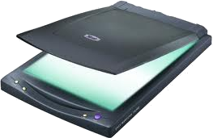
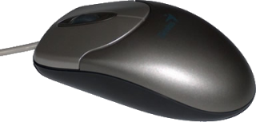
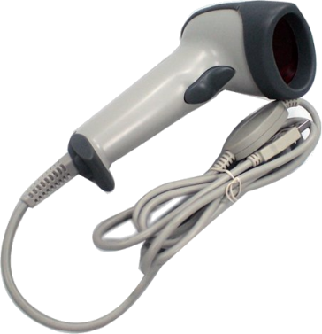
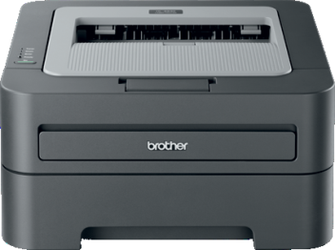
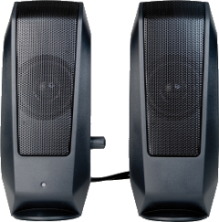

Collaboration
Input & Output Devices
see Appendix 2 for more information.
Below is a model of how the CPU, input, output, and storage devices work together.
Move the remaining pieces of hardware into the correct categories. Are they Input, Output, or Storage?
Input devices
CPU
Output devices
Storage

Slide 7






Creativity
Design your own Website
see Appendix 3.
Have you ever wanted to create your own website?
Take this opportunity to design it! It could be about absolutely anything!
Some examples…. a hobby or interest you have, a good cause such as environmental activism, or about your favourite sports team.
Use the information below to help you design it.
Website top tips:
All website have a very similar look and feel.
They all follow the same design principles.
They can include multiple pages and feature a lot of different functionality.
They all have a navigation system.
They all use icons:
https://www.iconfinder.com/
You could do this on paper (see appendix 3) Or you could Sign up to mockflow.com and begin creating your designs.

Slide 8

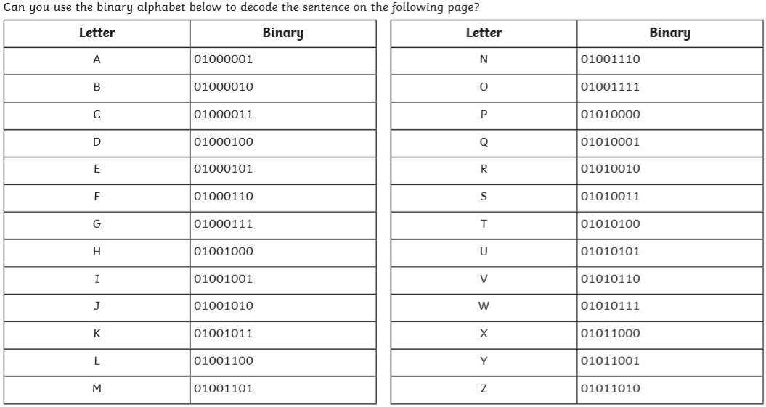
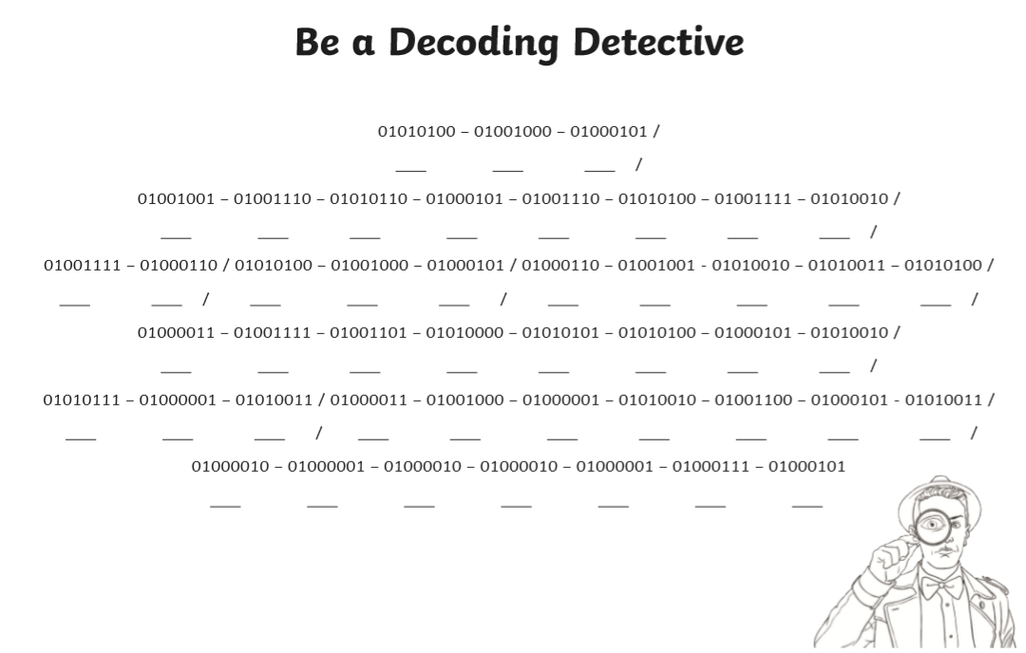
Independence
Be a Decoding Detective!
Can you use this Binary Alphabet to decode the sentence?
see Appendix 4

Slide 9

Appendix 1
Resilience
Use the wheel from the inside out.

Slide 10
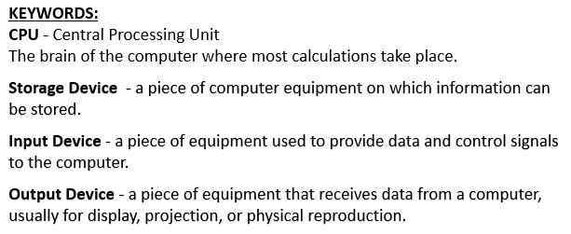
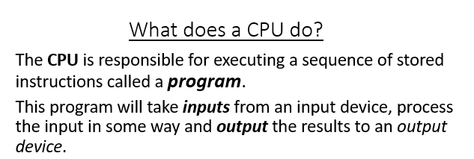
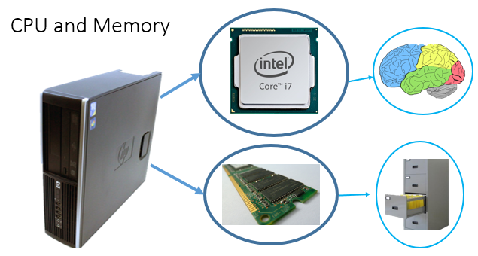
Appendix 2
Collaboration

Slide 11

Appendix 3
Creativity
Desktop Version
You could do this on paper.
Or you could Sign up to mockflow.com and begin creating your designs.

Slide 12

Appendix 3
Creativity
Tablet Version
You could do this on paper.
Or you could Sign up to mockflow.com and begin creating your designs.

Slide 13

Appendix 3
Creativity
Mobile Version
You could do this on paper.
Or you could Sign up to mockflow.com and begin creating your designs.

Slide 14
Appendix 4
Independence

Slide 15
Appendix 4
Independence

