Slide 1

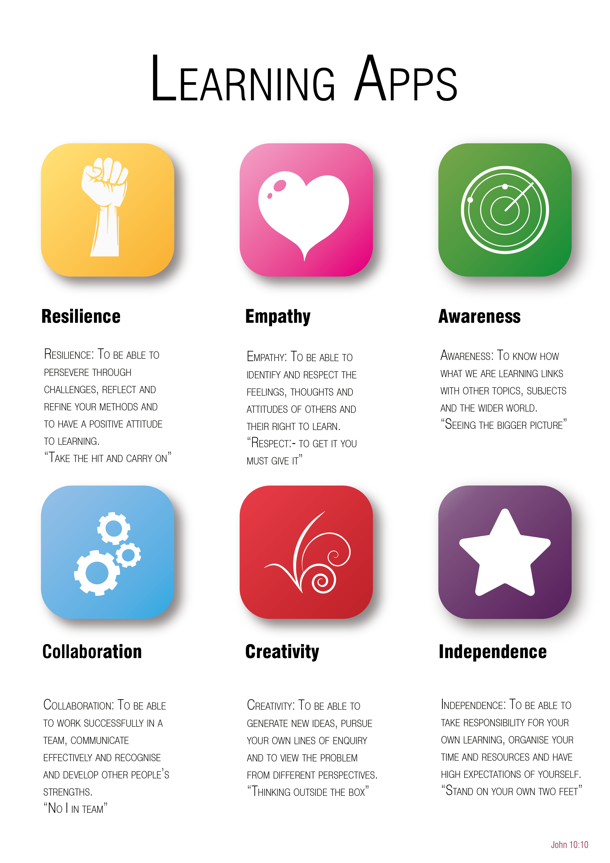
Year 6 to 7 Transition Project
Music &
Music Tech
The Bishop of Winchester Academy

Slide 2






Transition Pack Contents
Slide Number | LApp | Task Name | Tick when complete
3 |  | Music Festivals
4 |  | Learn How To Beat-Box!
5 |  | Make a Musical Instrument
6 |  | Musician’s Fact File
7 |  | Band Project!
8 |  | Learning Music

Slide 3

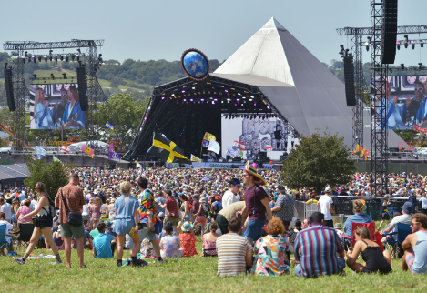

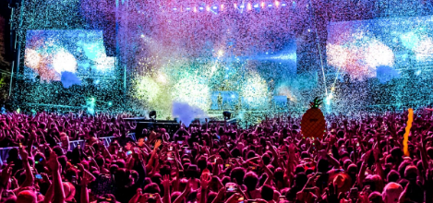

Awareness
Contents
Music Festivals
Summer music festivals are very important events in the UK.
Research summer music festival and create a PowerPoint or written project about it.
You could choose Camp Bestival, The Isle of Wight Festival, Glastonbury or a local festival that you know.
Where is it? What makes it unique? Who has played there?

Slide 4


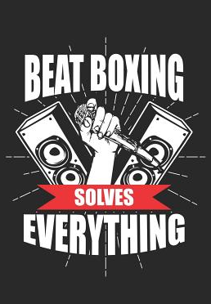
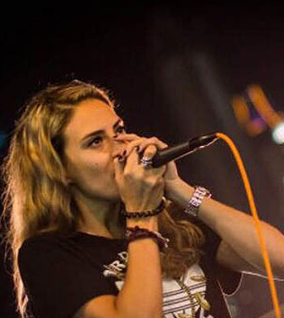
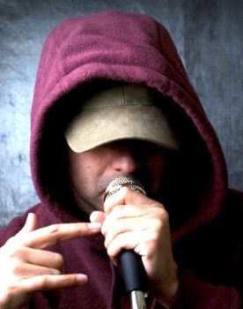
Independence
Contents
Learn How To Beat-Box!
Beatboxing is vocal percussion, where you imitate the sound of a drum machine using your mouth.
Watch the following youtube clip:
https://www.youtube.com/watch?v=TwvUZZxy1-w
Now, create your own beat using some sounds that you have learnt, or some new sounds you have created.

Slide 5

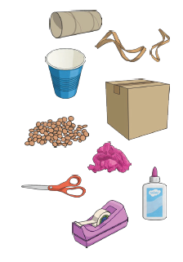
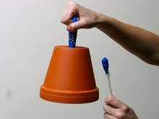
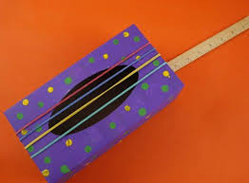
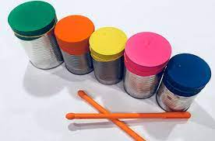
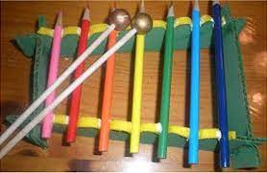
Creativity
Contents
Make a Musical Instrument
Did you know you can make a musical instrument out of things you can find at home?
You could make a shaker, a drum, a guitar or something else of your choice. What different sounds can it make?
Materials you could use include:
The inside of a kitchen or toilet roll
Elastic bands
Plastic or paper cups
Boxes of different sizes
Lentils or dried beans/rice
Newspaper
Plant pots
Jars
Sticks

Slide 6

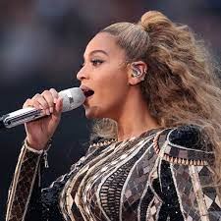
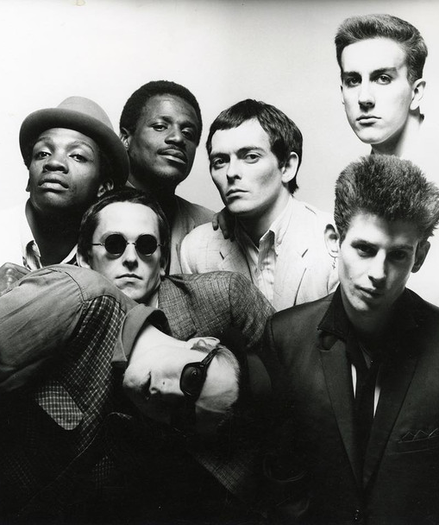
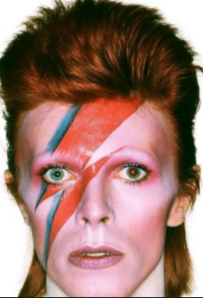
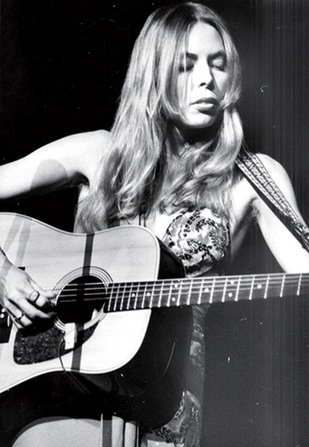
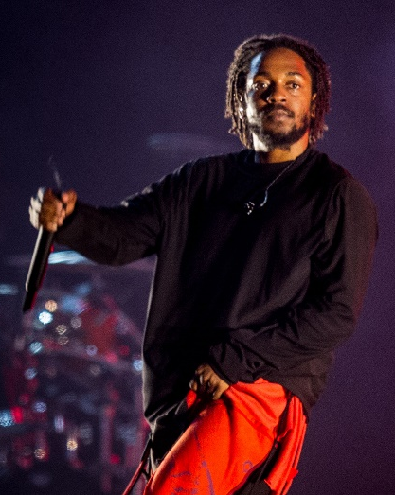
Empathy
Contents
Musician’s Fact File
Create a fact file on your favourite musician or band.
Include the following key points:
Their name or band
When were they famous?
What style of music do they play?
Have they won any awards?
What are your favourite songs by them?
What is it that you like about them? How does their music make you feel?
Any fun facts
Below are some examples of musical heroes of ours!
Beyonce
The Specials
David Bowie
Joni Mitchell
Kendrick Lamar

Slide 7

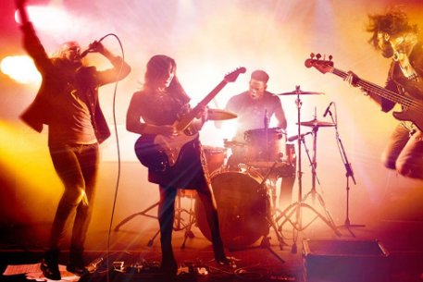
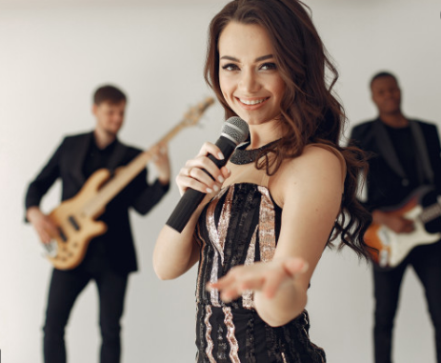
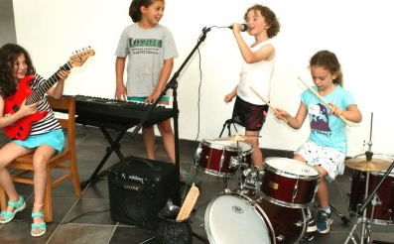
Collaboration
Contents
Band Project!
Learn a song of your choice (or create an original song!) with people in your household.
What skills can you teach to your siblings and grown-ups?
What can you can learn from them?
You could even do some karaoke – just have fun making music together ☺
.

Slide 8

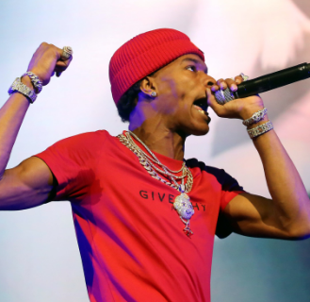
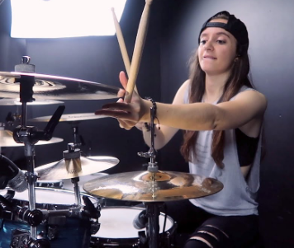
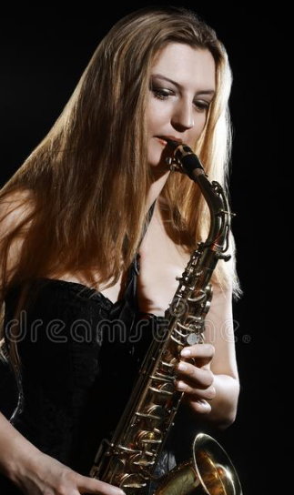
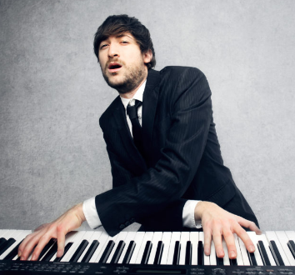

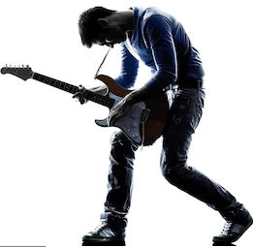
Resilience
Contents
Learning Music
You could learn:
The lyrics to a song or rap
The chords or melody of a piece of music if you have a piano, keyboard or piano app on a tablet
If you play an instrument, learn part or a new piece
Keep trying until you have learnt it and be proud of your self!

