Slide 1
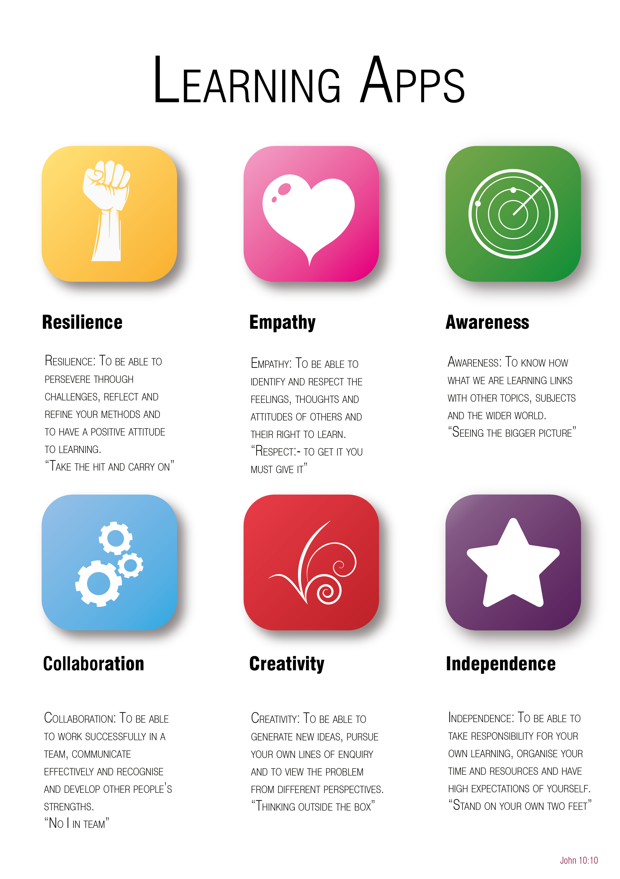
Year 6 to 7 Transition Project
English
The Bishop of Winchester Academy

Slide 3

Resilience
Reading is the cornerstone towards becoming a better writer and a better student in all subjects, not just English. Experiencing and understanding a breadth of reading materials is vital to help you become a great reader.
TASK: Over the course of a week, read 7 different non-fiction texts and summarise what you have read. You might read a newspaper, or news website, a magazine or blog.
Day | The Text | Summary of the extract/article
Monday
Tuesday
Wednesday
Thursday
Friday
Saturday
Sunday

Slide 4

Empathy
The Covid-19 crisis has affected every human being on the Earth, however, it has also been different for each individual. To understand that takes empathy.
An empathetic response requires us to take another person’s standpoint; to consider how things will be different for someone else; to walk a mile in another person’s shoes.
TASK:
Write a diary entry from the perspective of another person during the lockdown crisis.
It could be a person who is very different from you – perhaps living in another part of the world, much older, or with very different social circumstances, but should include an exploration of how you think that person would have felt. You can base it on a real, or imagined, other person.
It should be a personal response and written in the first person perspective.

Slide 5

Awareness
During your time studying English at TBOWA you will explore a range of non-fiction texts. One of these non-fiction text types will be NEWSPAPERS.
TASK:
EXPLAIN what you know about the 5 MOST IMPORTANT NEWS STORIES so far this year. ***It is up to you to decide what makes it an important news story.***
For each story you choose, write a 50-100 word summary of that story and provide a number in your order of importance from 1 – most important to 5 – least important.
For each story, you may also choose to include an image that summarises that story.
E.g:
1.
News Story:
Summary:
RELATED IMAGE

Slide 6

Collaboration
Working with others, or understanding that your work/contribution often builds on the contribution of other people, is an important skill in English.
TASK:
Complete one of the following tasks:
1. Using Zoom, Skype, Facetime, or another virtual meeting app, work with a friend or relative to create a fantasy story. Take responsibility for different parts of the story – perhaps they could write the first chapter setting up the fantasy world and describing the setting, then you could write the second chapter introducing the main character.
OR
2. Build on the work of an existing writer and try to mimic their writing by creating a pastiche (writing in their style). You could choose to write an additional chapter to an existing story, or begin an entirely new story written in their style.

Slide 7

Independence
One of the key things all of your teachers will aim to encourage at TBOWA is independent reading.
When you have read a book, be it fiction or non-fiction, it is always worth reflecting on that reading experience. One way to do this is through writing a book review.
Think about the books that you have read, independently, this year. Choose one of your favourites.
It might be book that you’ve loved, but equally it could be a book that you really didn’t enjoy (some of the best reviews contain quite harsh criticism).
TASK:
Use the template in Appendix 1 of this booklet to help you write a book review of this text.
Use descriptive language to explain your personal response to this book and whether you would recommend it to other readers.

Slide 8

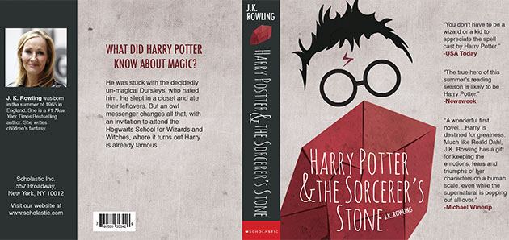
Creativity
TASK:
Design an alternative book jacket/cover for the book you have reviewed for your ‘Independence’ task.
You should include:
A picture or photo of that would be appropriate for the front cover of the book – preferably one you draw yourself
A blurb (short summary of the book) that doesn’t give too much away, but intrigues the audience
An ‘about the author’ section, spine, and range of suitable fonts and colours that you feel suit the book.
This can be completed using hand-written/hand-drawn materials, or using ICT.

Slide 9
Appendix 1 – Book Review
Book review by: _______________________________________________________________________
Title: __________________________________________________________________
Author: _______________________________________________________________
Non fiction:
Fiction:
Book Illustration
Would you/would you not recommend the book? Why?
Would recommend
Would not recommend
Why?
_____________________________________________________________________________________________________________________________________________________________________________________________________________________
_______________________________________________________________________
_______________________________________________________________________
______________________________________________________________________________________________________________________________________________
Rating:

