Slide 1

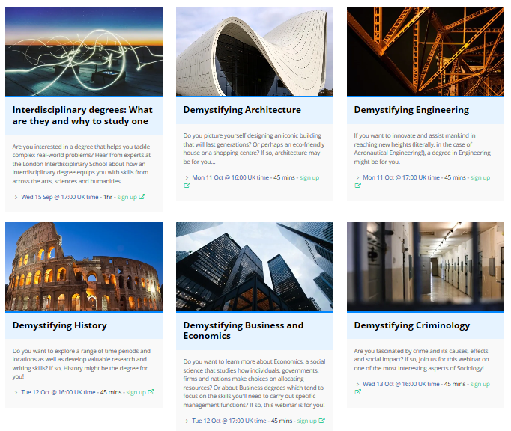


The Subject Discovery Webinars – October 2021

Slide 2
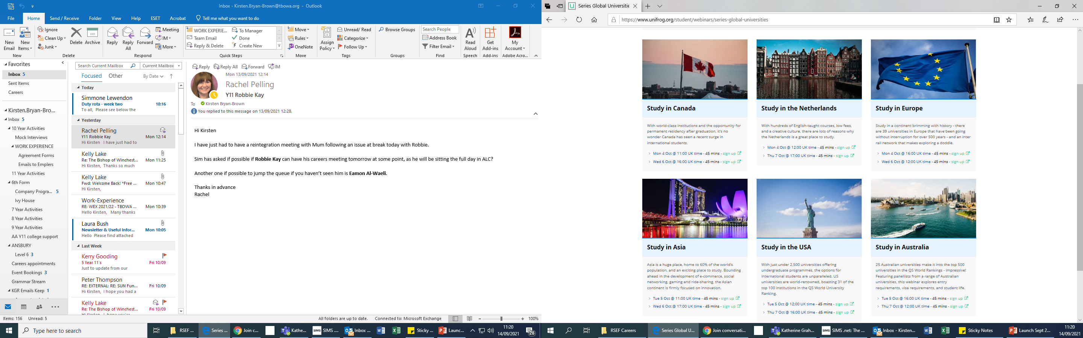
The Global Universities Webinars – October 2021

