Slide 1

Student Sign In:
Smartphones & Tablets

Slide 2

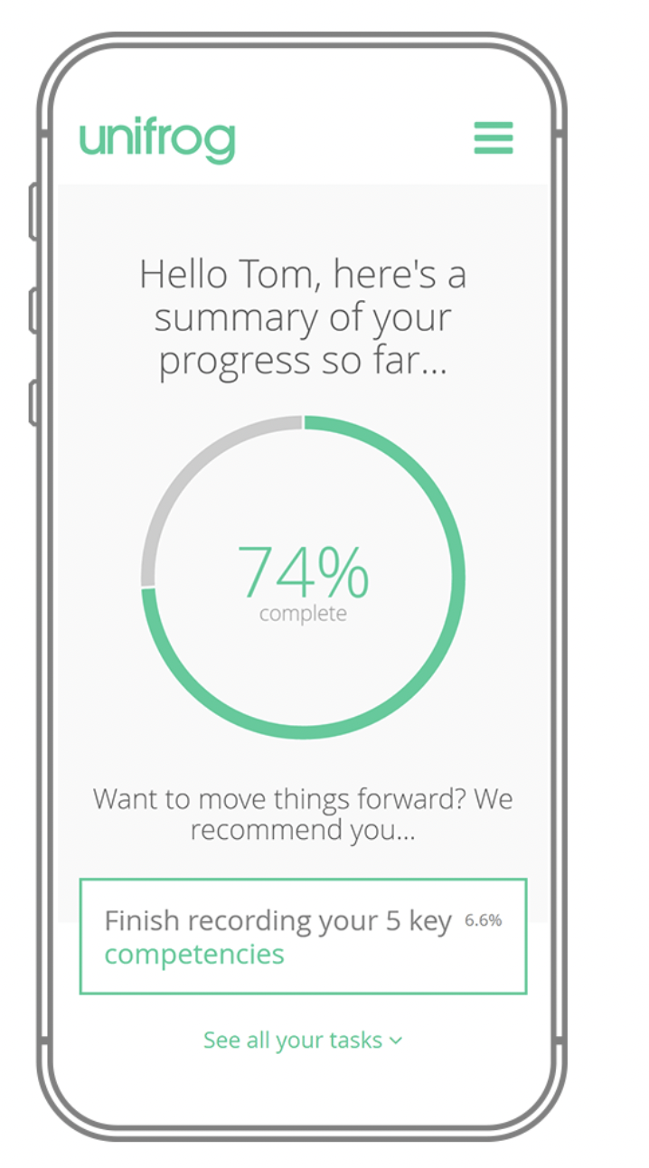
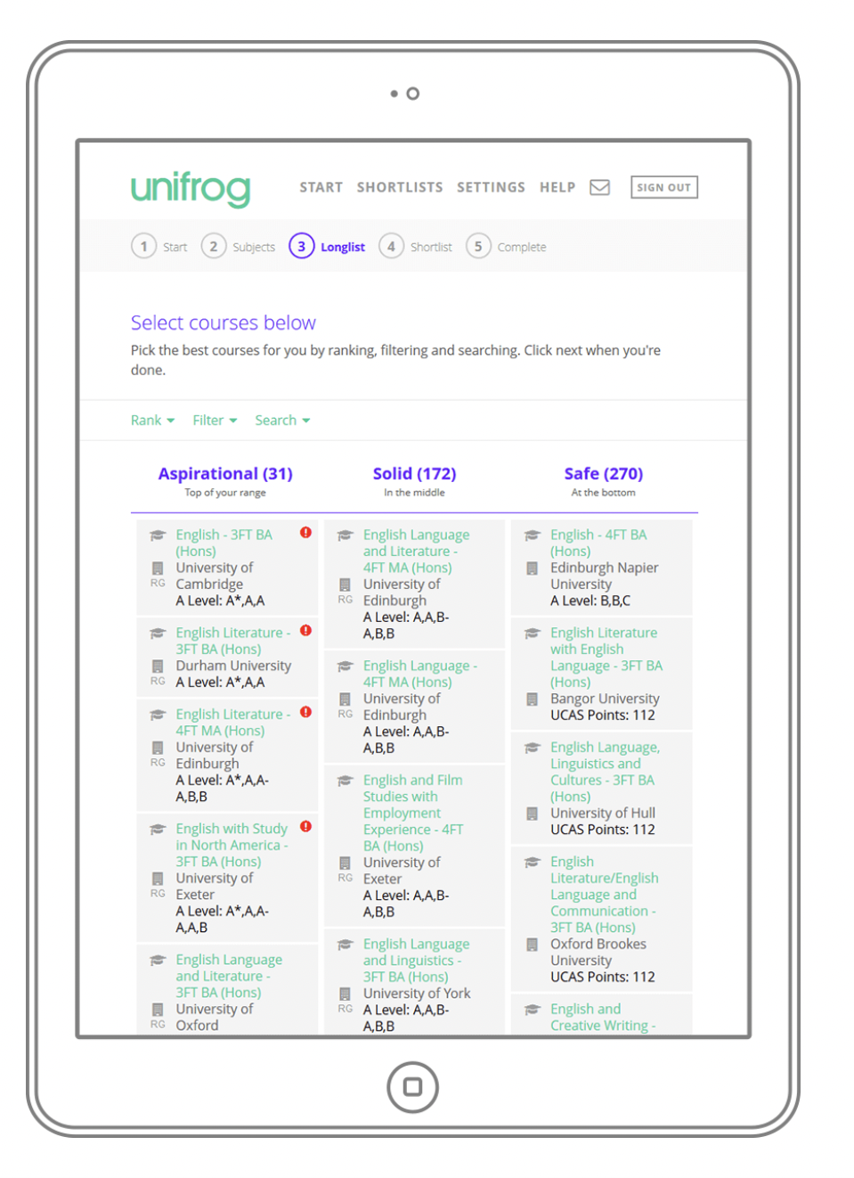
Smartphone & Tablet Sign In
Go to unifrog.org/student and sign in with your email address & password.

Slide 3
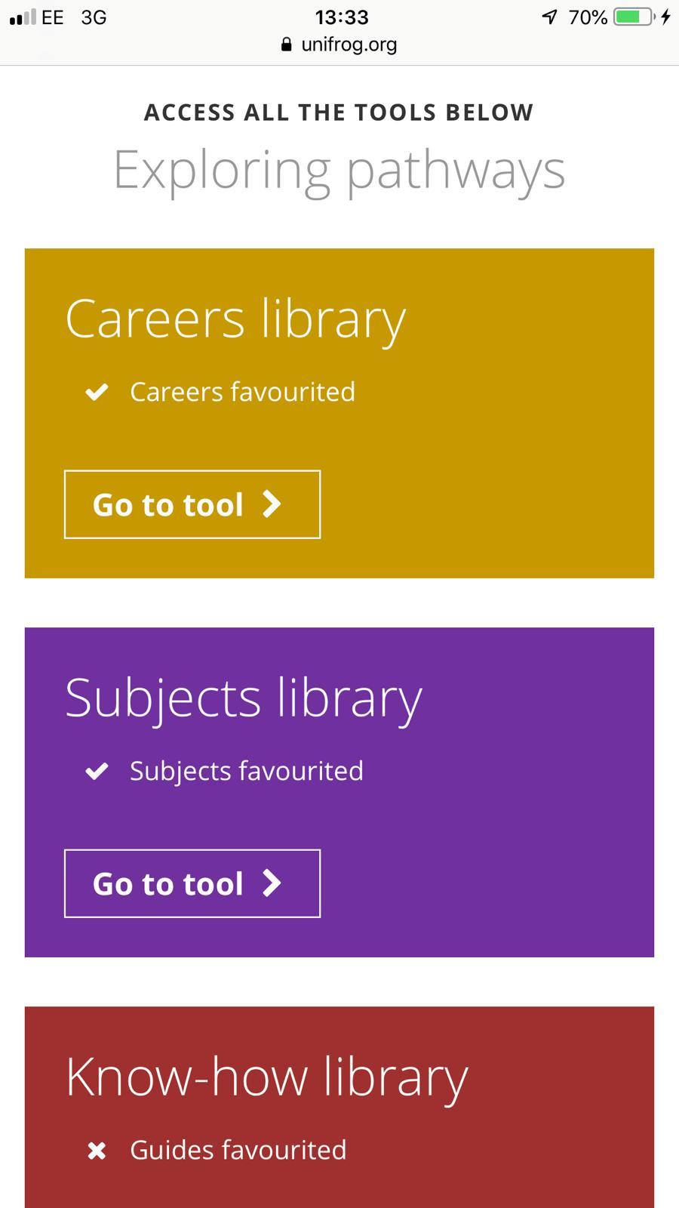
Smartphone & Tablet Sign In
You’ll then be able to use Unifrog in exactly the same way you can on a laptop- we’re fully optimised for smartphones & tablets!

Slide 4
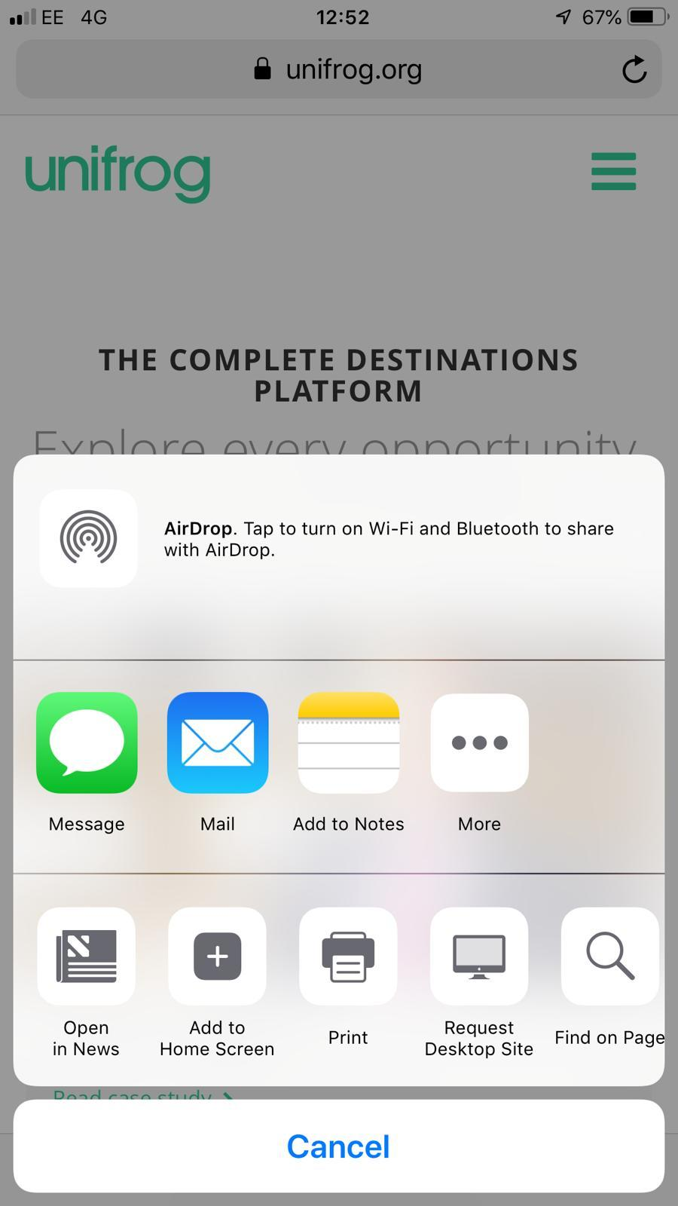
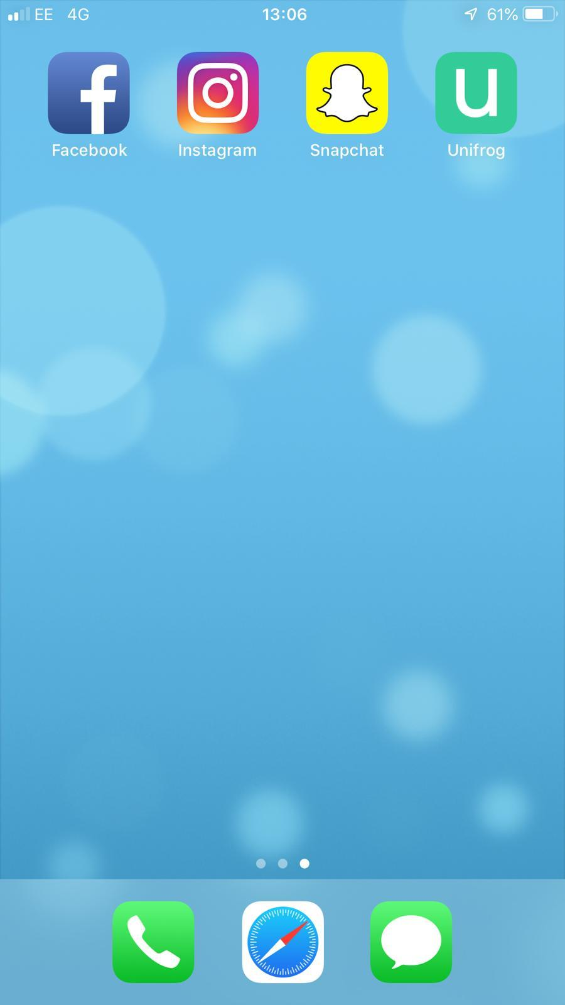
Unifrog as a home screen icon - iPhone
Go to unifrog.org/student in your browser.
Go to your ‘options’ button at the bottom of the page (this is a box with an upwards-pointing arrow) and select ‘Add to Home Screen’.

Slide 5
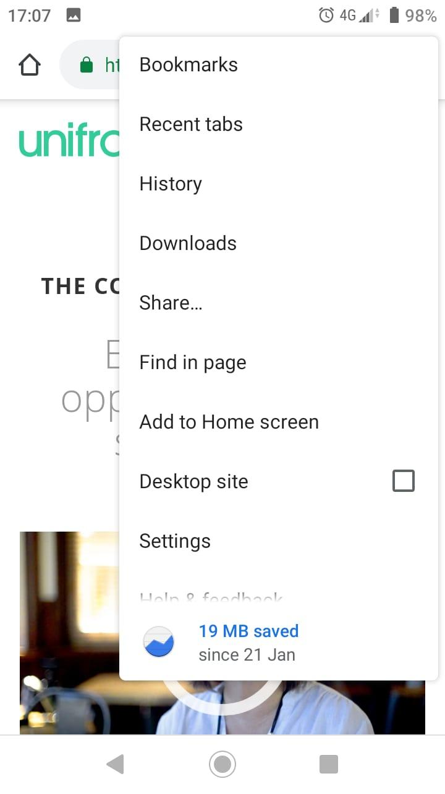
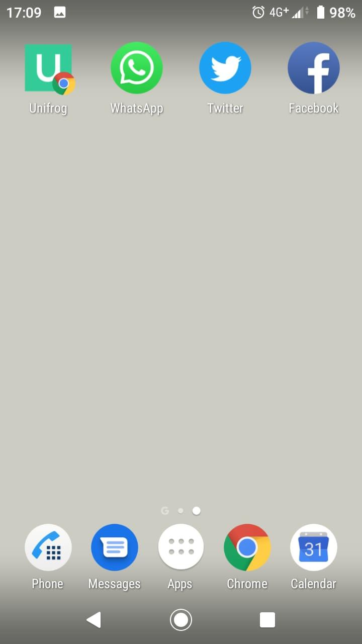
Unifrog as a home screen icon - Android
Go to unifrog.org/student in your browser.
Go to your ‘options’ button at top right side of the page (usually 3 horizontal lines) and select ‘Add to home screen’.

Slide 6
Unifrog as a home screen icon - Troubleshooting
If you cannot find the relevant options to add Unifrog to your homescreen, you may need to change your settings to the mobile-friendly version of the site.
To do this, go into your browser menu and untick ‘Desktop’ mode.

Slide 7


