Slide 1

Careers and Employability
Developing your Application and Recruitment Skills

Slide 2

Interviews
Applying to college or university, for an apprenticeship or employment, even for a part time job – you are probably going to need to attend an interview.
Practising really helps!

Slide 3

Mock Interview Day
Thursday 7 July 2022
Get to experience the full job application process:
Choose a position to apply for
Write your CV and application letter
Dress professionally for the role you are applying for
Practice your interview technique with a guest interviewer from the local business community
Will you be hired?

Slide 4

Recruiting…
TBOWA Resort have opened a beach front holiday complex in Bournemouth. In a partnership with The Bishop of Winchester Academy they are looking to recruit students for a 3 month internship over the summer season.
These opportunities will form part of the academic curriculum and will provide students with a valuable experience of work to support their academic development and careers education.

Slide 5

Internships
20
candidates for each opportunity
Animal Care
Bookings and Events Administration
Childcare
Creative Design
Engineering
Grounds and Landscaping
Hospitality and Catering
Information Technology
Marketing and Media
Minor Injuries and Well-Being
Performing Arts
Retail
Salon and Spa
Site Management
Sport, Leisure and Activities

Slide 6
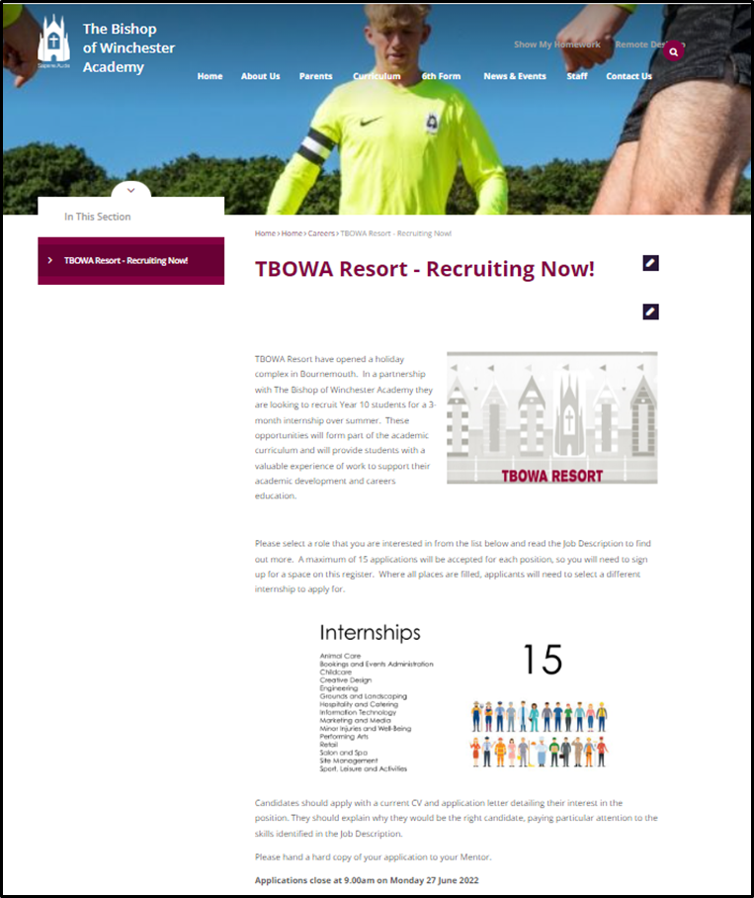
The application process:
RESEARCH
Go to the TBOWA Resort Website
Look at the different Internships on offer
- which are you interested in?
- which would best support your future education or training aspirations?
Book your application place by emailing your mentor with your chosen role.
(Places may go quickly for popular roles)
www.tbowa.org/about-us/careers/tbowa-resort-recruitment

Slide 7
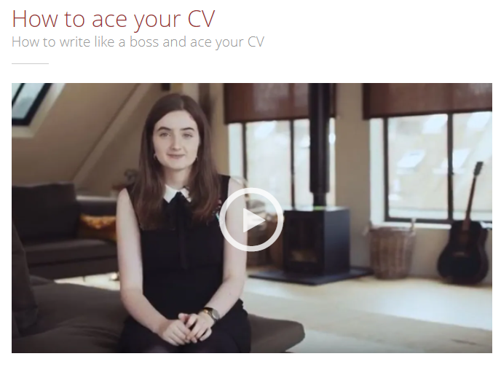

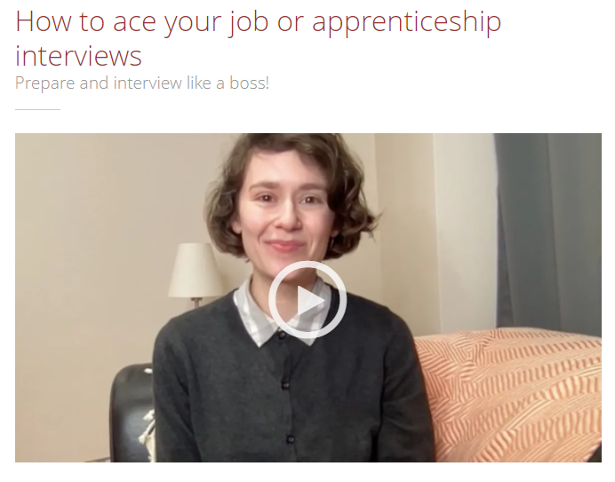
The application process:
APPLY
Read the Job Description carefully – particularly where it mentions the skills they are looking for in a candidate
Prepare your CV – you might already have one you could amend
Write an application letter that shows why they should choose YOU – don’t forget to spellcheck
There are guides on Unifrog to help you – click the picture for links to these
Check it carefully, ask a friend, parent or relative to read it over for you – read the Job Description again, does your letter make you sound like the perfect candidate?

Slide 8
Closing date for Applications:
9.00am
Monday 27 June

