Slide 1

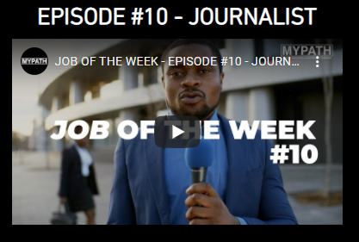


Thinking about Careers…
Remember you can research more about careers in Journalism using your account.
You could work in print, online or on television.
The BBC, ITV and Sky all offer Higher and Degree Apprenticeship Programmes where you could train to become a Journalist.

