Slide 1

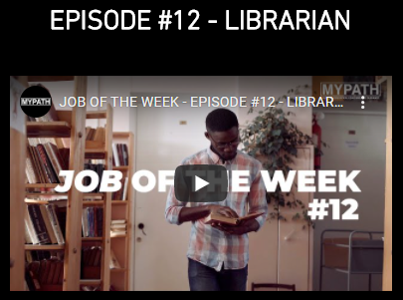


Thinking about Careers…
Remember you can research more about this job, or roles in Information Management more generally, using your account.
To find out if this could be the type of job for you, why not ask about volunteering in a library? Some of the local libraries are offering our Year 10 students a placement during Work Experience week.
Use the Careers section on the academy website to find more work experience and volunteering ideas.

