Slide 1


Slide 2


Slide 3


Slide 4
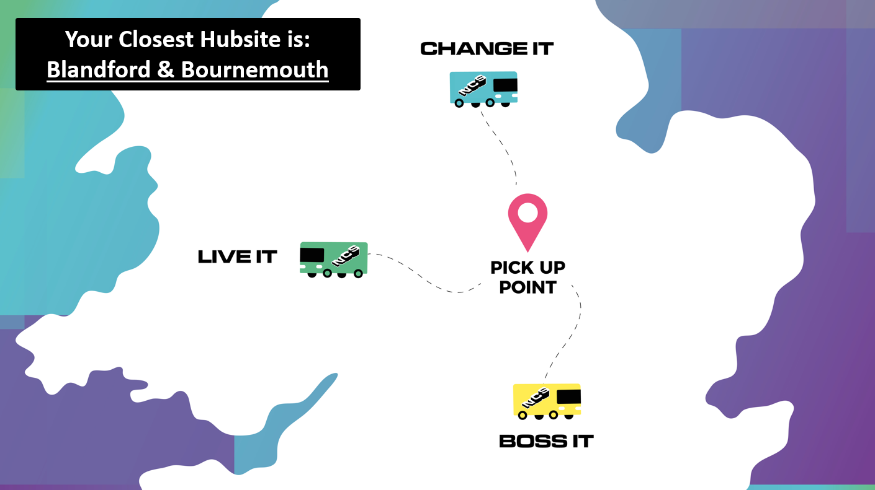

Slide 5
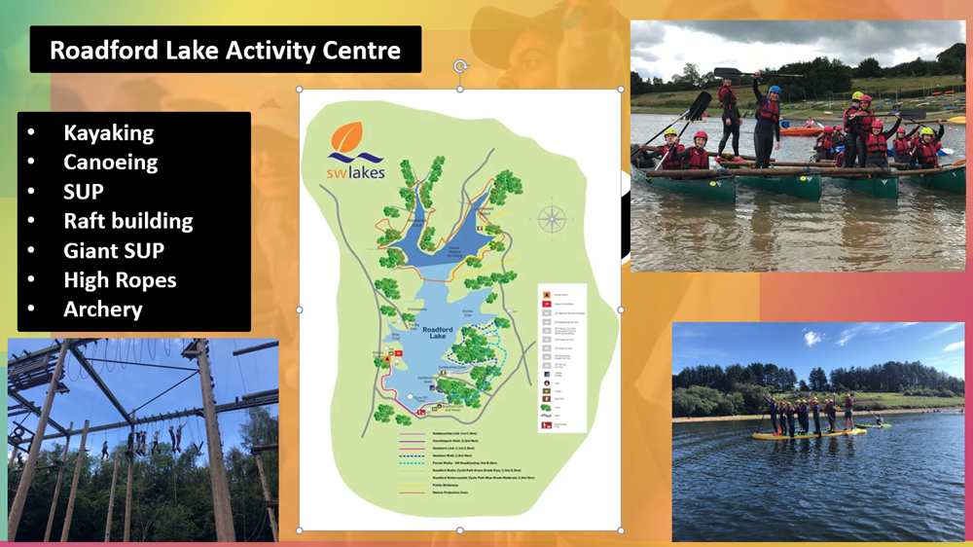
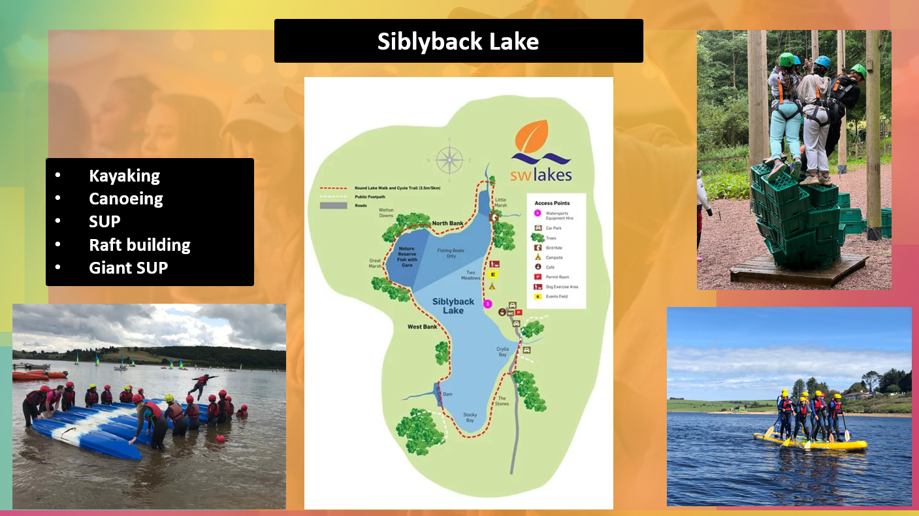
Devon Centre
Cornwall Centre

Slide 6


Slide 7
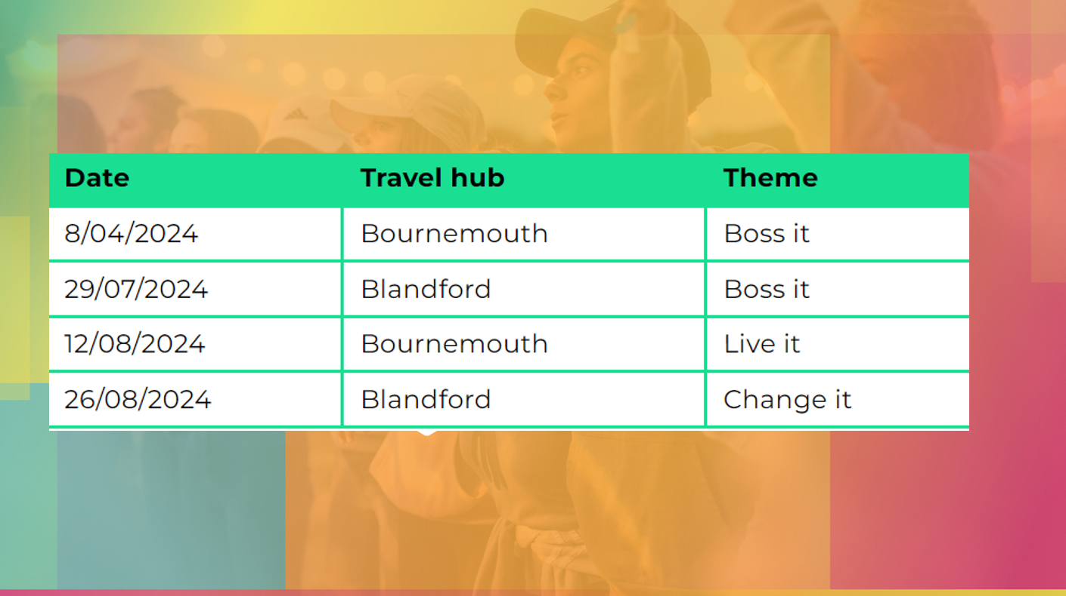

Slide 8



Slide 9


Slide 10


