Slide 1

National Apprenticeship Week
7 – 13 February 2022
5 – 11 February 2024

Slide 2
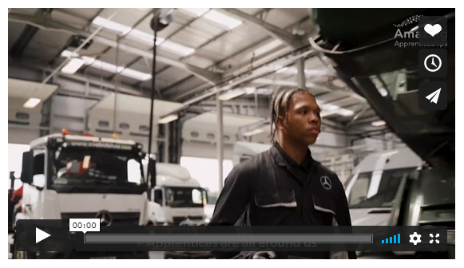
Why might I be interested in apprenticeships?
https://amazingapprenticeships.com/resource/apprentices-are-amazing-film/

Slide 3




What is an apprenticeship?

Slide 4







Slide 5

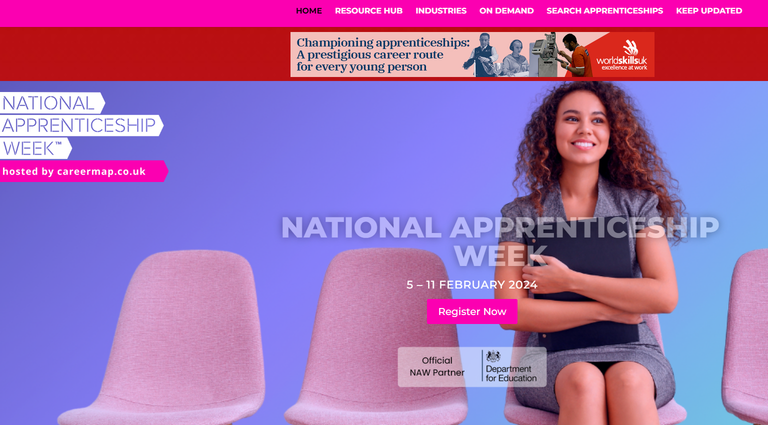

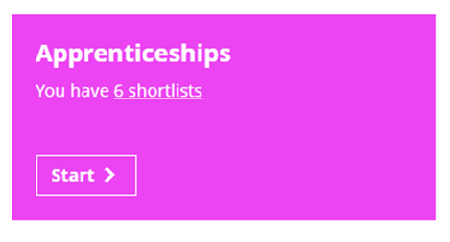
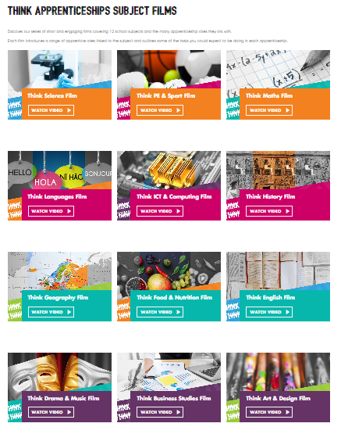
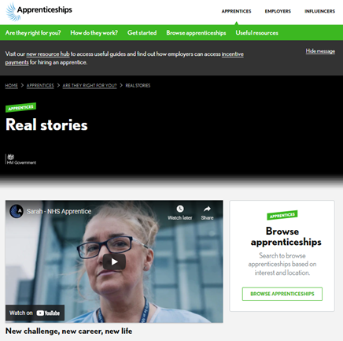
Click each box to access more resources

Slide 6
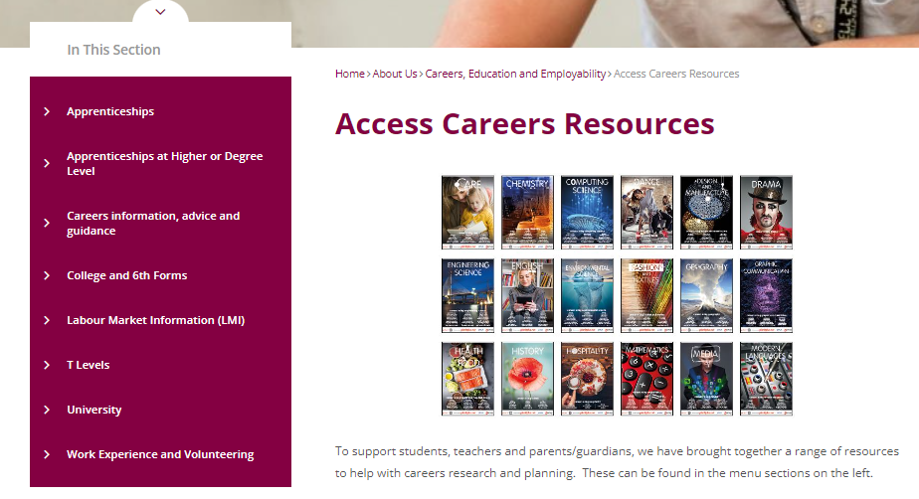
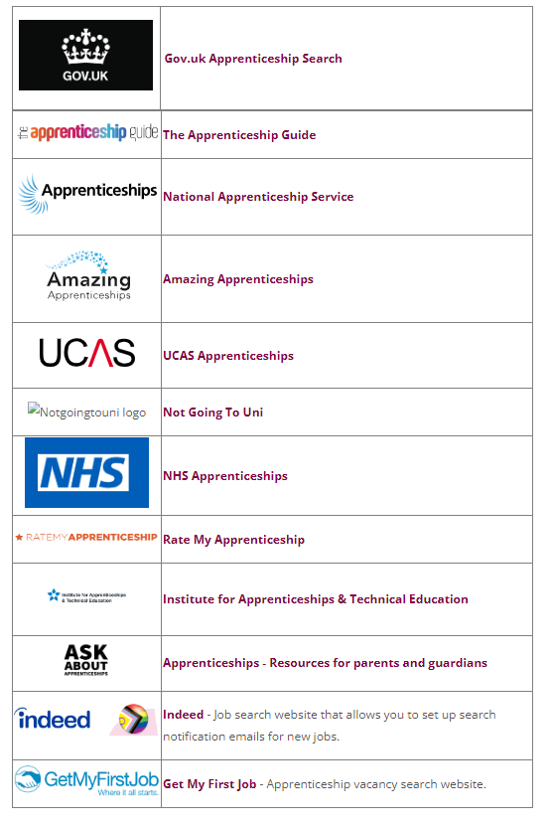
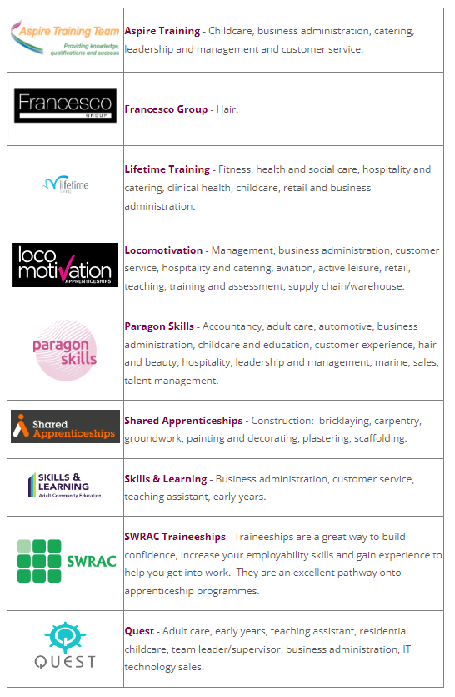

Slide 7


Slide 8
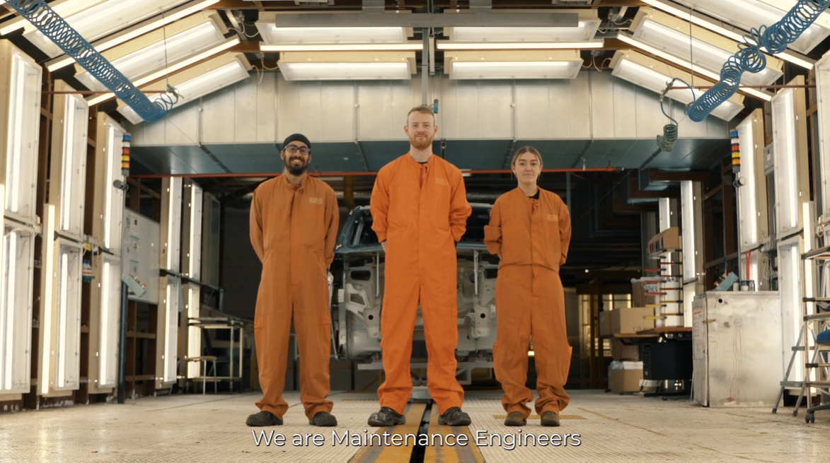

https://vimeo.com/763808752
https://amazingapprenticeships.com/apprenticeships-in-luton/

Slide 9
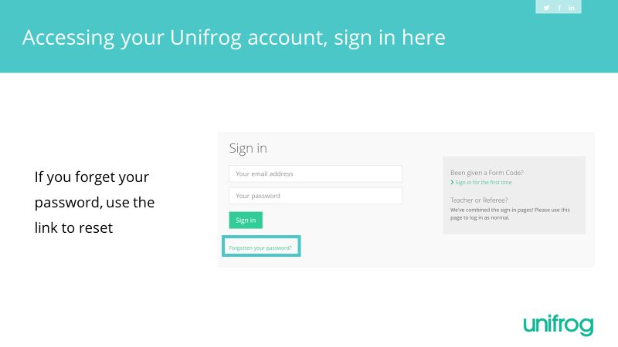

Slide 10
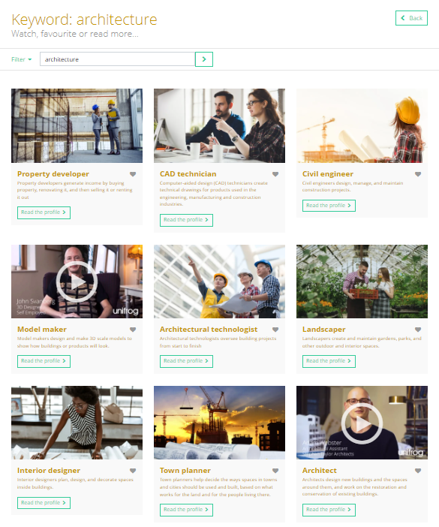
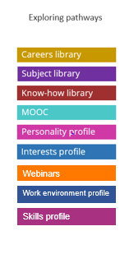
Exploring pathways
Use the tools in the
Exploring pathways section to research your careers ideas and to check your next steps on to 6th form, college or an apprenticeship are taking you in the right direction.

