Slide 1


How Unifrog can support your
Careers and Options ideas – Getting started

Slide 2

What is Unifrog?
Unifrog is your online resource to easily explore your interests or to research different careers ideas for your next steps – whether that is choosing GCSE Options or thinking about future careers paths.

Slide 3
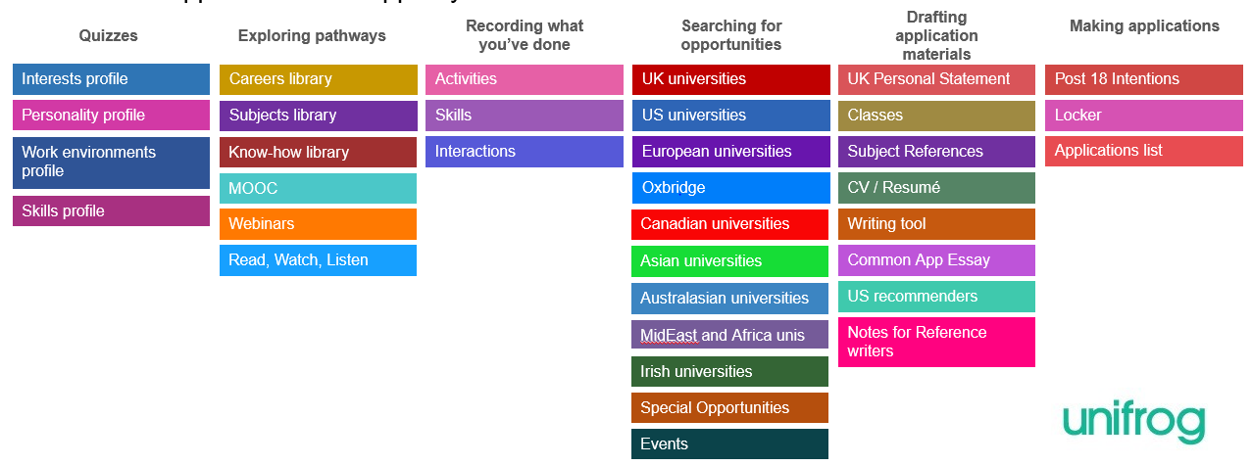
Available resources
Unifrog contains a huge amount of information to help you – try exploring behind some of the coloured boxes

Slide 4
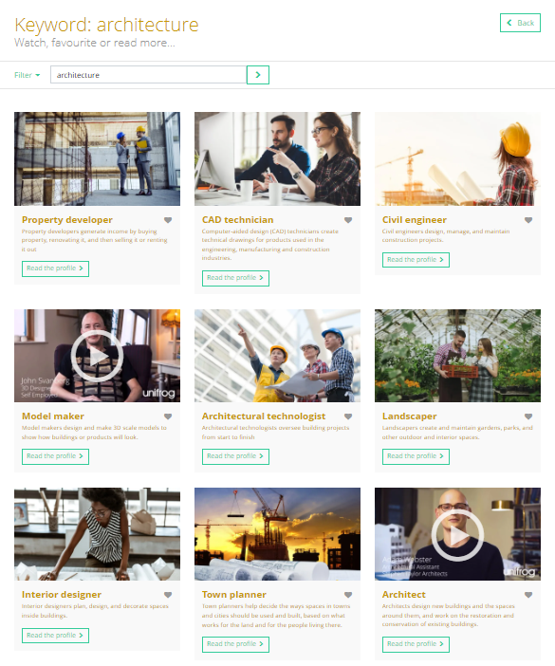

Exploring pathways
Use the tools in the
Exploring pathways section to research your careers ideas. You can check that your Option choices will support your next steps on to 6th form, college or an apprenticeship.

Slide 5
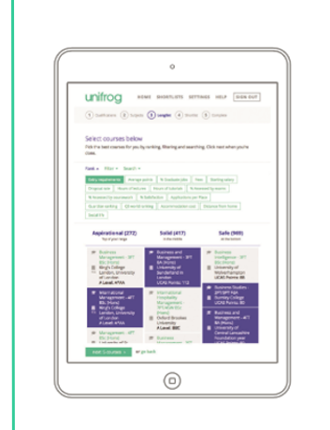
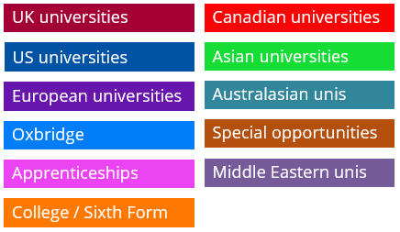

Searching for opportunities
Use the tools in the Searching for opportunities section to compare universities, degree courses, apprenticeships, foundation degrees or vocational courses and research any prerequisite subjects.

Slide 6
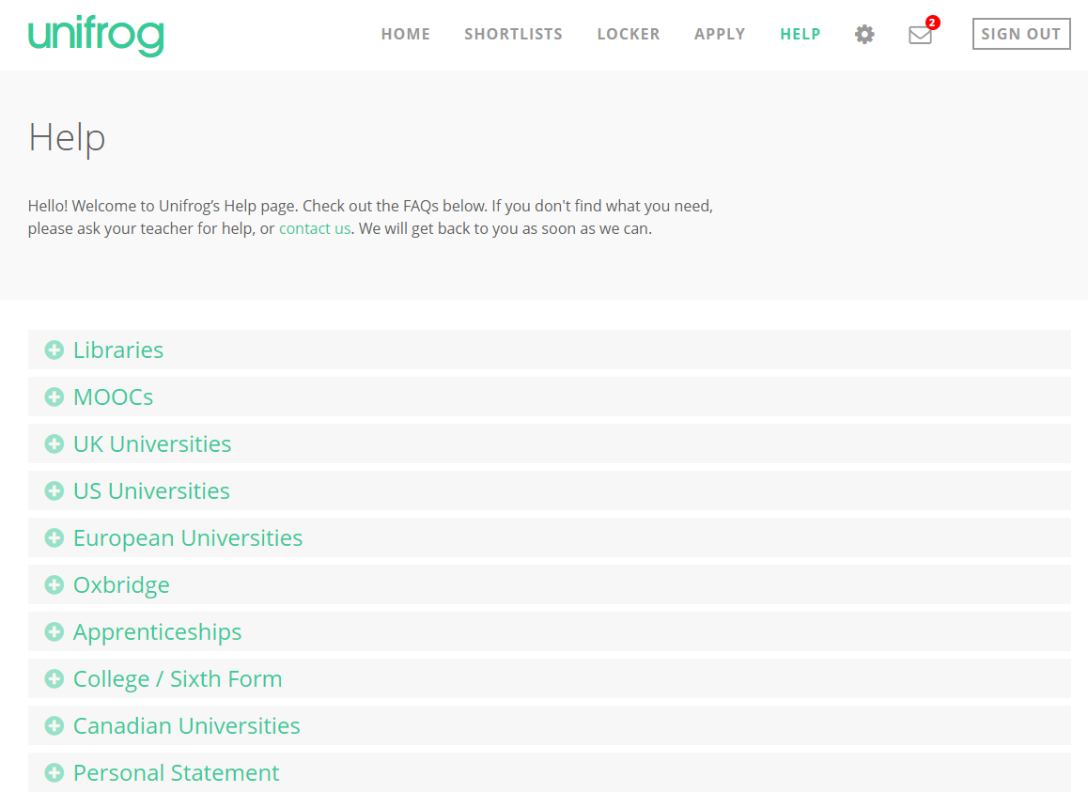
Finding out more
Use the help section if you need a guide or want more information about the tools.
If you get stuck, ask your mentor for help or watch the guides on the academy website.

Slide 7
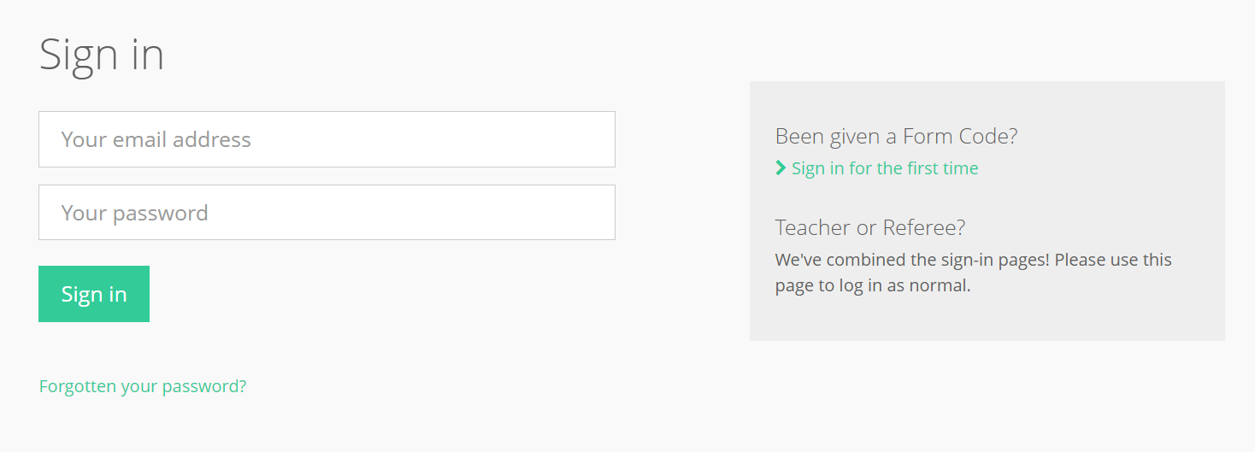
Accessing your Unifrog account, sign in here
Sign in with your academy email address. If you forget your password, use the link to reset

Slide 8

Making it easy!
A link has been sent to your school email account to help you get started.
Click the link and follow the instructions.
Notes:
Delete this slide if you are using the form code method

Slide 9

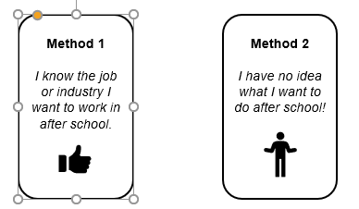

Using Unifrog to explore your Choices
Why not use one of these ways to help you get started with Unifrog

Slide 10

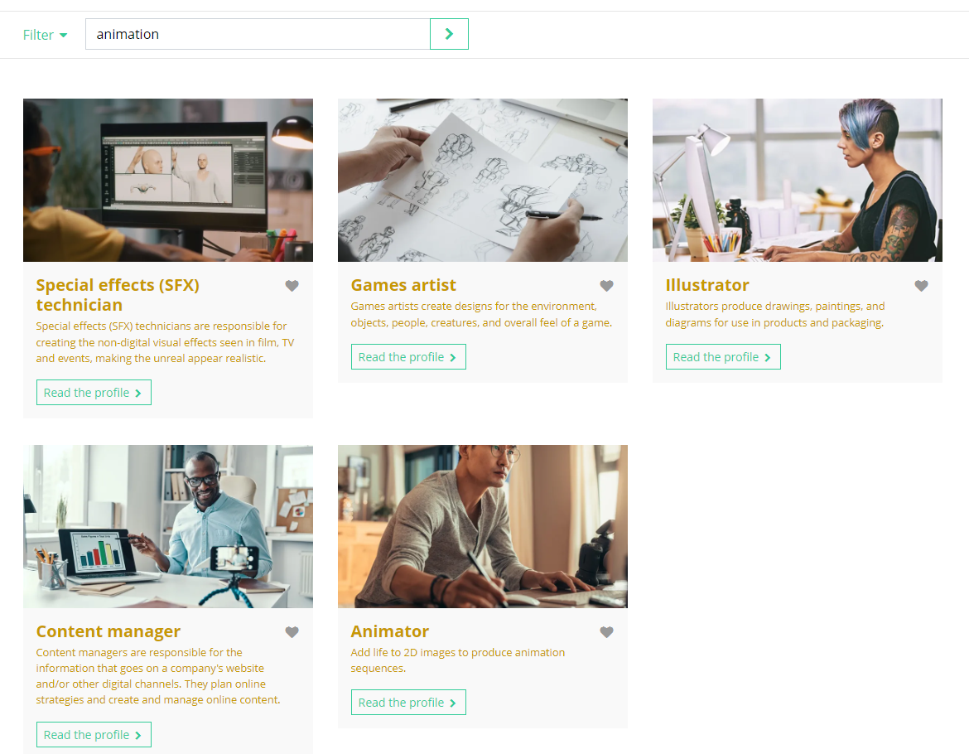
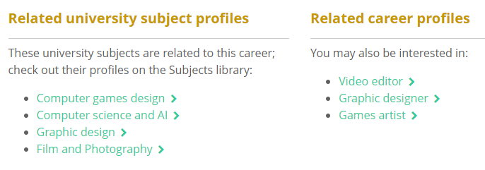
Using Unifrog to explore your options
Use the Careers Library to search for the role or business sector you are considering:

Slide 11


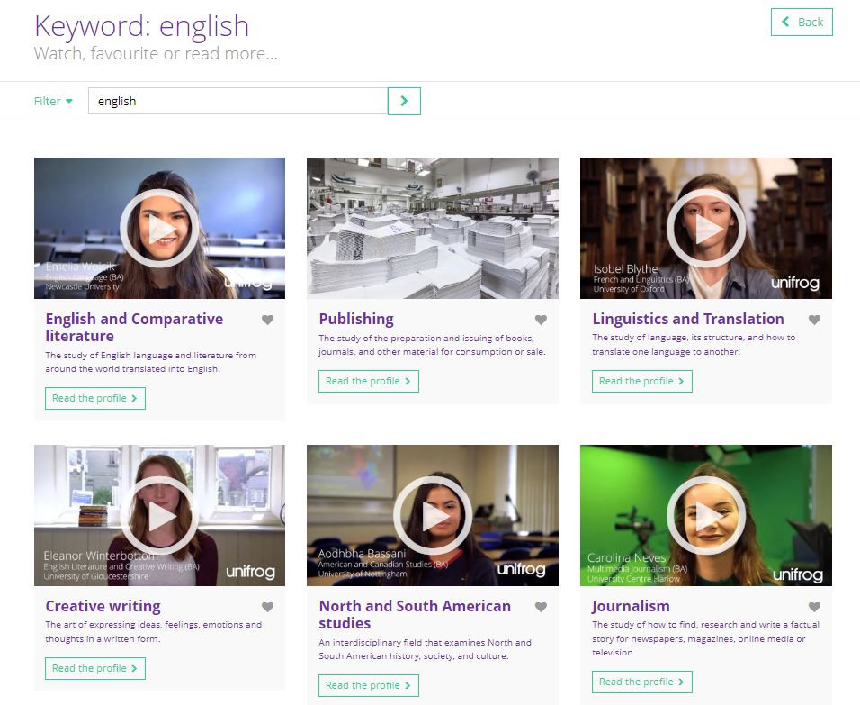
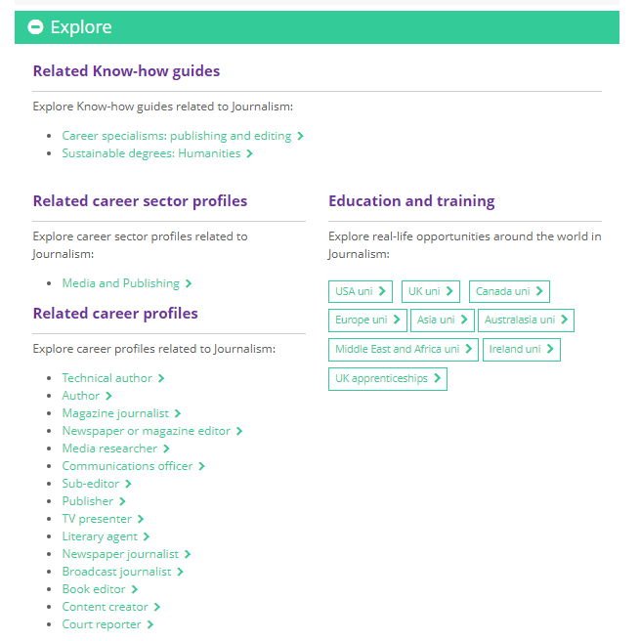
Using Unifrog to explore your options
Use the Subjects Library to search for careers ideas around your favourite subjects:

Slide 12
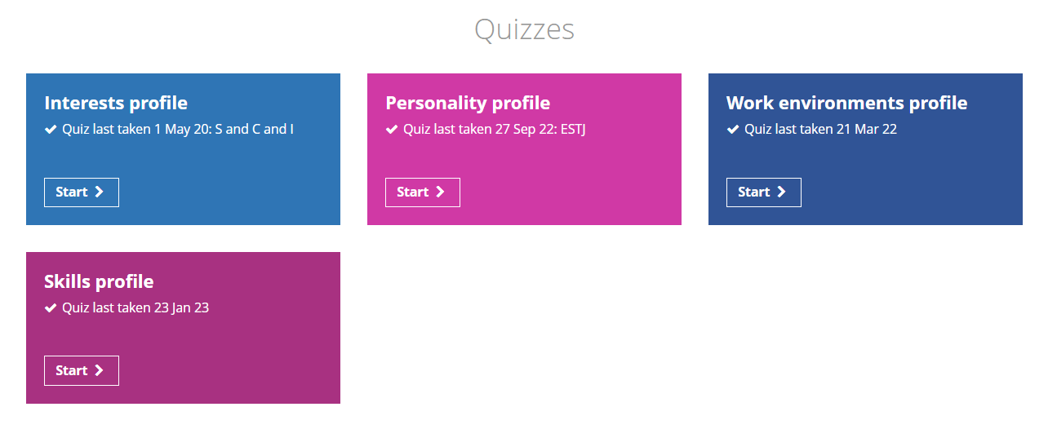
You could also try taking some of the quizzes to help you find different careers ideas

Slide 13


