Slide 1

Work Experience 2024:
CVs & Covering Letters

Slide 2

What is a CV?
A CV is a succinct collection all of your achievements and important information for employers. It will include contact information, skills, work experience, education, and other achievements – so it’s important to write and organise your CV clearly. You are making a first impression as a professional, so your CV needs to set you apart from other applicants. A spelling error could be enough for your CV to be put on the ‘no’ pile!
Why is a CV important?
It’s the first chance you get to impress a potential employer.
It’s a reflection of you as a person; are you very organised, for example? Your CV can show this by being set out neatly and professionally, without you having to use up precious space saying “I’m an organised person”.
Different jobs require you to have different skills and strengths. A CV is important in highlighting that you have those skills and strengths needed for the role.
Keyword: A CV (also known as a ‘curriculum vitae’ or ‘resume’) is a written overview of your skills, education, and work experience. They are often sent to employers when you apply for a job. A CV is your first chance to introduce yourself to an employer, so it’s important to make a good first impression! The layout, language, and spelling will say a lot about who you are.

Slide 3
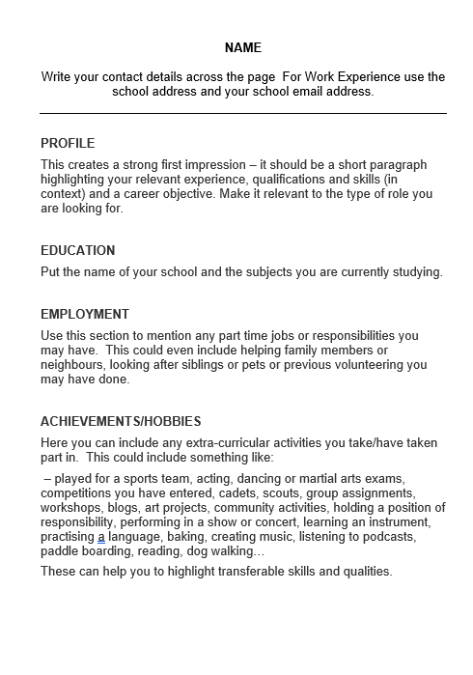
For Work Experience will probably only be one page.
Make sure to set it out neatly on the page.
And ALWAYS remember to use the Spelling and Grammar check – ideally twice!

Slide 4
What is a Cover Letter?
A cover letter is a document or email you send along with your CV. It’s your opportunity to explain what it is you are looking for, how this is relevant to your careers ideas, and how your skills and enthusiasm would make you a great candidate for a role.
A cover letter is a formal document – even when it is an email - so address the person you’re sending it to, and sign off at the end formally. Think about formatting and how the letter looks on the page – and remember to spell and grammar check! Remember to include the dates of our Work Experience Programme.
The person reading your cover letter should get a sense of your personality and why you want to work for them.
Keyword: A cover letter is a document you usually send to an employer with your CV. Traditionally, it’s set out as a formal letter, with your address, the employer’s address, and date at the top of the letter. Instead of being an overview of your skills and experience, it’s written with the job you’re applying for in mind. The person reading your cover letter will get a sense of your personality and what you actually want from the job.

Slide 5
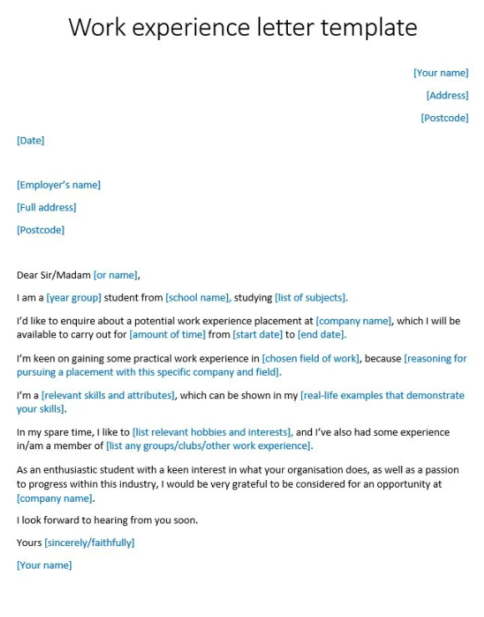
For Work Experience you can use the same format for an email but you would usually leave out the address.
Make sure to set it out neatly.
And ALWAYS remember to use the Spelling and Grammar check – ideally twice!

Slide 6
What is the difference between a cover letter and a CV?
A CV is a well-presented set of information about your work experience and skills.
A cover letter, on the other hand, will give the employer a sense of your personality. You can explain why you want to do your work experience with them, and what you will bring in terms of your strengths and experience to the opportunity.
A cover letter expands on the skills you’ve shown on your CV.
It’s your chance to explain why you would be perfect for a particular work experience placement.

Slide 7

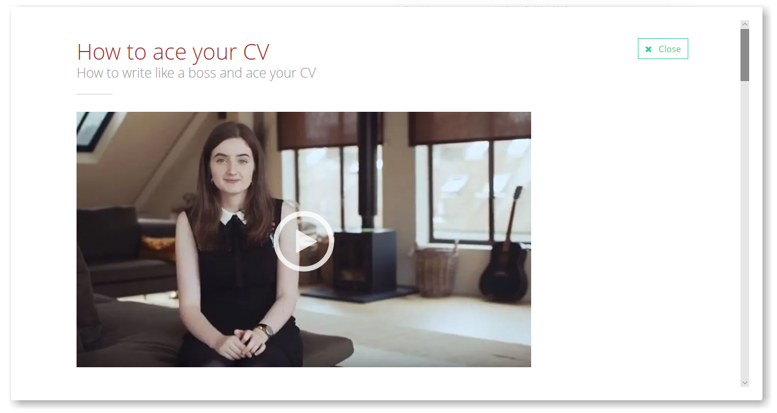
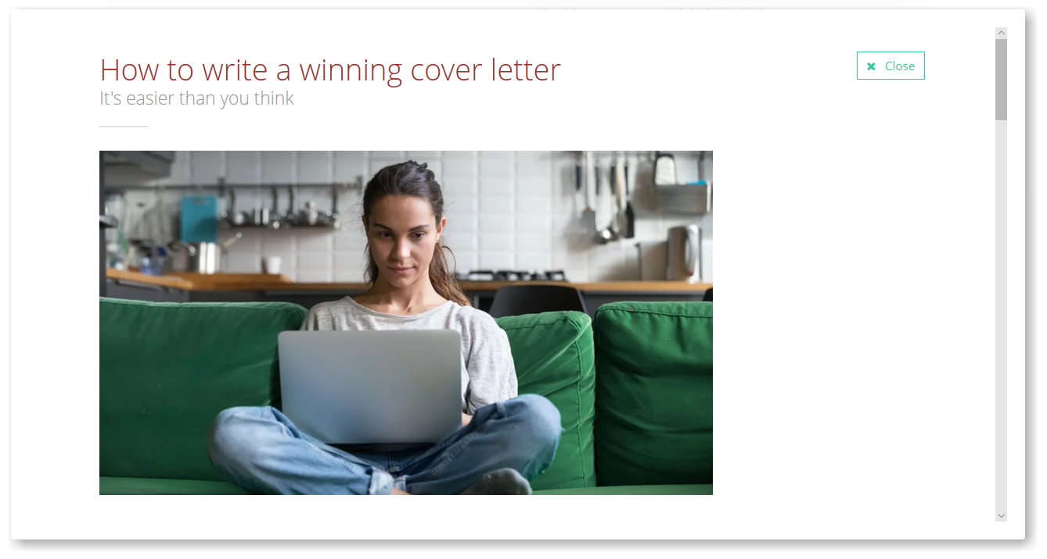
To help you get started look at the guides in the Know How Library on

Slide 8

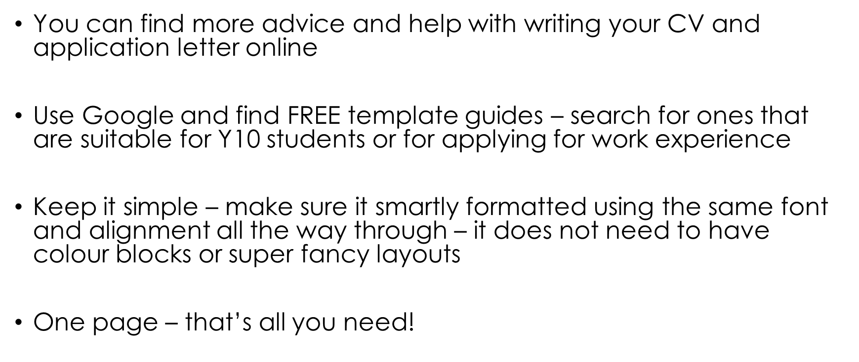

Slide 9


