Slide 1

The Bishop of Winchester Academy
Name:
Study Skills Booklet 2018-2019

Slide 2
Year 11 Key Dates:
Wednesday 26th September visit to BIC – The Careers & Apprenticeship Show Trip
Tuesday 16th October – 6th Form Open Evening
Thursday 18th October – Reports Available
Tuesday 30th October - Parents’ Evening 1
Monday 12th November - Mock Fortnight
Wednesday 19th December - Mock Results
Wednesday 12th December – Year 11 Reports
Tuesday 8th January - Parents’ Evening 2
Tuesday 7th May – GCSE’s commence

Slide 3
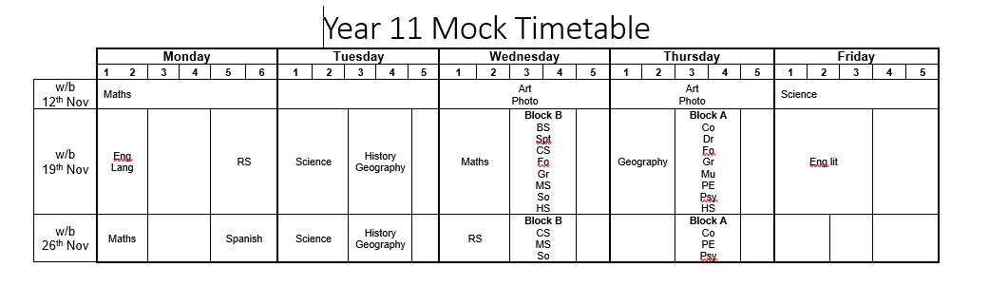
Academic Mock Exam Timetable

Slide 4
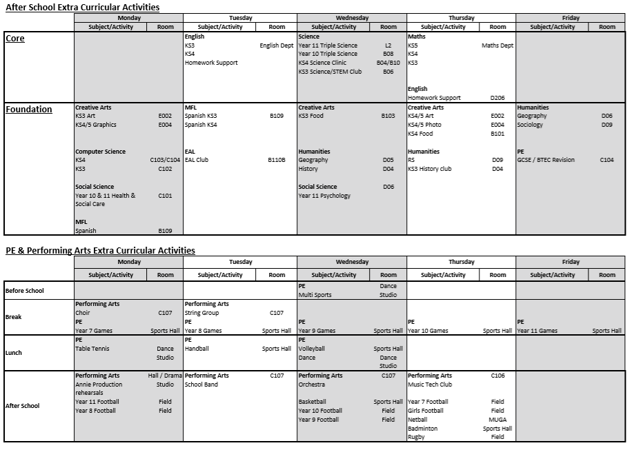

Slide 5


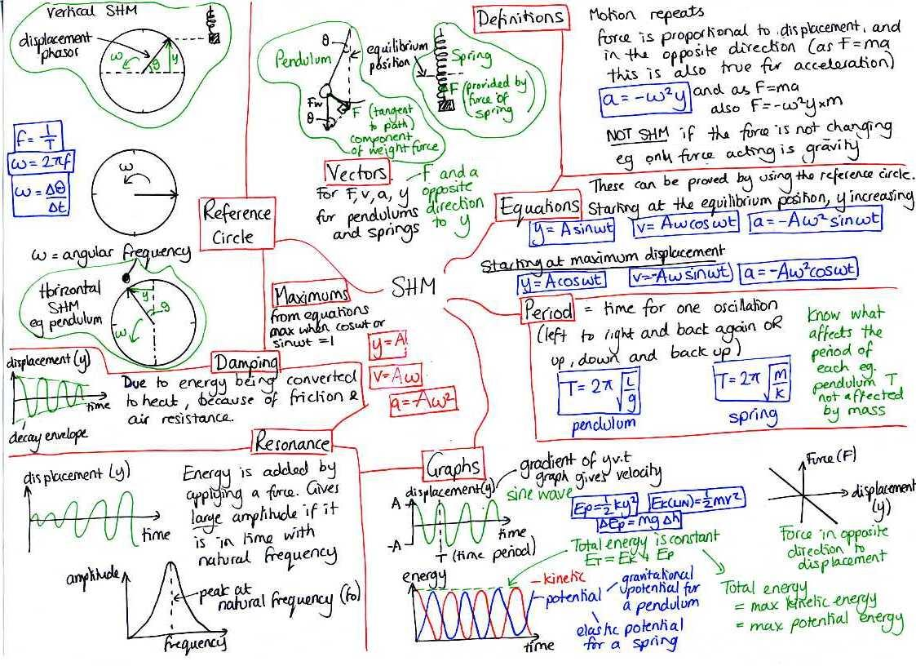
OK, so what is the basic idea behind revision?
Turn your classwork and information from textbooks into some form of revision notes and then learn them.
KWL
What do we know?
What do we want to know?
What have we learned?
This means the following:
Revision needs to be active not passive; you actually have to engage with the process.
Reading through your folder and the textbook a few times will not do!
Reading revision guides will not do either; you will have been taught specifically for your exam board; revision guides tend to be quite general and so either contain too much information or too little. Only use guides that your teacher has suggested.

Slide 6
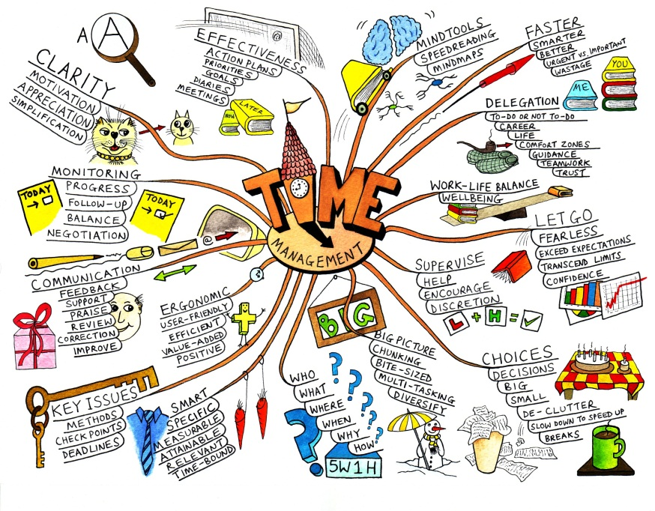
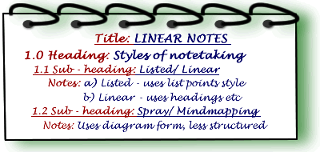
Some revision techniques:
Linear notes on paper:
Reduce what is in your folder/exercise book/textbook;
Read through what you need to summarise before you actually summarise it;
Use headings and subheadings
Keep notes brief;
Write everything in a way that you understand;
Do not copy huge chunks out;
Add detail
Underline key words; highlight; write in different coloured pens;
Use bullet points, arrows or numbers to keep it clear and organised;
Leave spaces to add points;
Use arrows or dotted lines to link points.
Spider diagrams:
Key question, exam question or a key topic in the centre;
Subtopics or subheadings;
Add key pieces of information;
Develop some of your points;
Add symbols or images;
Use different coloured pens or highlight different points;
Use different sized pieces of paper.

Slide 7







Avoid all distractions:.
Be honest and strict with yourself;
Keep your TV, computer, laptop, iPad, phone, kindle, Facebook, twitter and any games away
If music becomes a distraction, get rid of it.
Do not waste time or delay starting.
Clear space to store folders, textbooks and revision.
It is going to be around for a while so make space for it somewhere in your house. Make sure you tell parents what it is and where it is so they do not move it or throw it out!
In your breaks:
move around;
drink water;
eat something .
You will need a desk or a table that is not cluttered so you can spread things out on. You might want to leave things out for the next session.
Sleep well:
Do not work into the early hours of the morning
give yourself a break between finishing revision and going to bed.
Do some form of exercise during revision and exams.
Some final tips to help you when revising:
Reward yourself at the end of your revision session.
Find a space you are comfortable revising in:
This might be your bedroom, or a study or the kitchen. Some of you might find it easier to revise if your parents are there with you.
Tell your parents/family or who you live with when you are revising:
They can help by keeping distractions away from you including themselves, brothers, sisters, friends and pets and keeping the house quiet.
They can help and support you by testing you and keeping you on track if you lose focus.

