Slide 1

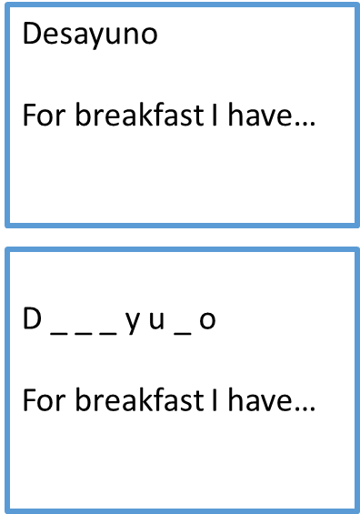
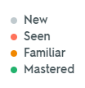
Little and often. Learning vocabulary is like growing plants. The seed needs watering little and often for it to grow. Your vocabulary knowledge likewise needs regular attention.
Spend 15-20 minutes each day studying and revising. Here’s a list of learning tools & strategies that you can try.
It’s important that you identify what works for your best.
1 Flashcards. Create a set of cards with the words. You can use the section Flashcards on Quizlet to guide you on the process OR you can also print them too.
2 Look – Say – Cover – Write – Check. Write out the Spanish words every day. Every time you complete one column, colour code the word to reflect at which stage of learning you feel you are with each of them. Remember to challenge your memory, progressively trying to spell the words without support, from memory.
3 Oral pair work. Practise with a family member or a friend the words.
Spelling Bee competition
Ping Pong translation.
Beginnings and endings. Your partner says the start of the word and you have to finish it & translate it. A) Un gim.. B)Un gimnasio – a gym
Begin by testing Spanish into English (so that you are developing your understanding). Then say the English and ask for the Spanish. Make sure you are progressively challenging youself / your partner.
Versatile Flashcards. A set of flashcards that you can use independently as well as with someone else to test you. On one side write the full word / phrase in Spanish as well as the meaning in English. This will mean that you will be able to get someone from your family to test you even if they don’t speak Spanish. On one side of the card, write the English meaning (you can also write a clue). You can use this side to test yourself – with or without the clue (and flick over to check your answer). When getting someone to test you, they can also show you this side to prompt you if you need extra support.
Top tip: Colour code your cards every day to self-assess which words you have mastered. This means that you can produce the word – write it from English to Spanish with no spelling mistakes!

Slide 2
4 Make a revision activity. E.g. anagrams, missing letters, odd one out, secret code, definitions, word search. This can also be a podcast (record yourself saying the words, spelling them out loud, and listen back to it every day).
5 Use one of the following online resources:
For GCSE Spanish students in years 9, 10 and 11
www.activeteachonline.com
This resource is set-up for GCSE Spanish students in years 9, 10 and 11 and has listening, reading and vocabulary activities that are directly linked to the Viva curriculum used within the Spanish department.
Username: First name and last name (written together as one word with the first letter of your first name and first letter of your last name capitalised (for example ReneeMerritt)
Password: ChangeMe251
https://www.memrise.com/group/227087/
Excellent for building vocabulary skills into your long-term memory.
After you create your own free account, click on the above memrise link and you will added to my group where I have published all of the GCSE vocabulary by unit.
The below resources are accessible for all year groups 7 – 13
www.bbc.co.uk/languages
A wide variety of activities and videos to watch for learners at all stages. There is something for everyone.
No username or password required
https://www.duolingo.com/course/es/en/Learn-Spanish-Online
A very popular website for learning languages. Initially, you take a five-minute assessment and it will tell you your level of Spanish and then target your study offerings at that level.
You will need to create your own free account
www.mindsnacks.com
Lots of fun games to help you improve your Spanish.

Slide 3
https://www.languagesonline.org.uk/Hotpotatoes/spanishindex.html#Topics
A lot of different games to learn vocabulary and grammar by topic.
No username or password required
https://www.lightbulblanguages.co.uk/resources-spanish.htm
Useful for Spanish learners from primary to A level.
No username or password required
www.quizlet.com
Famous for its flashcards. You make your own flashcards or you can choose from hundreds of pre-created sets.
You will need to create your own free account
https://speakonia.apponic.com/
Free downloadable software that enables you to type-in any text and it will read it back to you. Helpful for improving pronunciation.
www.wordreference.com
A dictionary and verb conjugation look-up tool. The most widely used online dictionary for academics.
No username or password required
If you would like any further information on any of the details above or have any questions regarding Modern Foreign Languages please do not hesitate in contacting me.
Yours faithfully
Renée Merritt
Modern Foreign Languages Lead

