Slide 1
Bishop of Winchester Academy
English Department

Slide 2
We offer two GCSEs to Y11
GCSE English Language
Linear (same exam sat by all)
2 exam papers both cover reading & writing skills
Fiction, non-fiction & literary non-fiction
GCSE English Literature
Linear (same exam sat by all)
2 exam papers covering four set texts and two unseen poems:
Macbeth
19th century novel: The Strange Case of Dr Jekyll & Mr Hyde (sets 1-4) & A Christmas Carol (sets 5-9)
Blood Brothers
Power & Conflict poetry anthology (15 poems)

Slide 3
Exam information
Final exam dates:
Literature: 15th May & 23rd May
Language: 4th June & 7th June

Slide 4
Revision Materials
There are numerous revision guides for both AQA English Language and the set literature texts.
We recommend that students purchase a revision guide and workbook for each set text. There are many available to purchase through SQUID.

Slide 5
After School Support
Tuesday in the English department: 3pm - 4pm
Your child’s teacher will offer an enrichment tailored to their ability

Slide 6
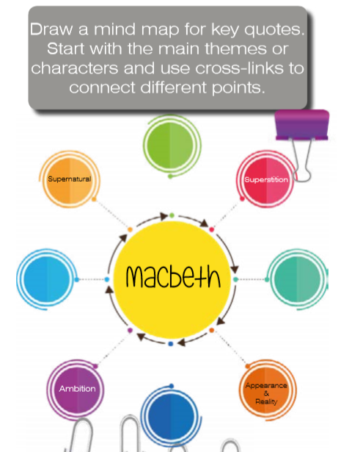
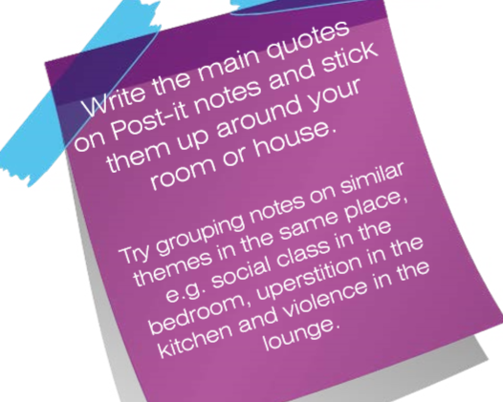


Slide 7
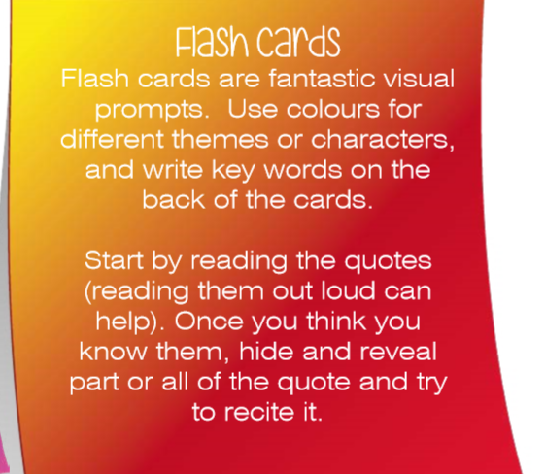

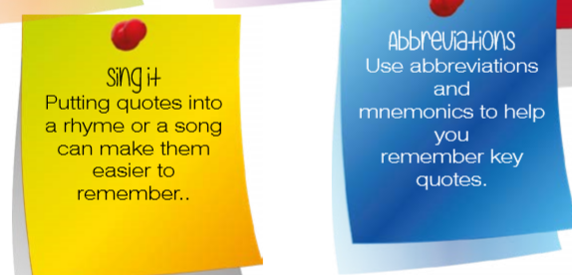
Practice questions!!

