Slide 1
GCSE Media Studies
3rd June (PM)
Component 1
Quality Street
This Girl Can
The Man with the Golden Gun
Spectre
Pride magazine
GQ magazine
The Guardian
The Sun
The Archer
Pokemon Go
10th June (PM)
Component 2
Duran Duran ‘Rio’
Taylor Swift ‘Bad Blood’
Website for Taylor Swift
Bruno Mars ‘Uptown Funk’
Website for Bruno Mars
Luther
The Sweeney

Slide 2
Revision materials/support
Thursday in D206 with Mrs Dimmer 3-4pm
Half term – February 21st 9-11am

Slide 3
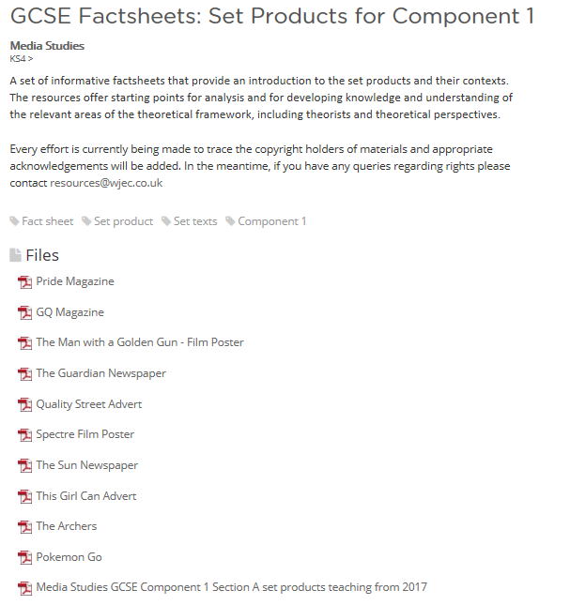
Fact sheets can be found on the Eduqas website

