Slide 1

Bishop of Winchester Academy
Science Department

Slide 2
Exam information
Exam Structure
All students will sit 6 science papers in the summer, 2 papers for Biology, Chemistry and Physics.
Double Award (Trilogy) exams are 1 hour and 15 minutes duration, Triple exams are 1 hour and 45 minutes duration.
Mock exam dates:
The mock exams start week beginning 19/11/2018, it is intended that there will be 3 mock papers based on the Paper 1 content for Biology, Chemistry and Physics.
Final exam dates:
Biology Paper 1: 14/05/2019 Paper 2: 07/06/2019
Chemistry Paper 1: 16/05/2019 Paper 2: 12/06/2019
Physics Paper 1: 22/05/2019 Paper 2: 14/06/2019

Slide 3
Revision Materials
Available on SQUID:
Revision guide for Double Award (£6) and Triple (3 x £3)
Level 8 to 9 Practice Exam Questions for Triple Students (3 x £3)
Tonight Range of Materials at discounted price from Oxford Press
Ensure that the correct tier of entry is selected, ask your child’s Science teacher for advice if you are unsure about this.

Slide 4

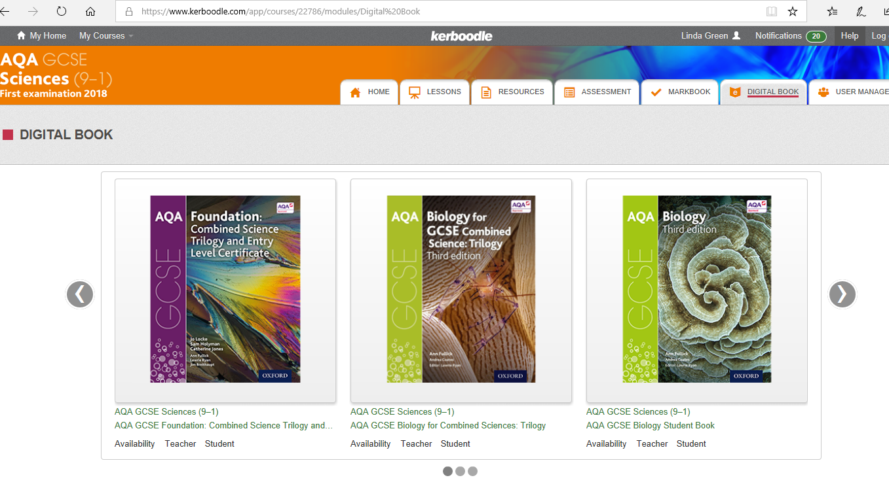
Online Material
Kerboodle
Online Textbook
Podcasts
Questions

Slide 5

EzyScience – video tutorials and exam questions

Slide 6
After - School Support
Science Clinic
Wednesday in the Science department: 3pm - 4pm
Dedicated Triple Science sessions for Year 10 & 11.
Help with homework.
Identify areas of concern and bring this along for personalised support.
There are several rooms available specialising in Foundation and Higher Level. Several members of the Science Team are available in the rooms to help and discuss any queries.

